Slide 1

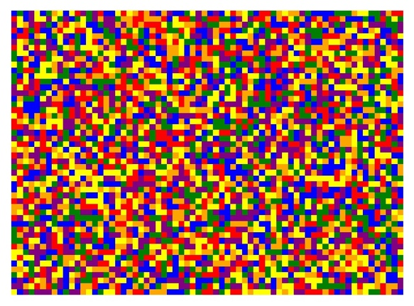

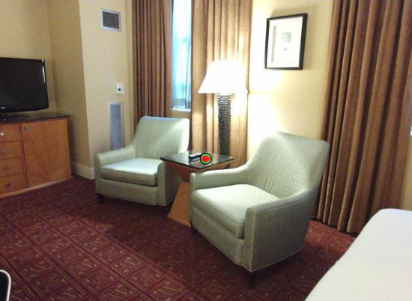
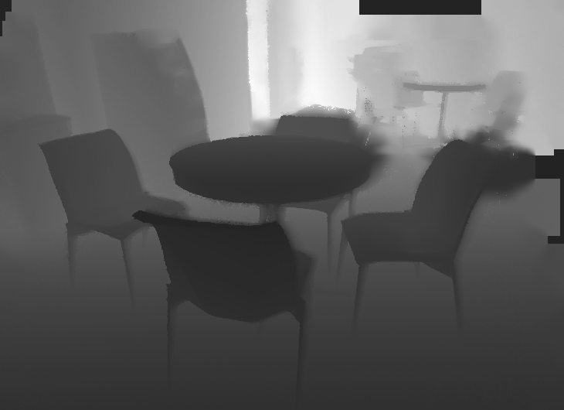
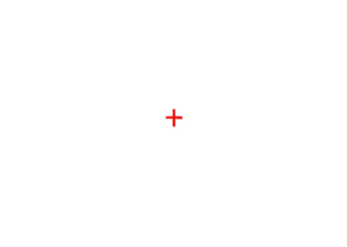
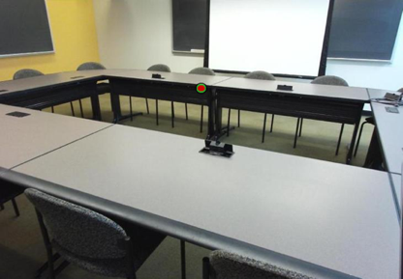

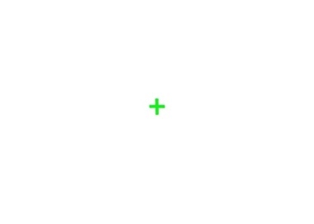
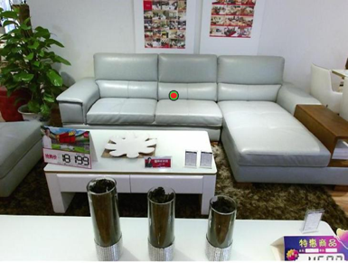

A.
B.
How far away was the target, in meters?
Target Image
125, 250, or 1000 ms
500 ms
time
- 0.25 m
500 ms
Depth Image
- 2.6 m
- 5 m
C.
Respond which target was closer
125, 250, or 1000 ms
500 ms
time
500 ms
500 ms
500 ms
125, 250, or 1000 ms
500 ms
Figure 1. Behavioral Paradigms. A) Sample target image and corresponding SUN-RGBD depth map. B) Verbal estimate paradigm. Scenes with embedded targets were presented for a variable duration followed by a mask. C) Distance discrimination paradigm. Participants were presented with two scenes for the same duration and responded which target was closer.
Notes:
DONE

Slide 2
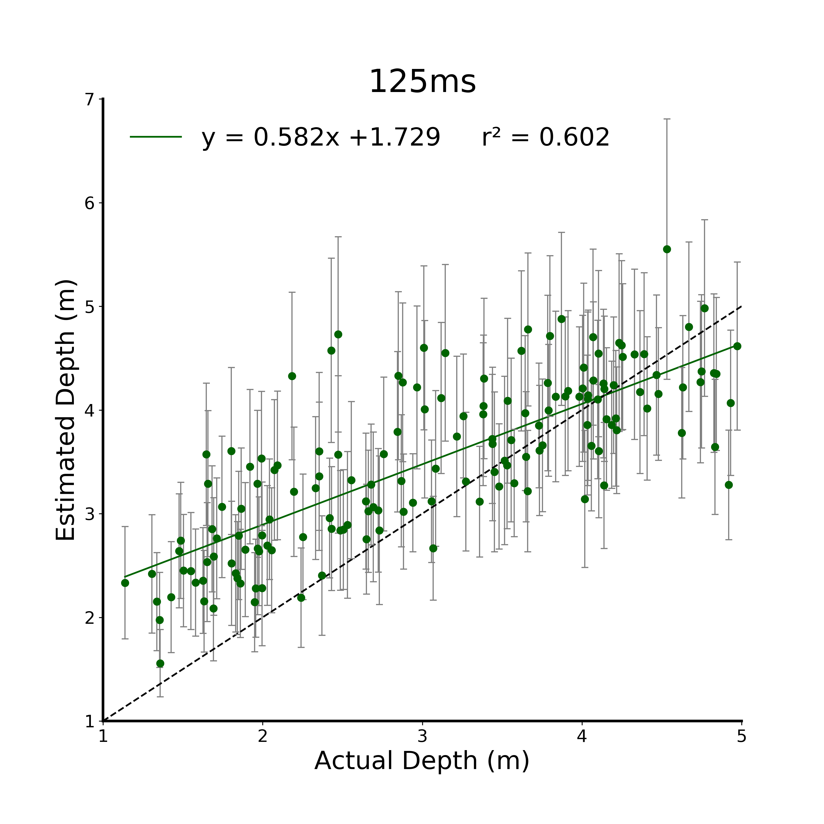
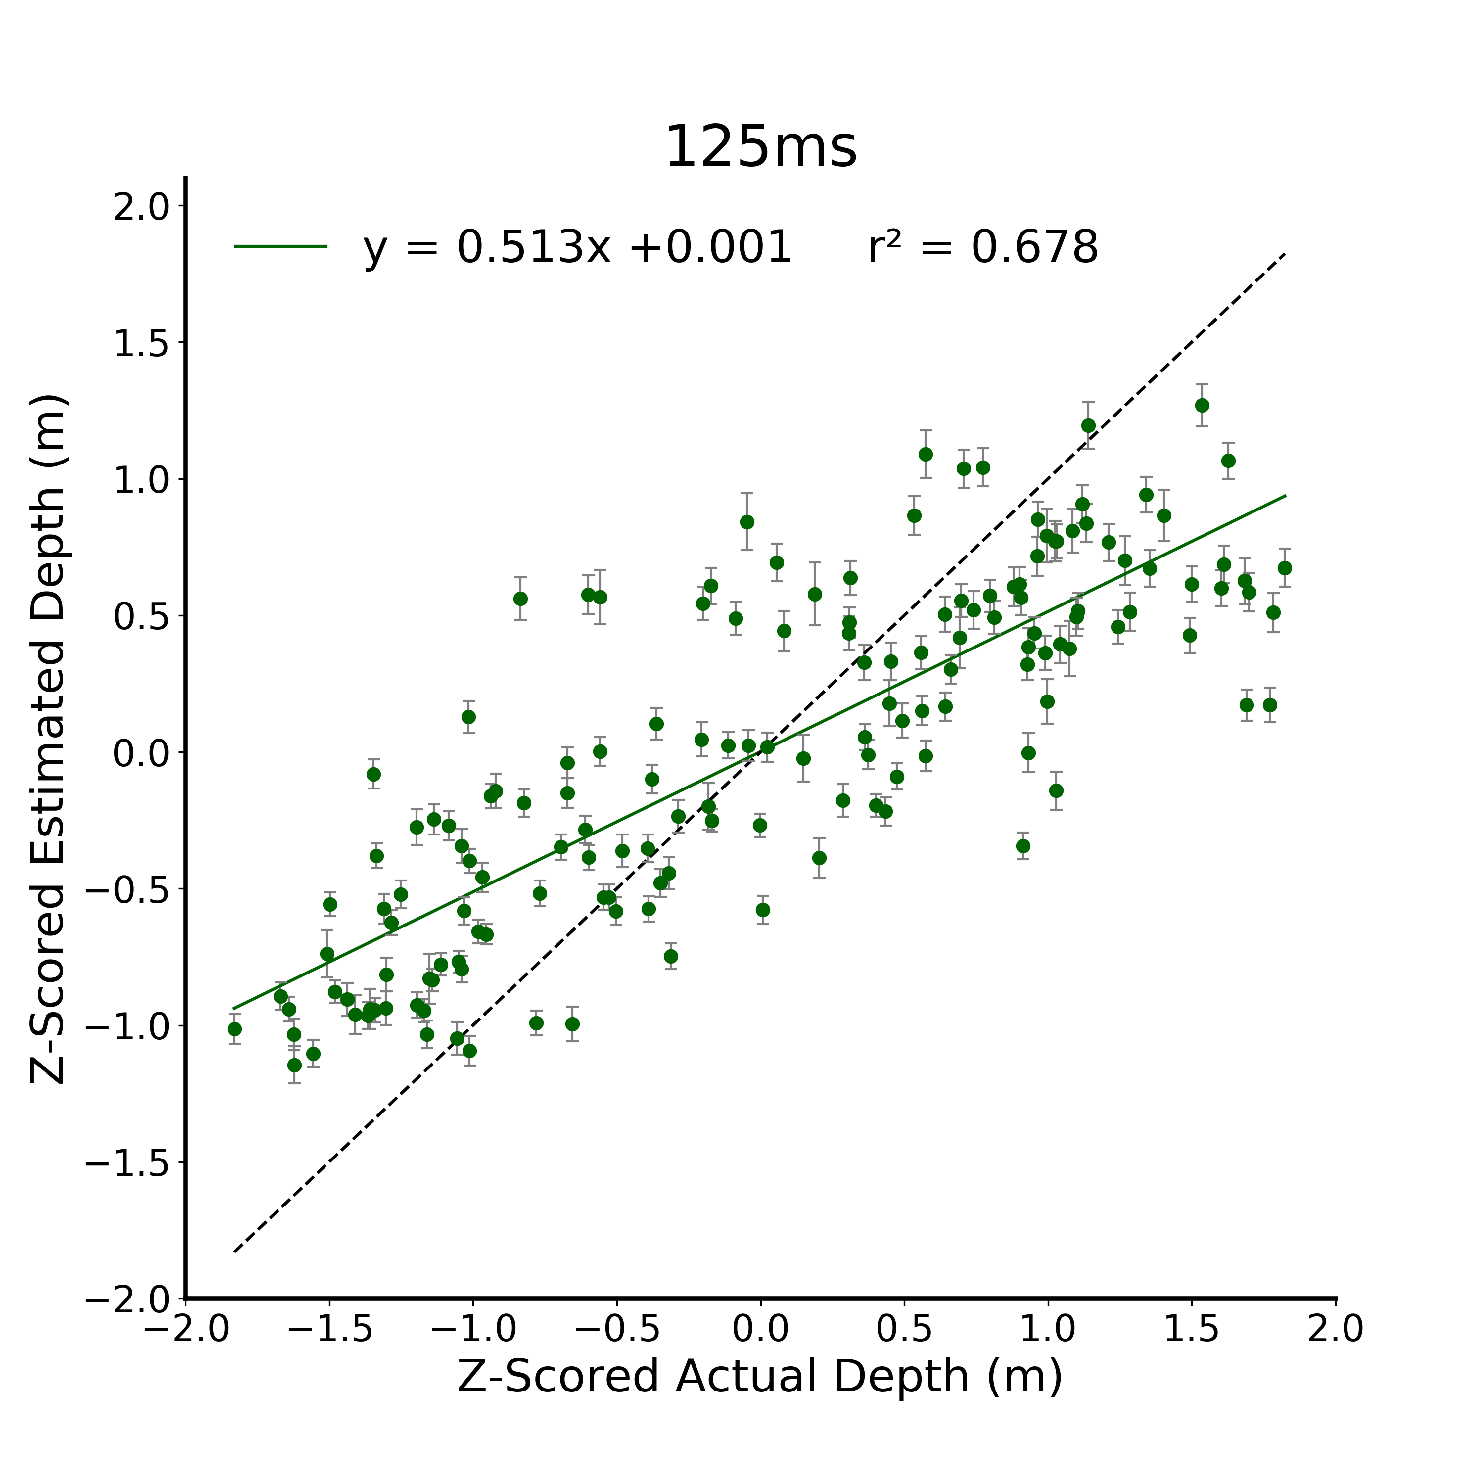
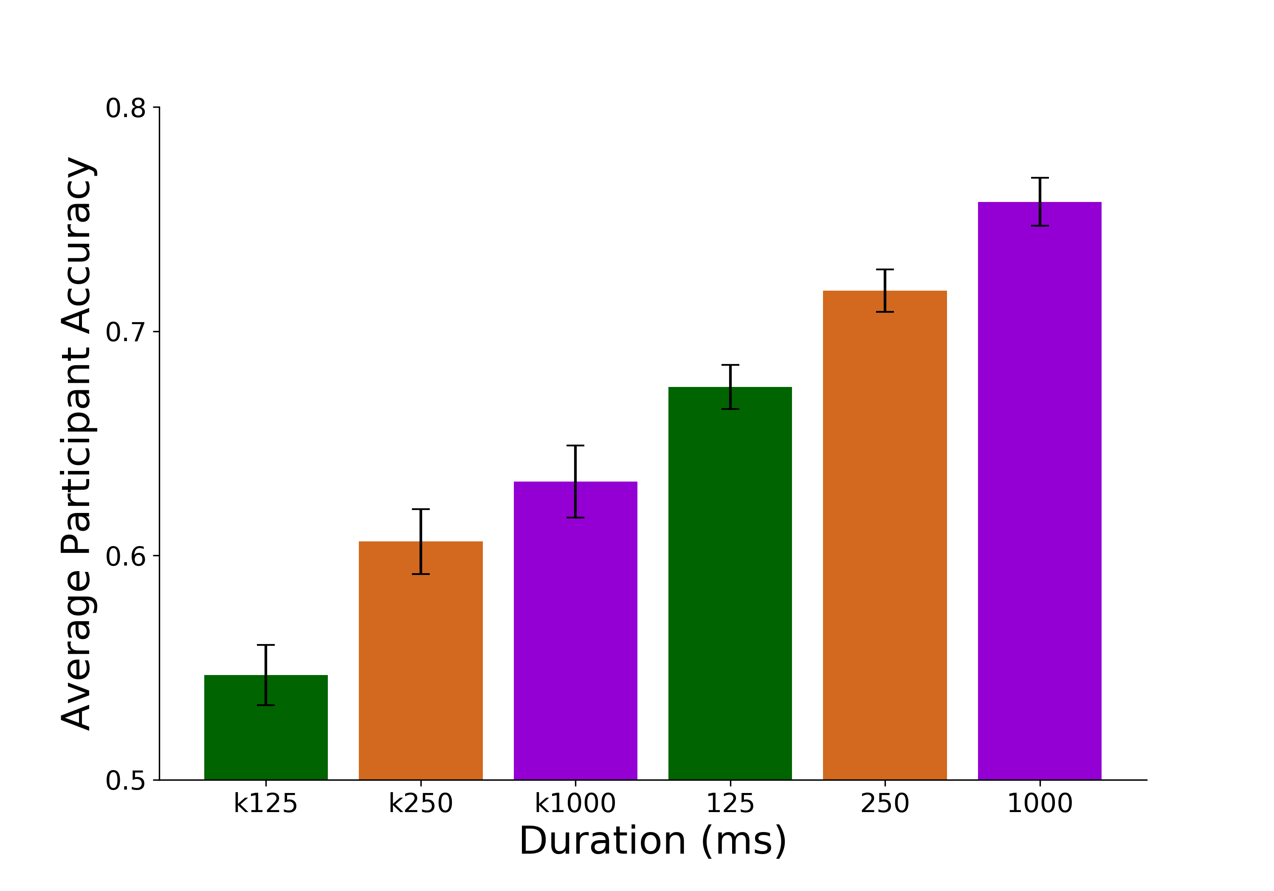
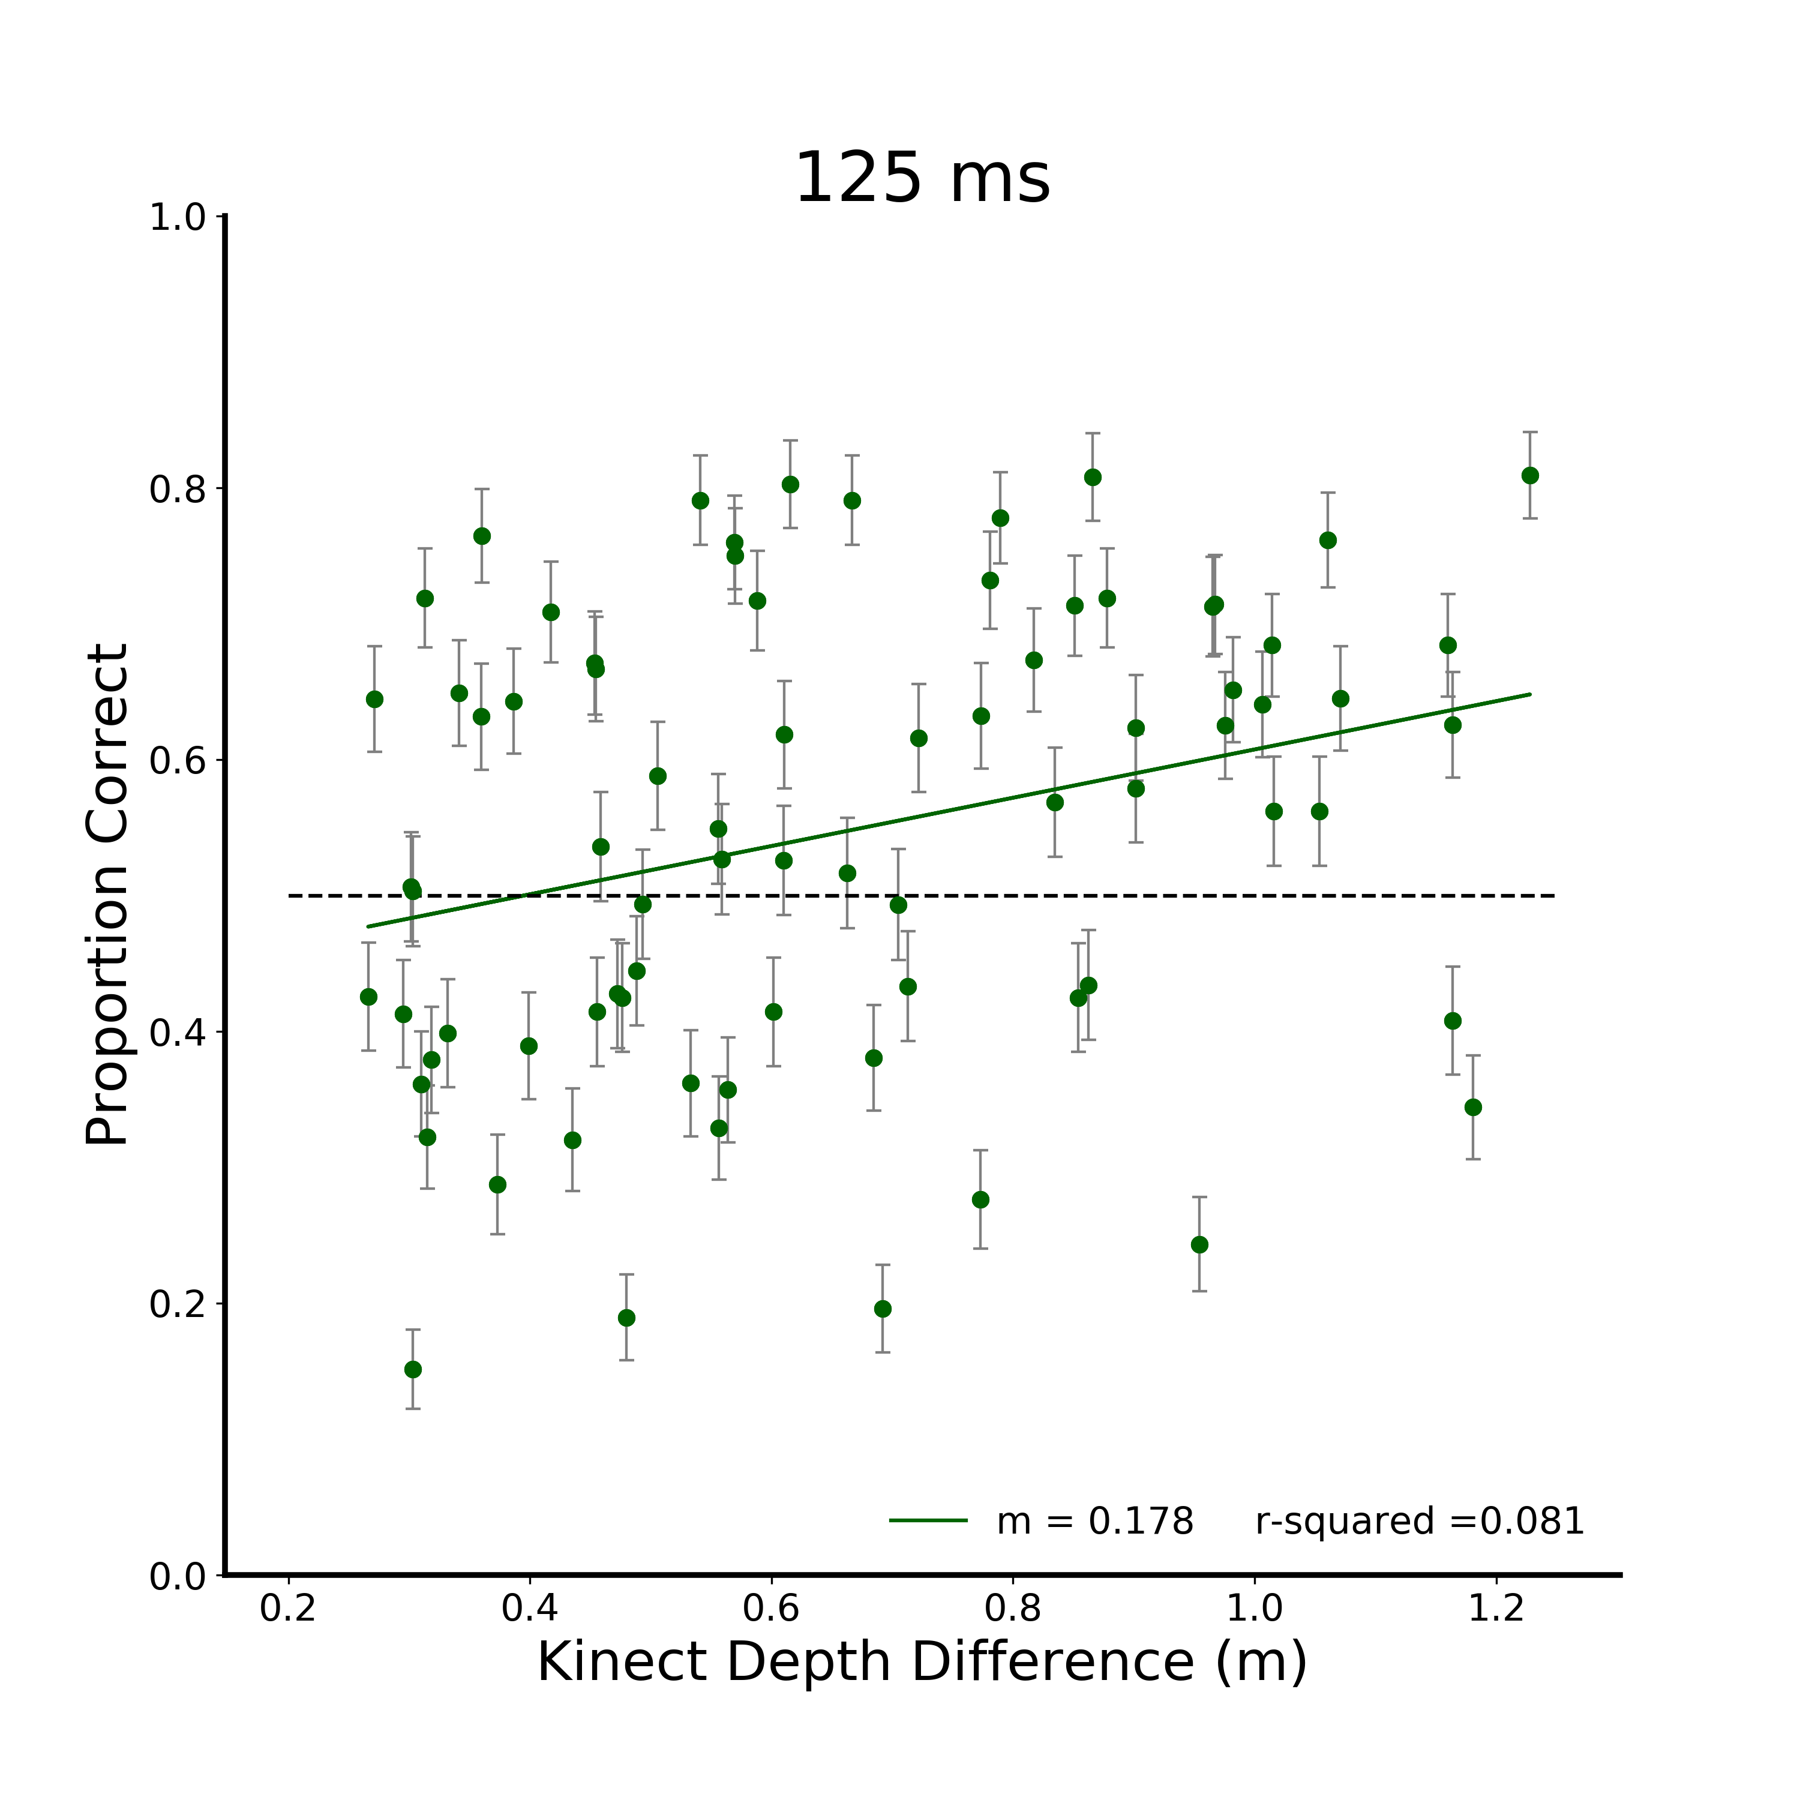
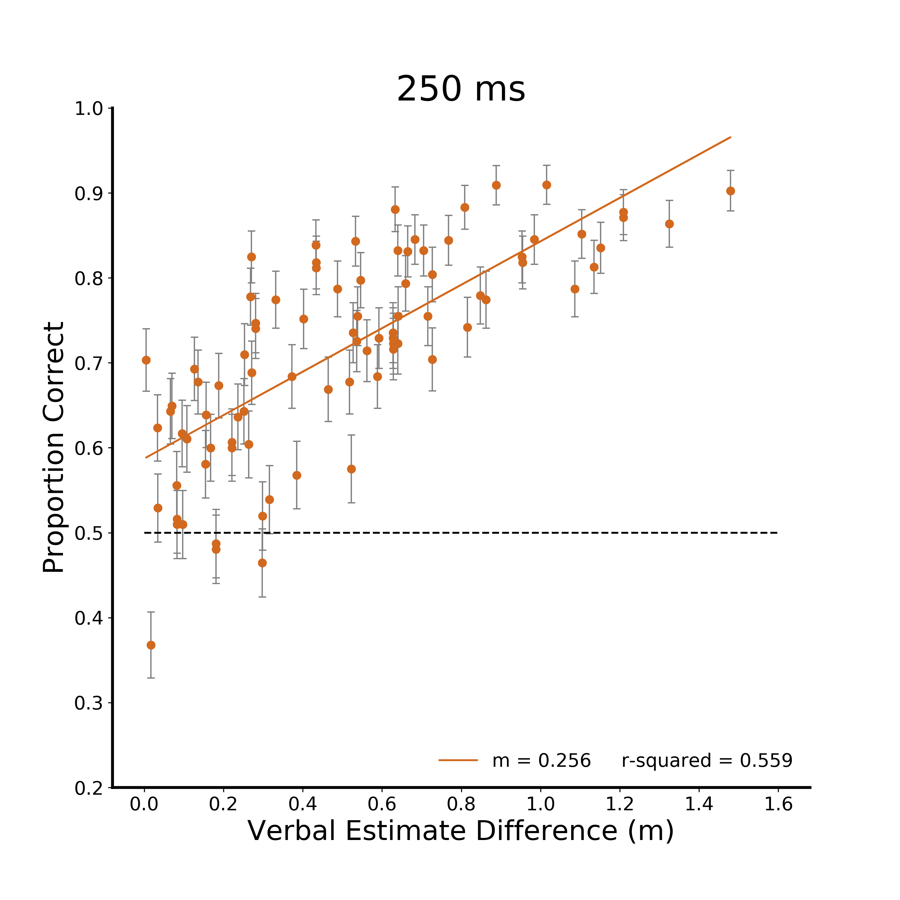
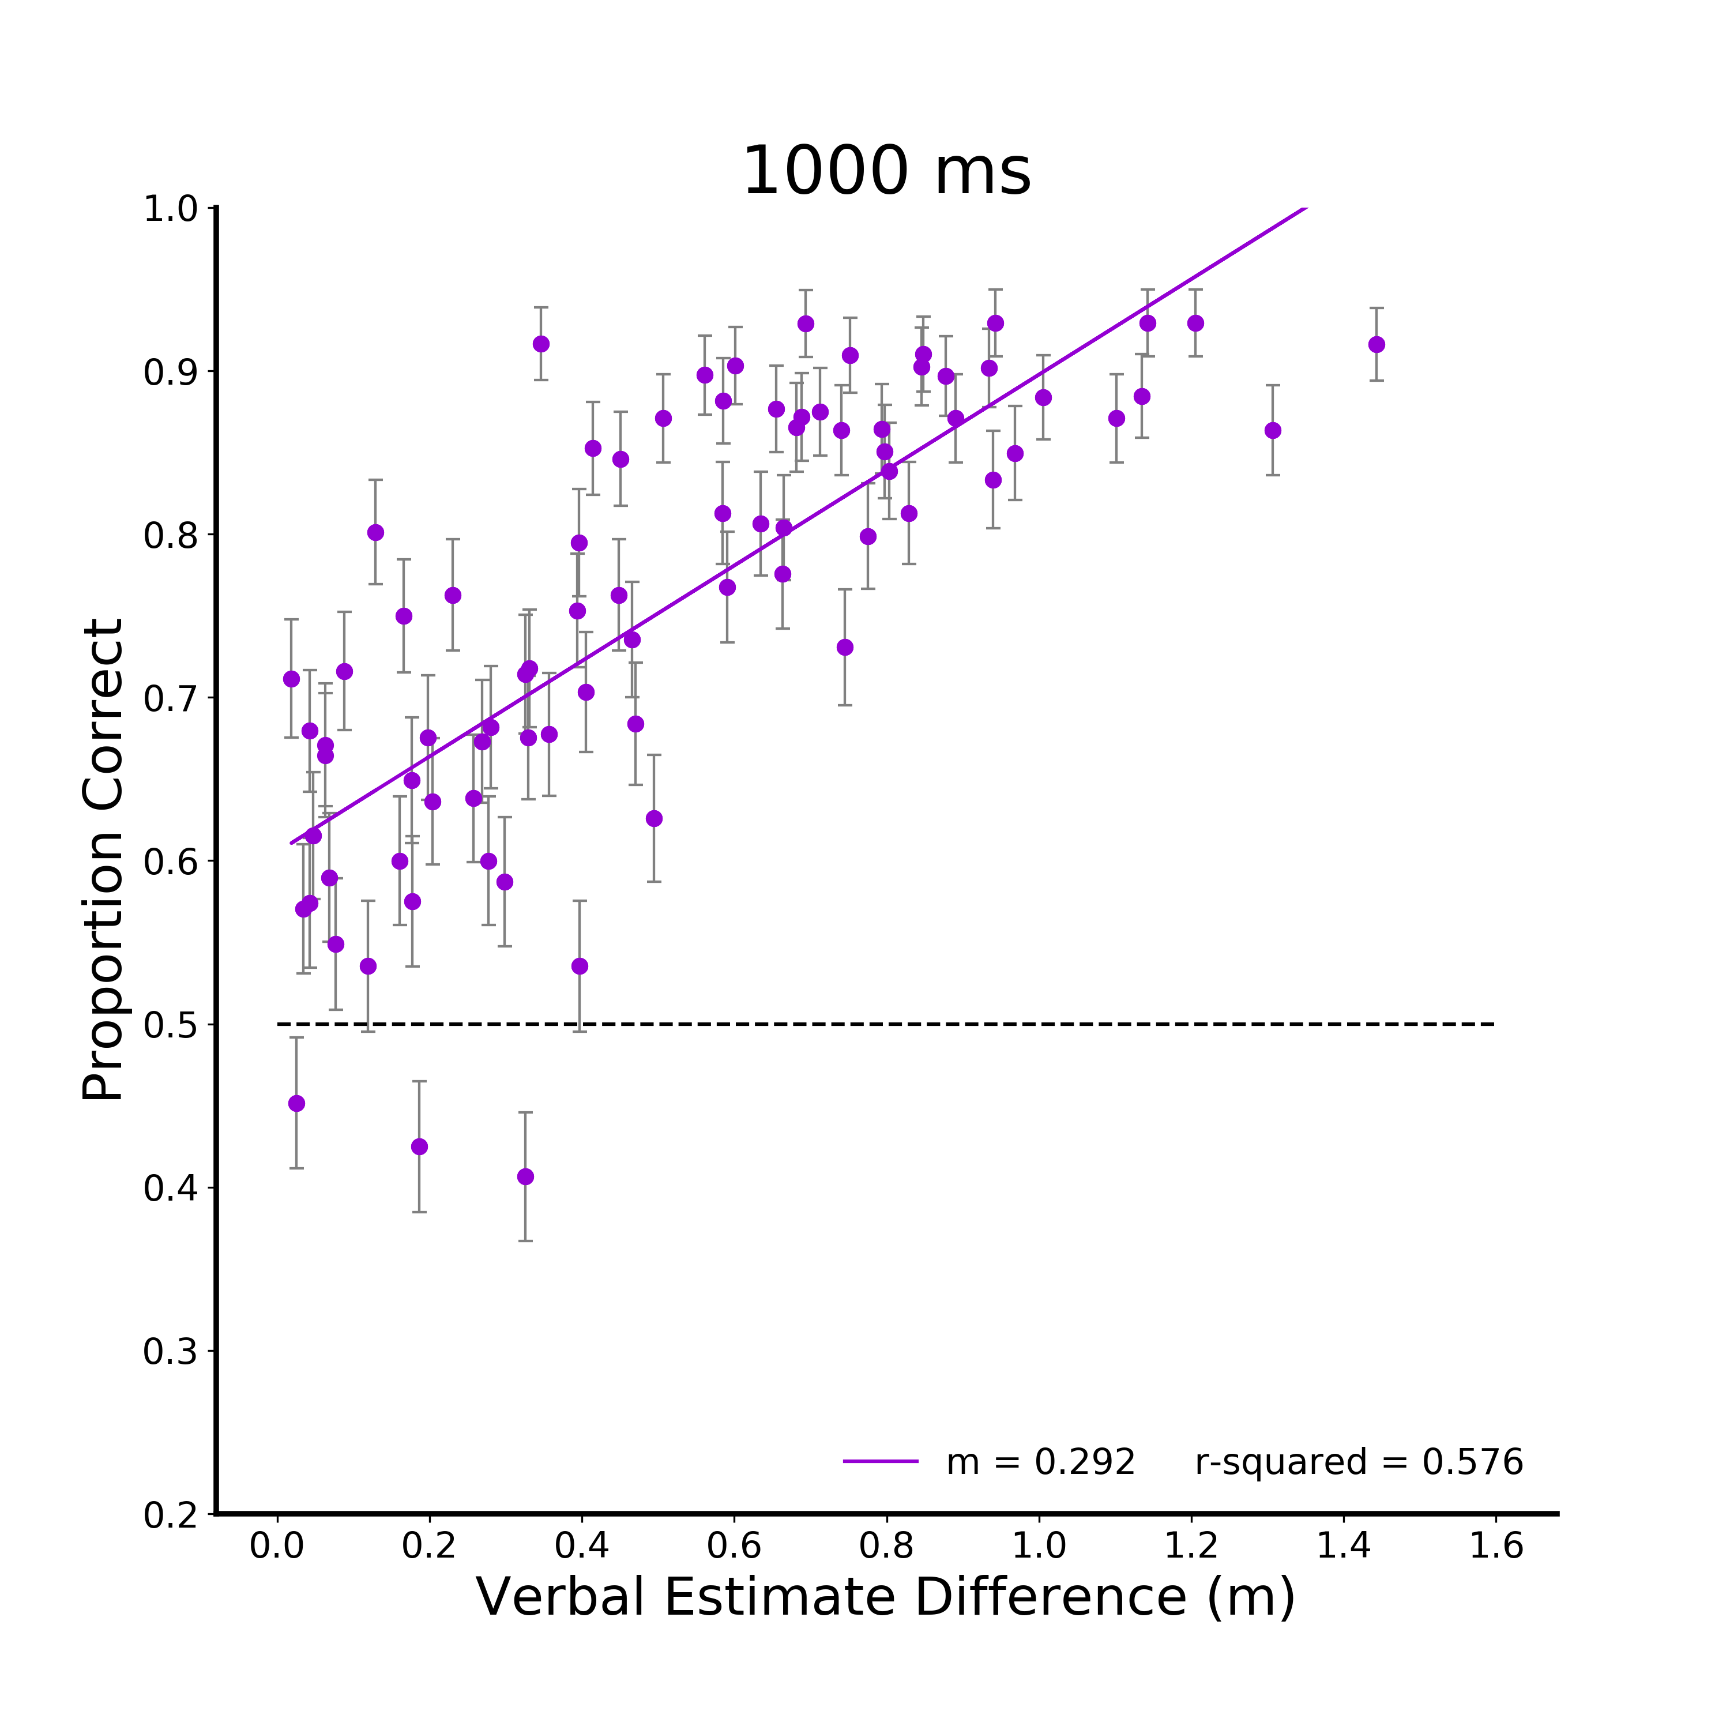
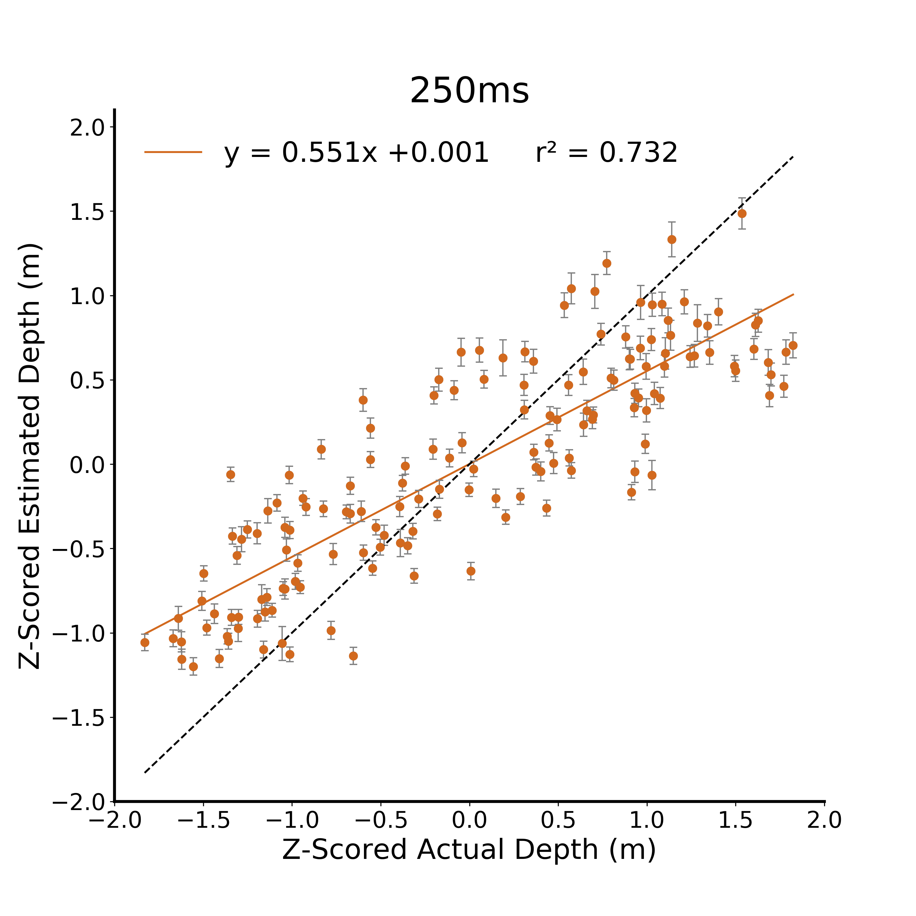
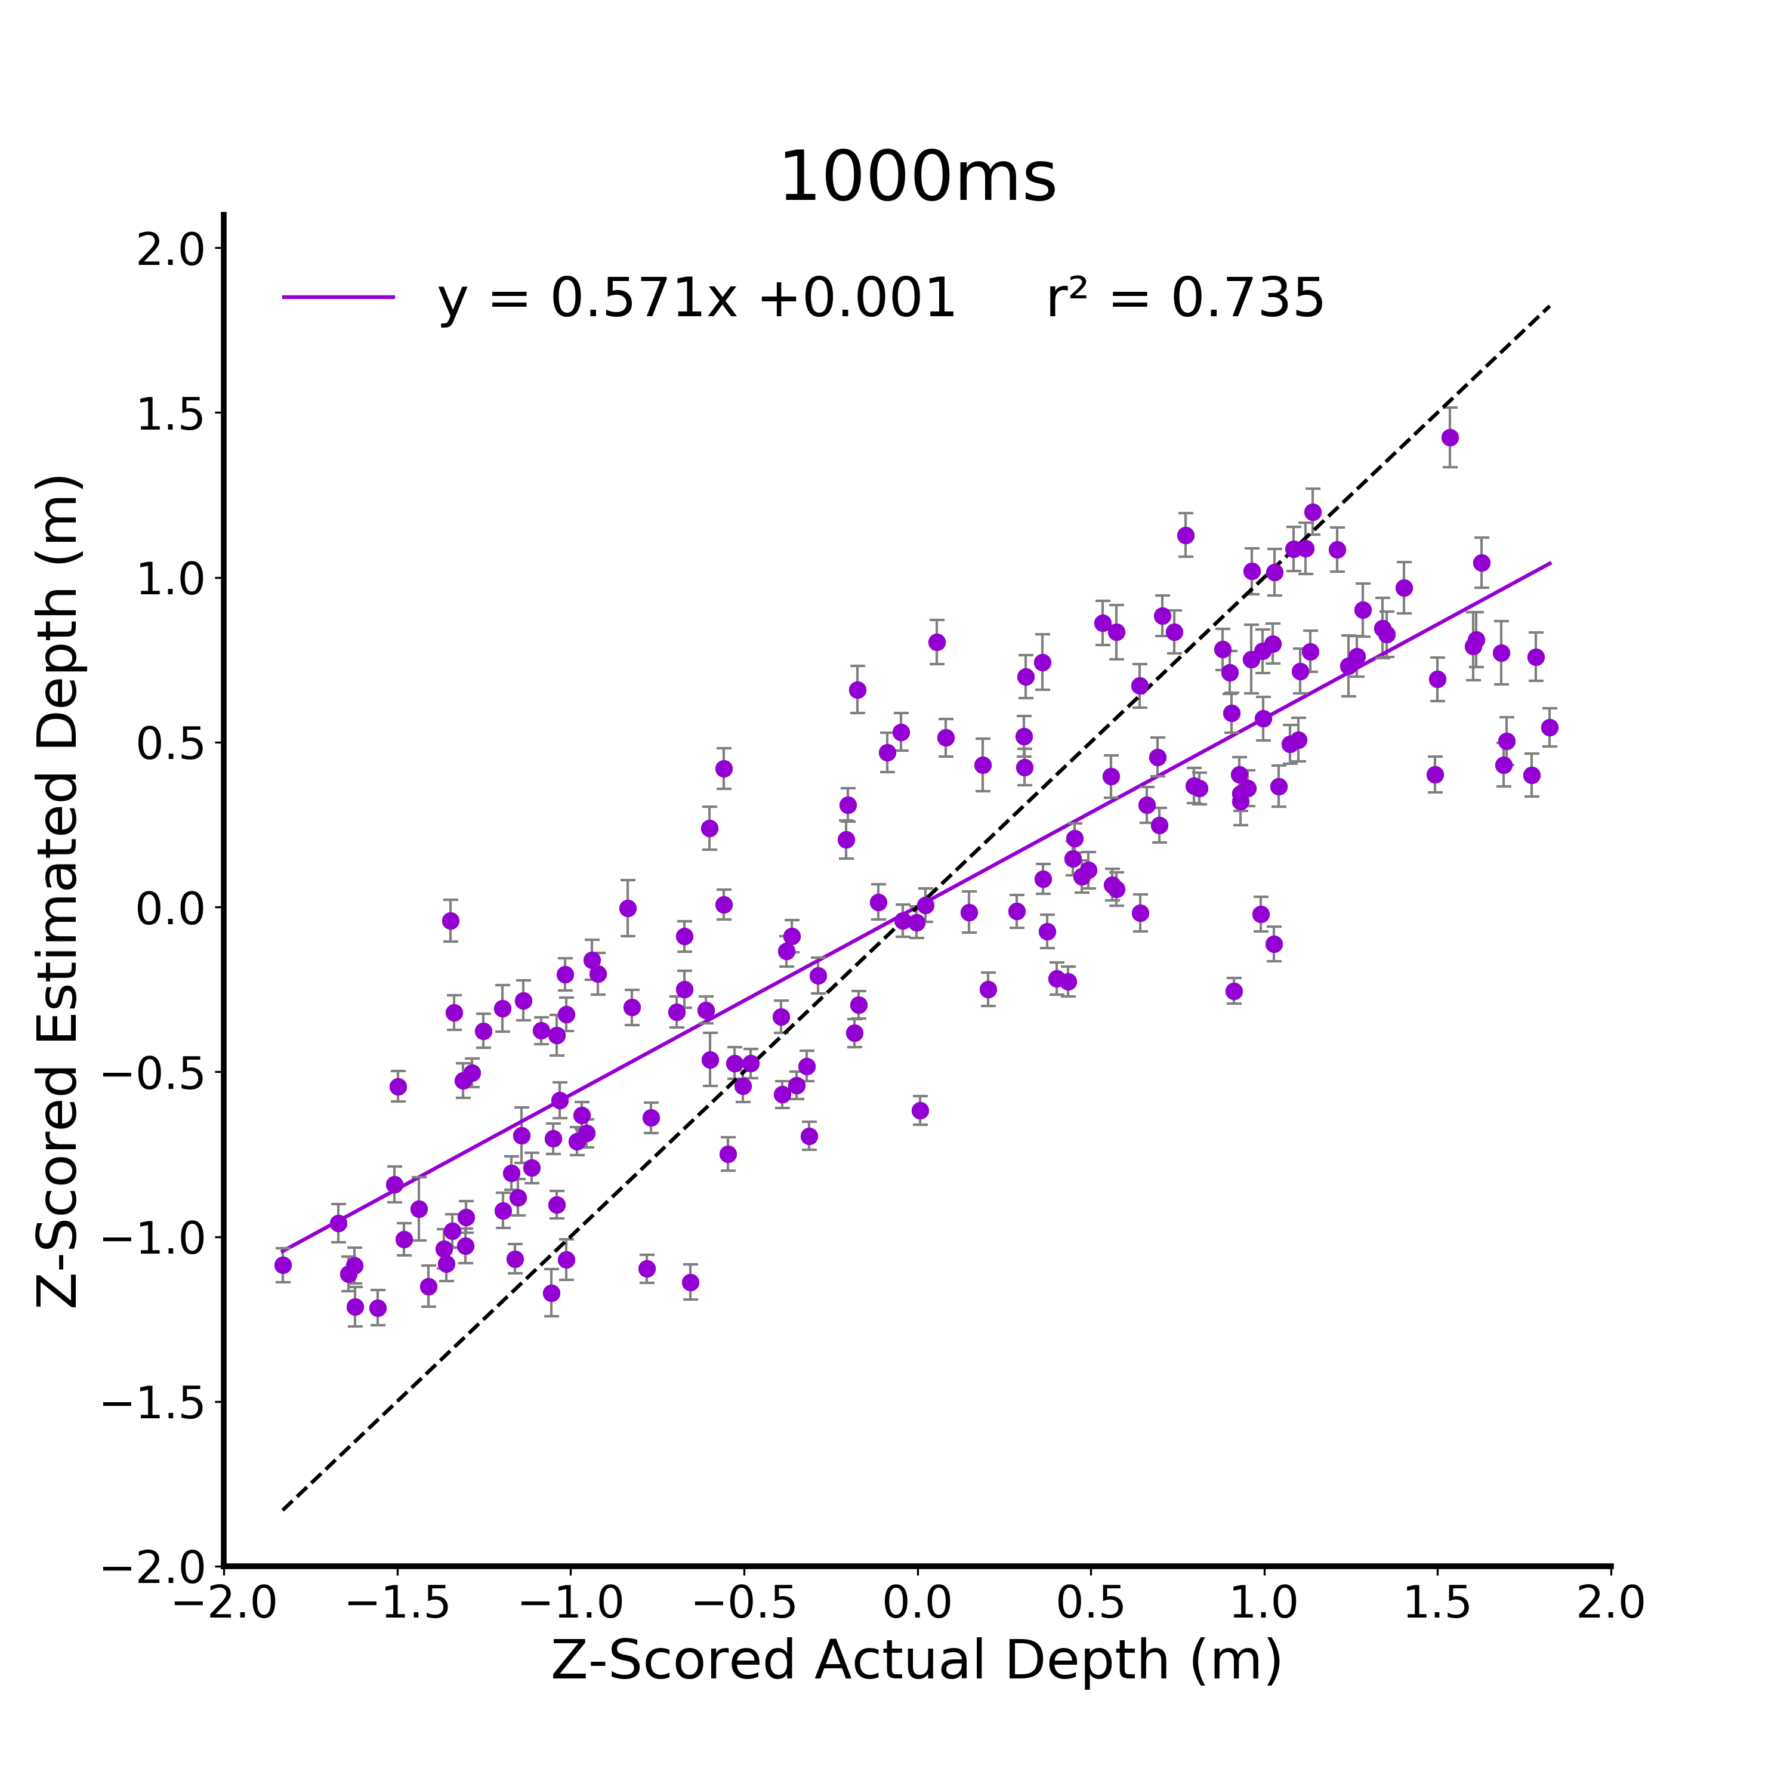
A.
B.
C.
D.
Figure 2. Verbal Estimate Linear Models. A) Raw data from the verbal estimate task for the 125 ms viewing duration condition. Participants are independent between viewing duration conditions and all error bars in plots are between subjects standard error. B) Z-scored data at 125ms. C) Z-scored data at 250ms. D) Z-scored data at 1000ms.

Slide 3

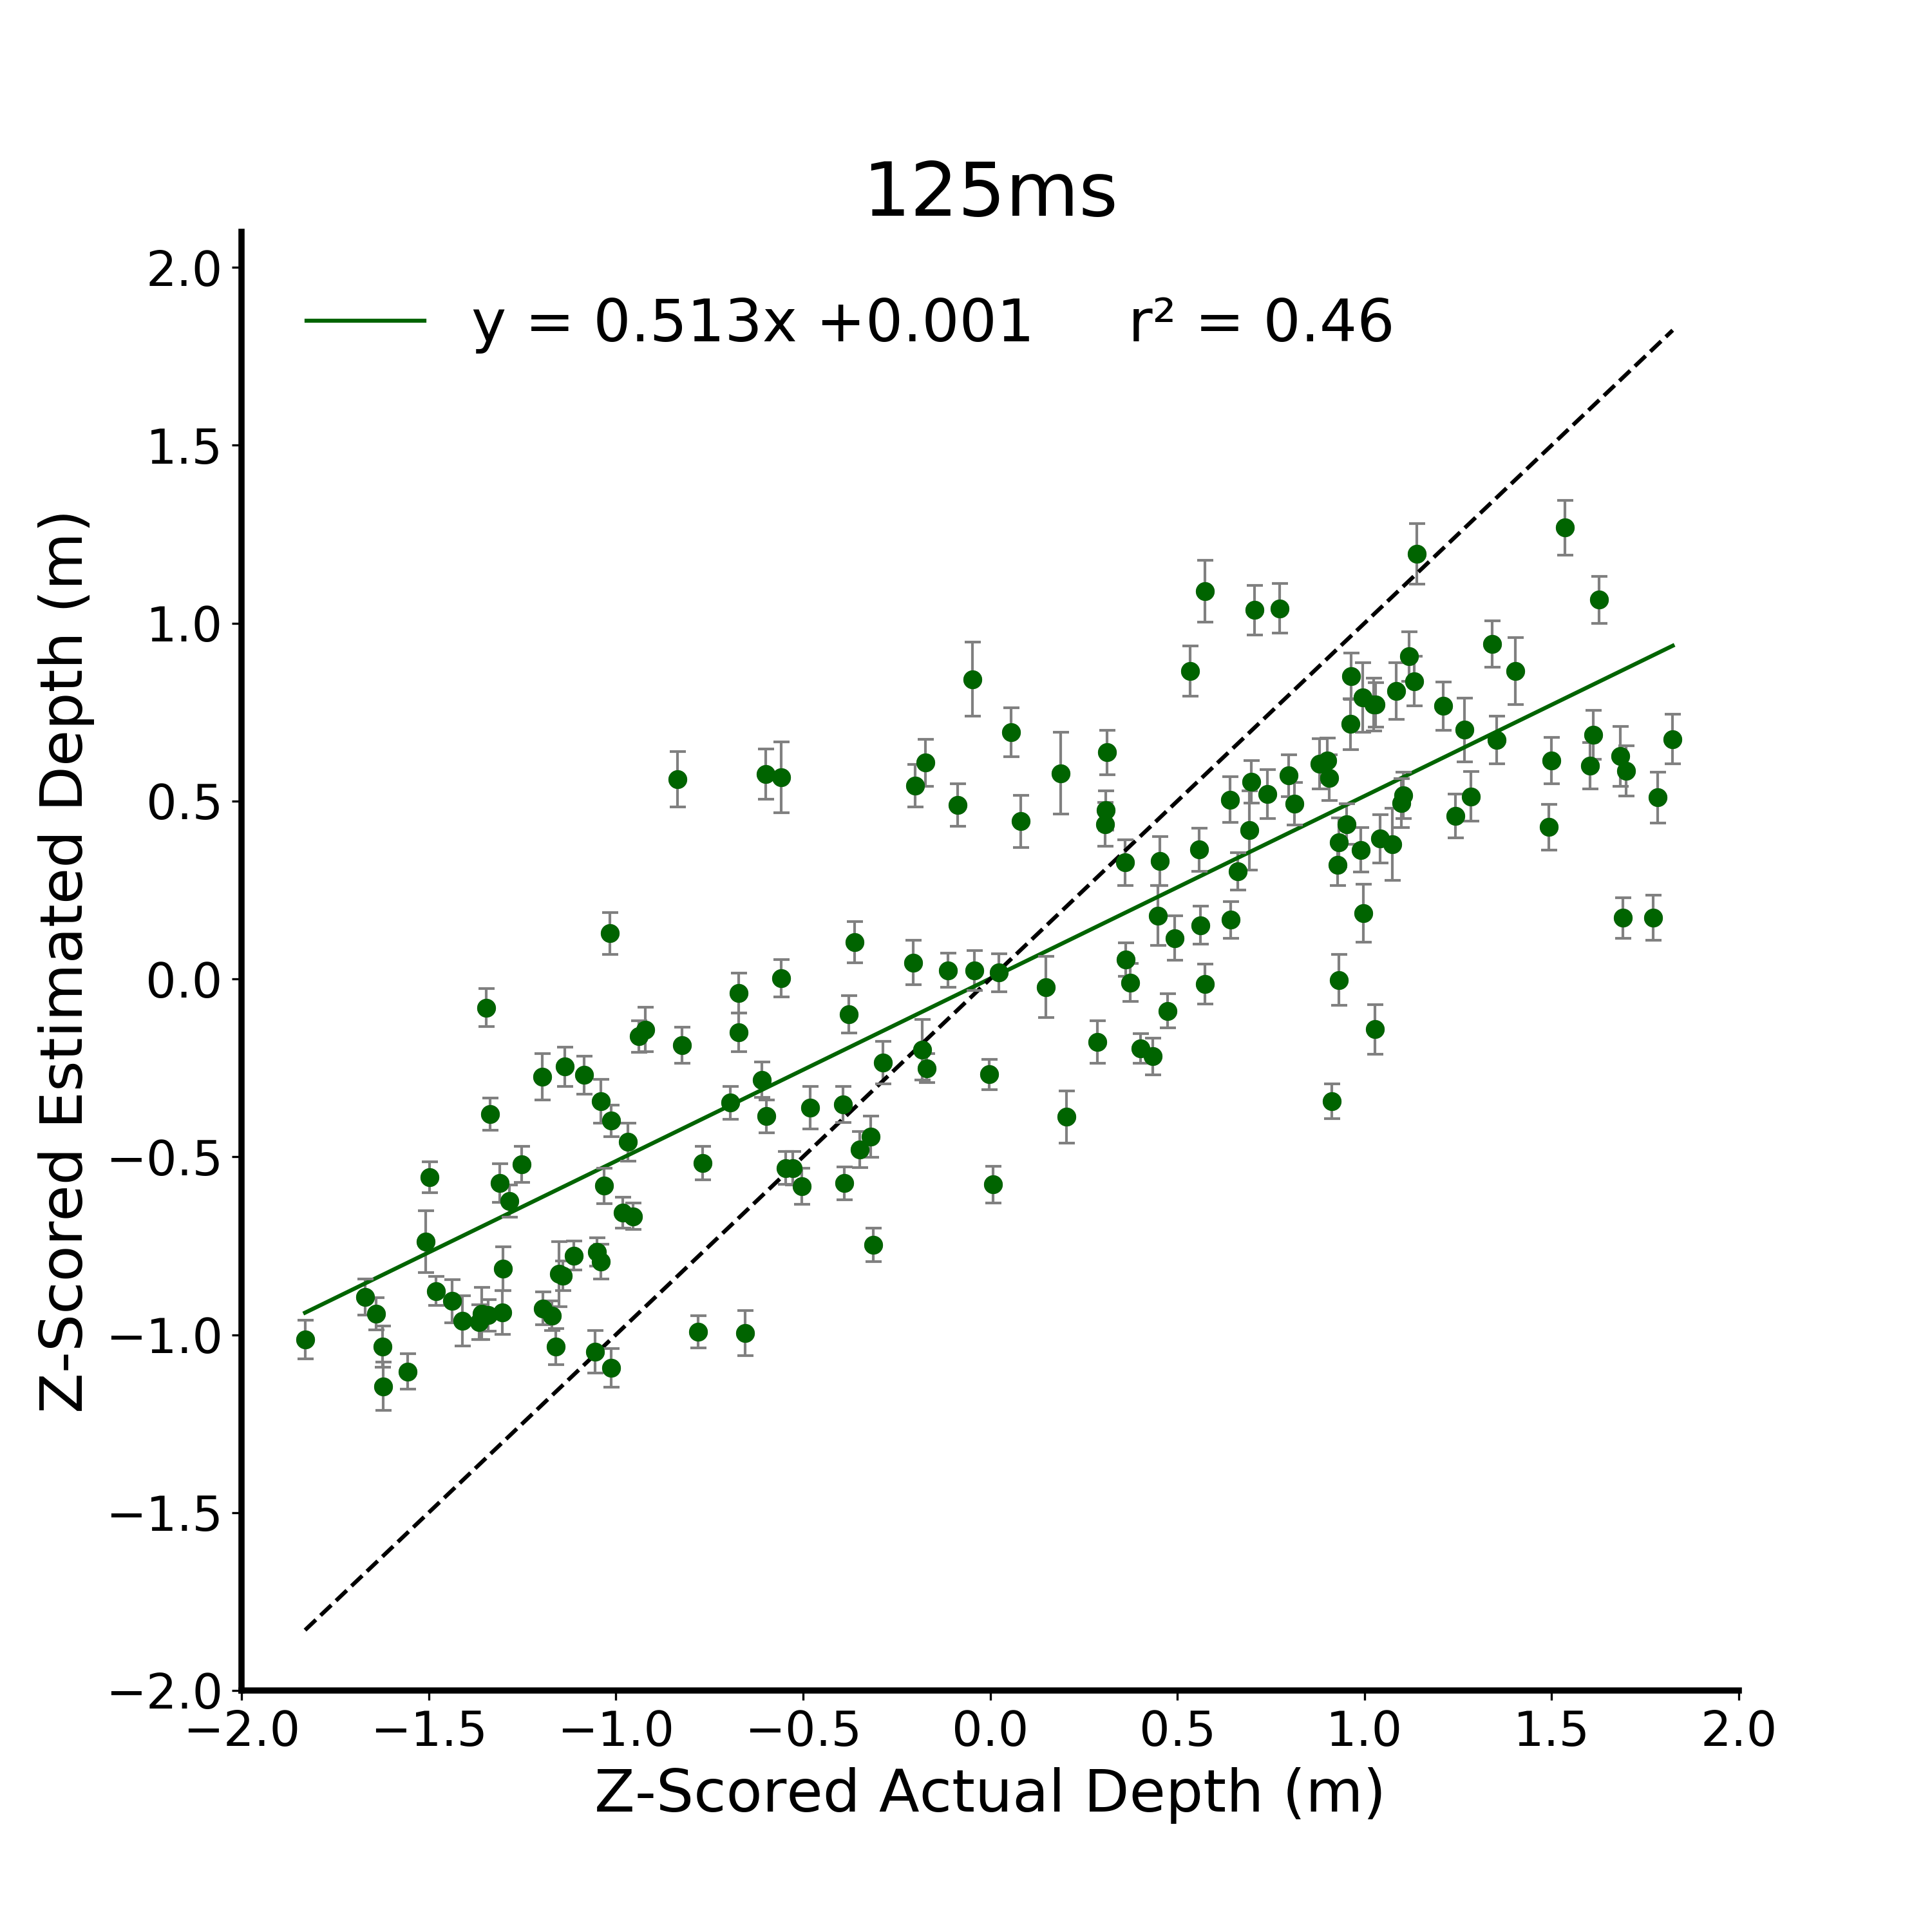

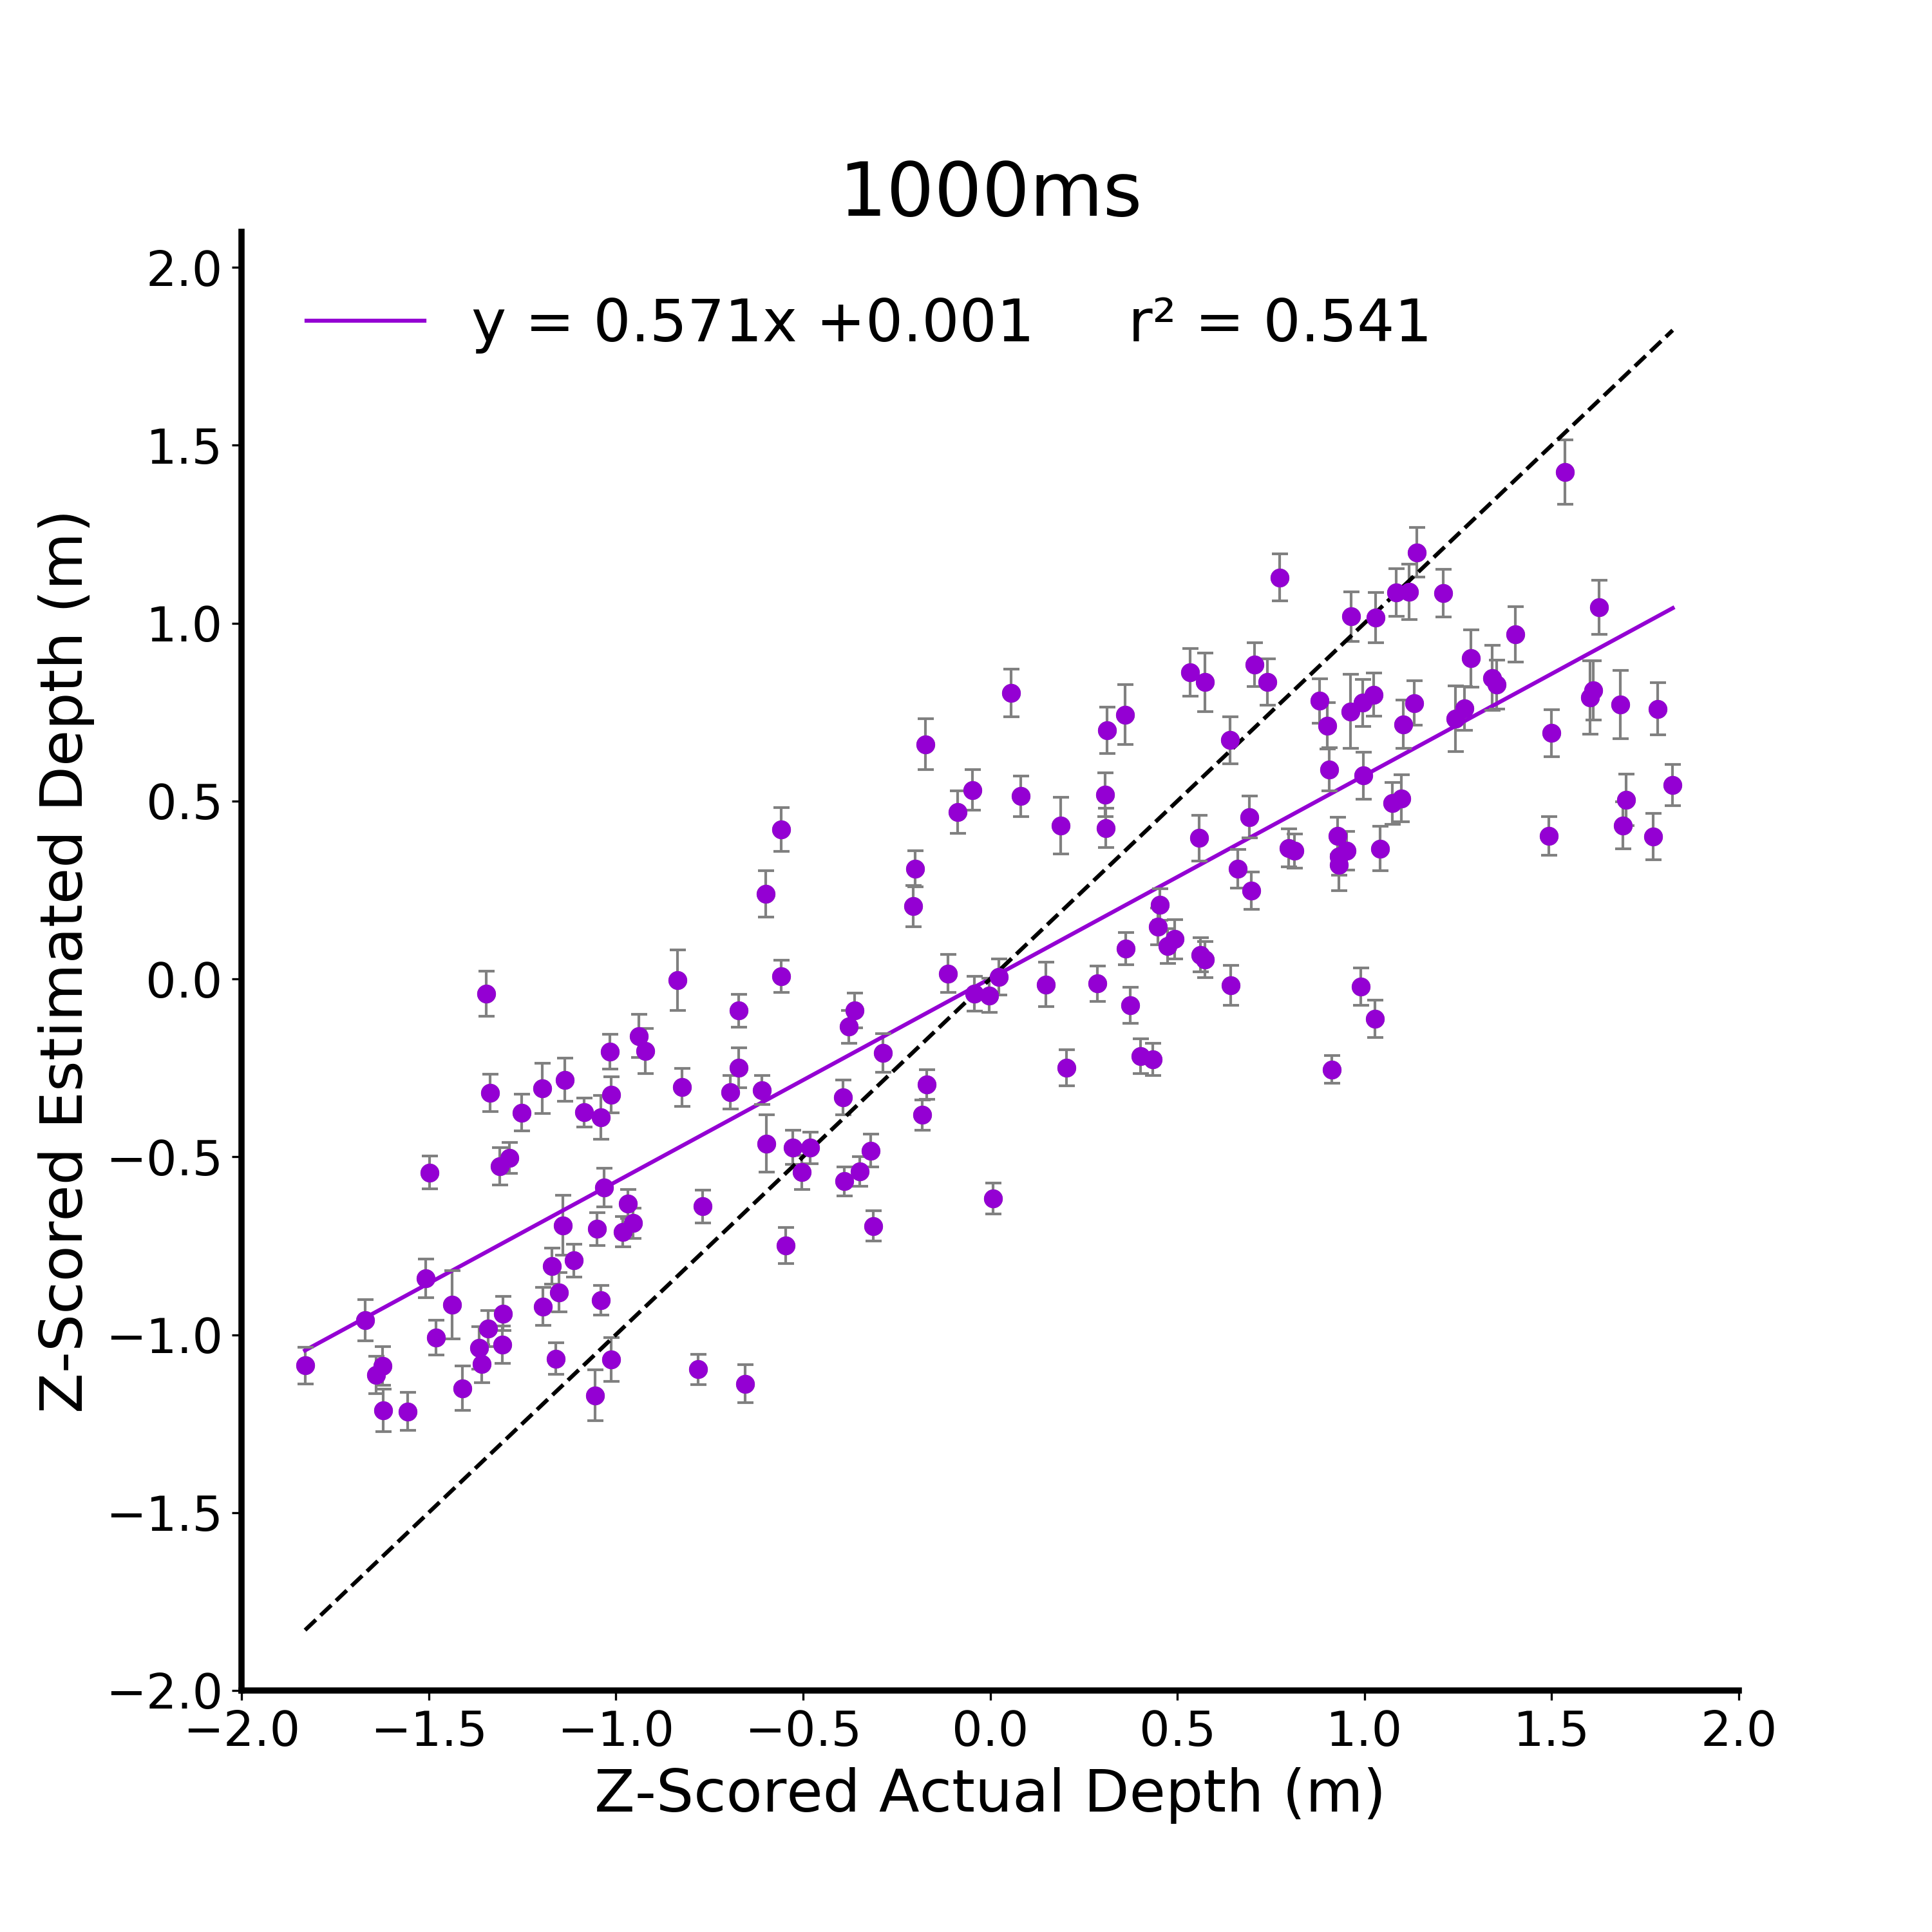
A.
B.
C.
D.
Figure 2. Verbal Estimate Linear Models. A) Raw data from the verbal estimate task for the 125 ms viewing duration condition. Participants are independent between viewing duration conditions and all error bars in plots are between subjects standard error. B) Z-scored data at 125ms. C) Z-scored data at 250ms. D) Z-scored data at 1000ms.
Notes:
DONE

Slide 4
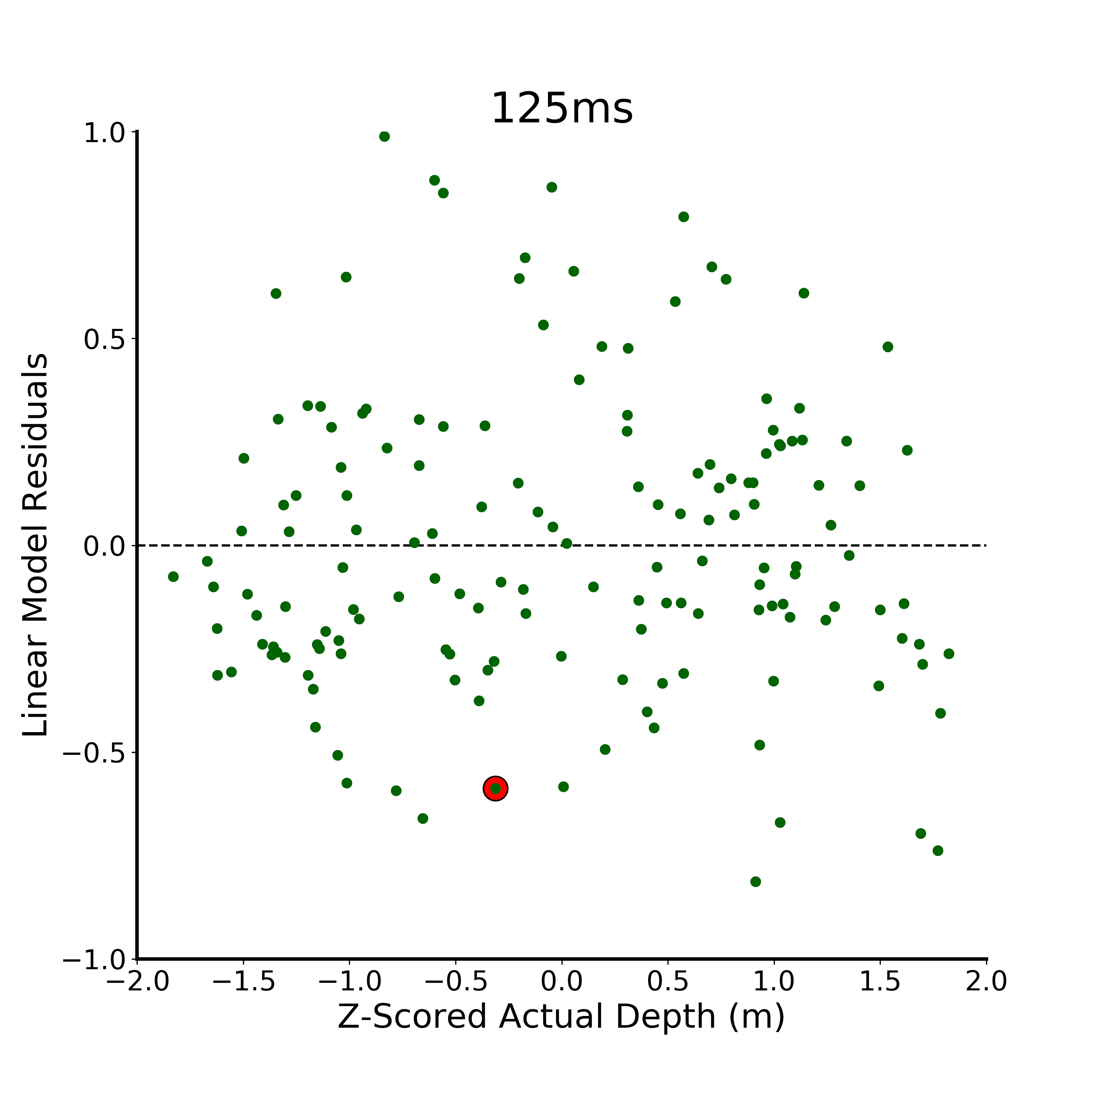
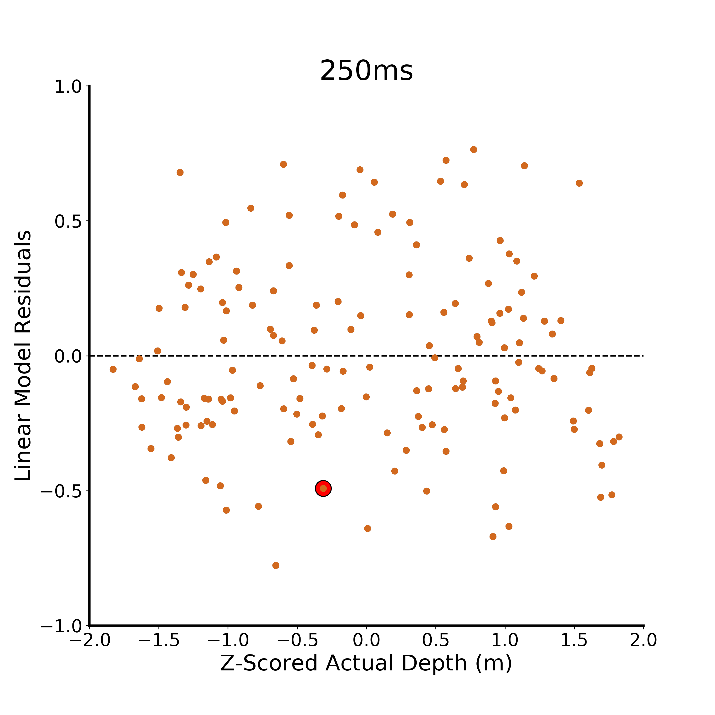
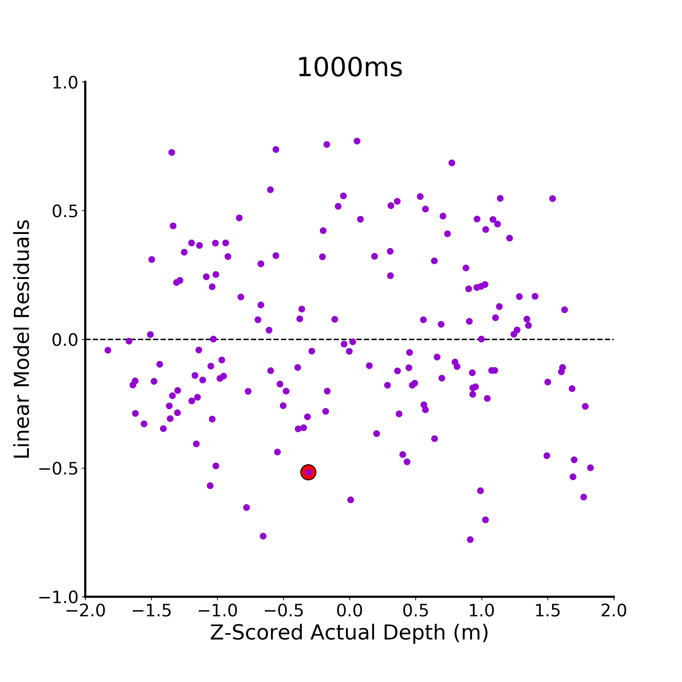
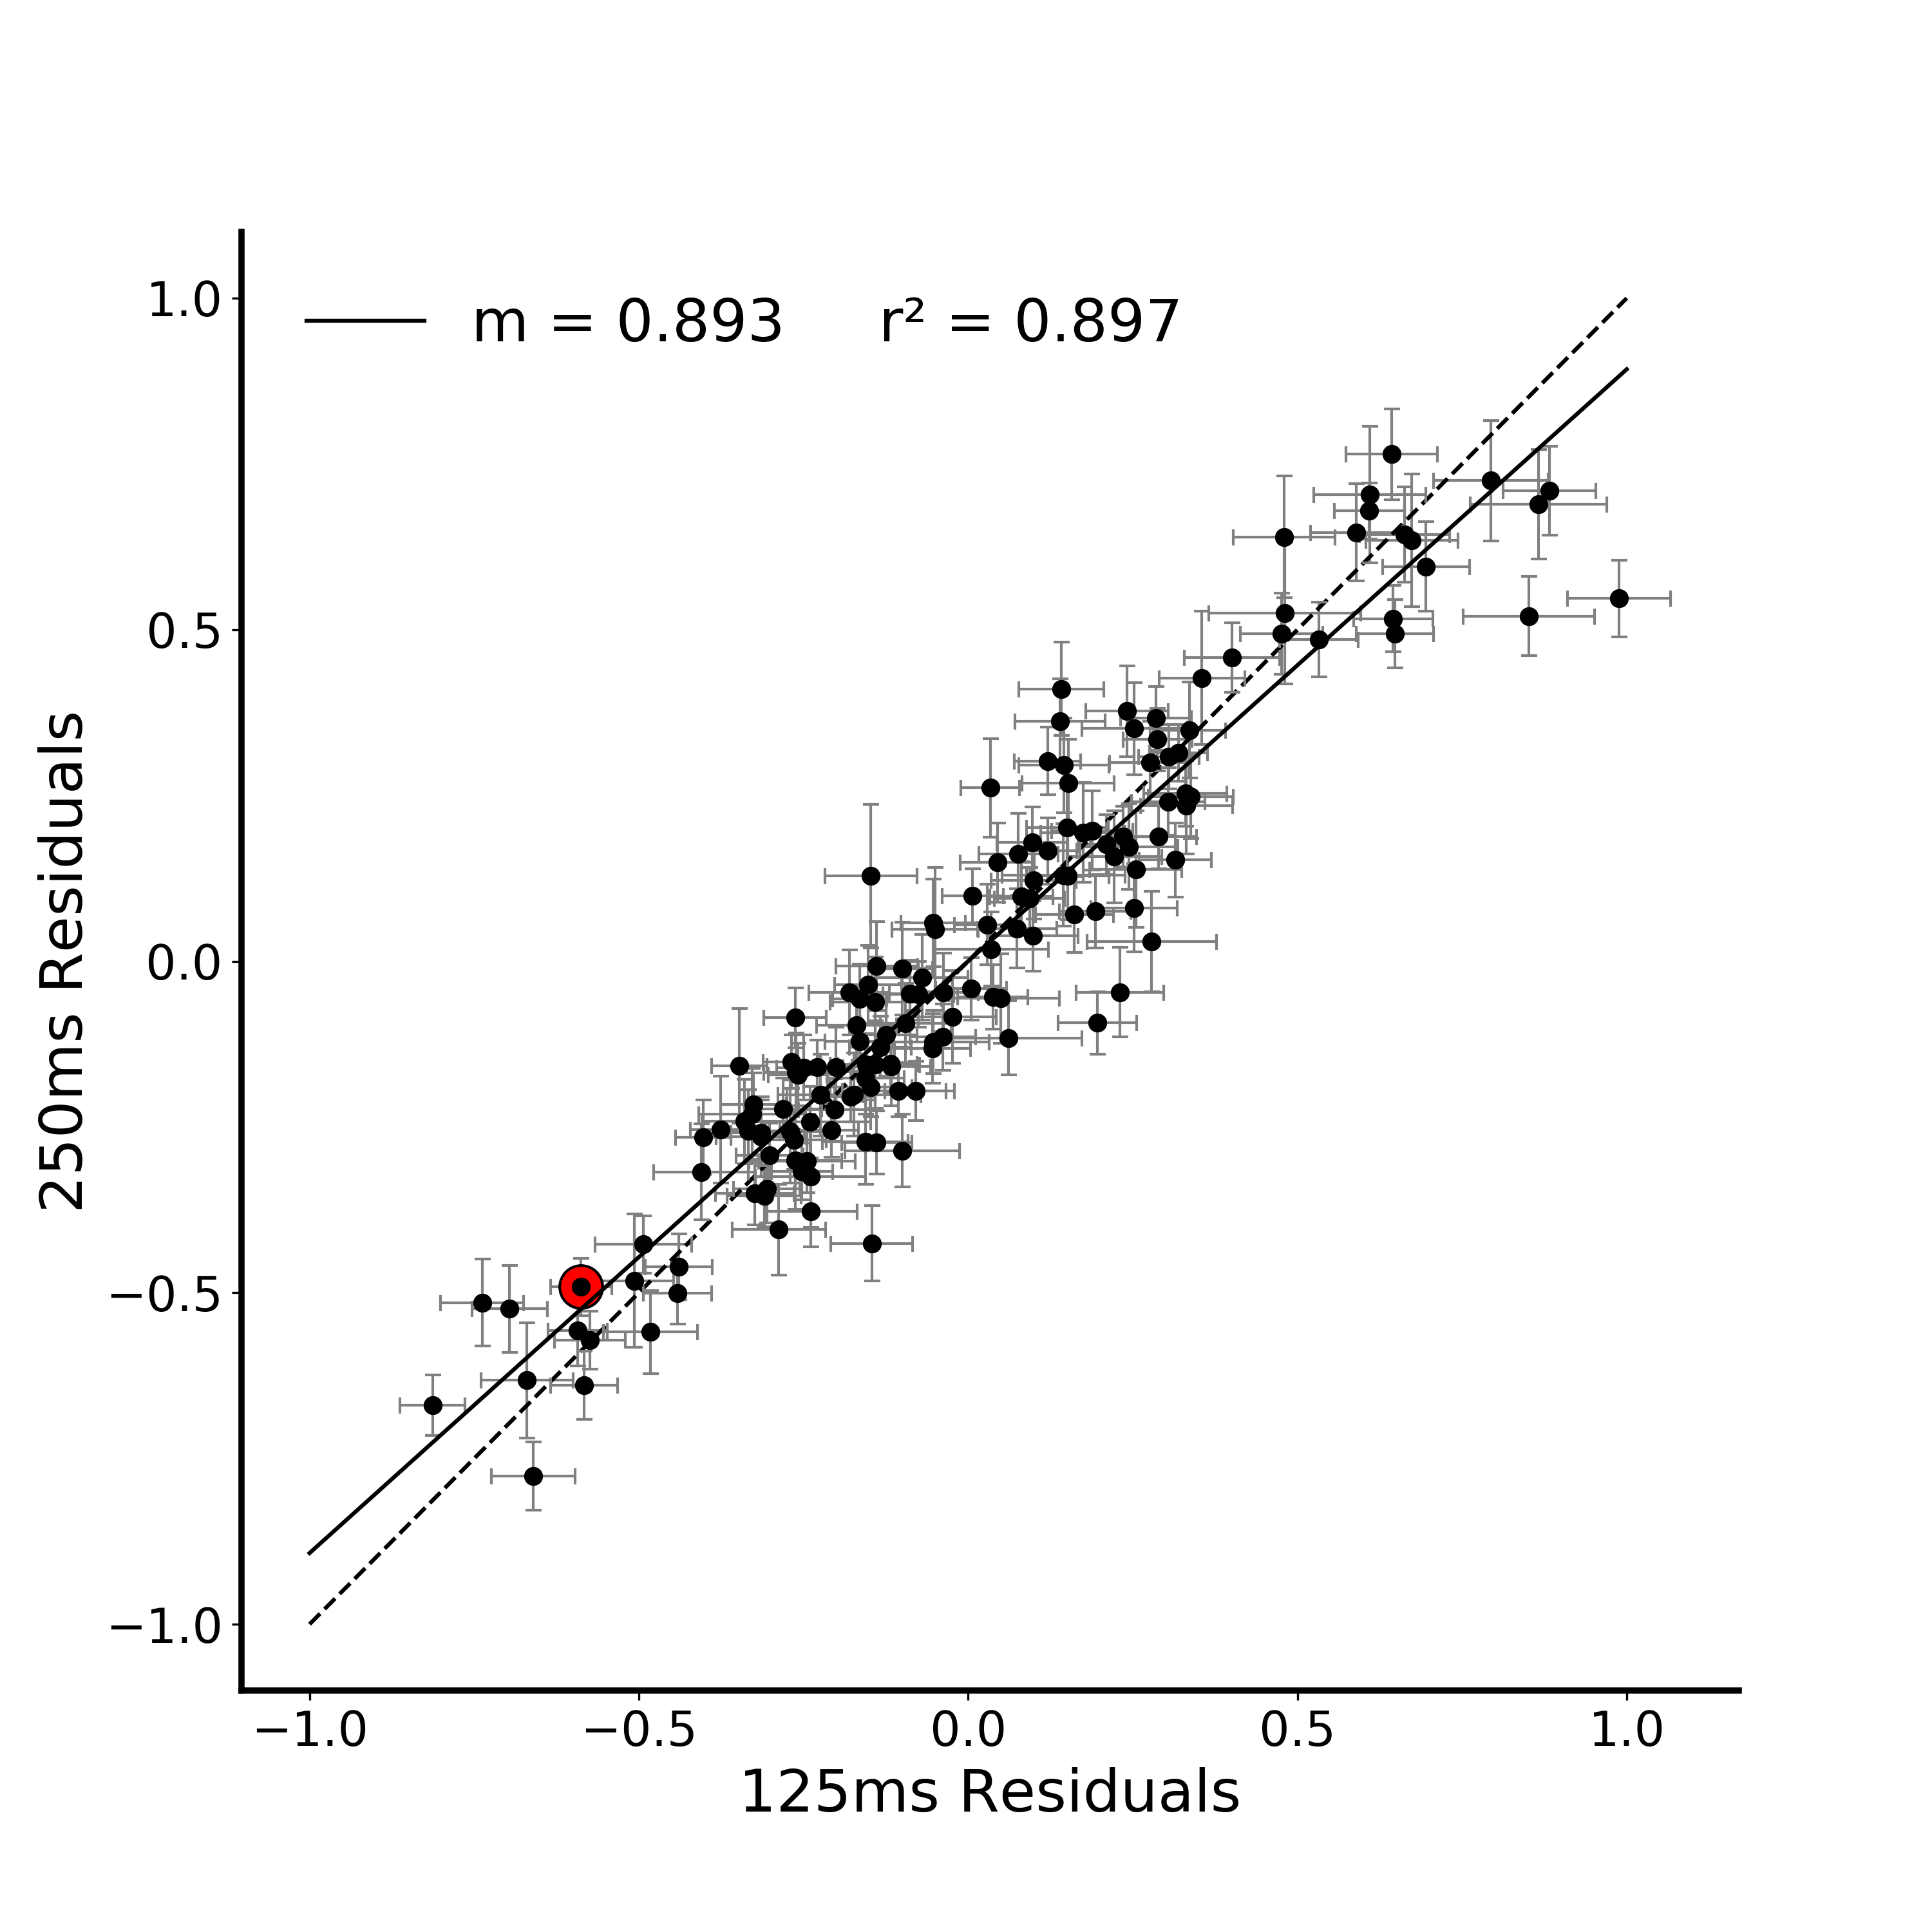
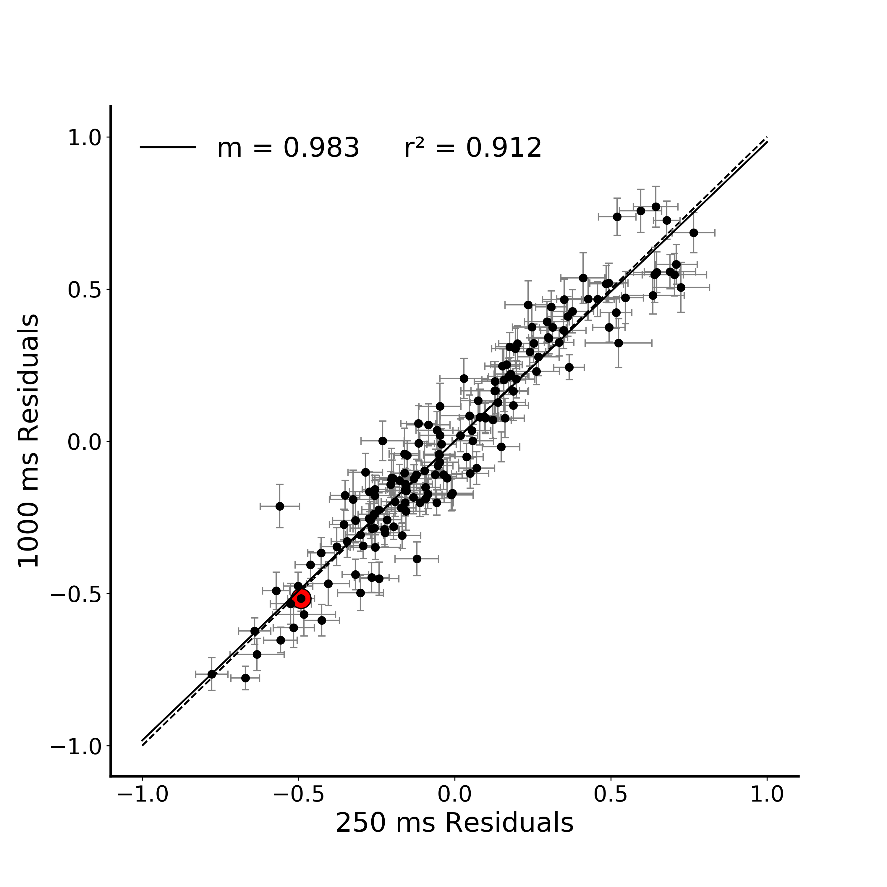
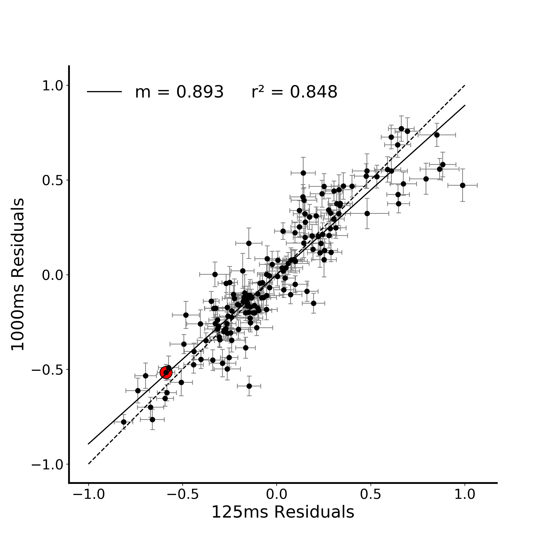
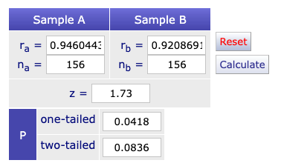
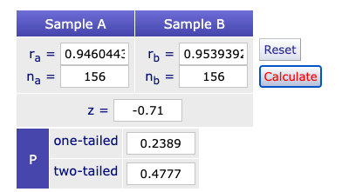
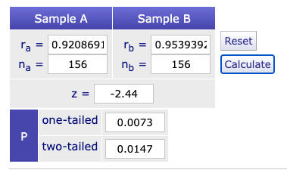
A.
*
B.
**
Figure 3. Correlation between verbal estimate regression residuals in Figure 2. A) Verbal estimate residuals (difference between the model prediction and the average estimate for that stimulus) at each viewing duration plotted against z-scored actual depth. The residual for a particular stimulus at each viewing duration is highlighted in red. B) Correlation between all combination of verbal estimate regression residuals at the three viewing durations (125, 250, 1000ms). The residual correlation for a particular stimulus is highlighted in red on all plots. (* indicates p < 0.05, ** indicates p < 0.01)
(125x250) (125x1000)
(125x250) x (250x1000)
(125x1000) x (250x1000)
Notes:
DONE
Note temporal evolution here (250 and 1000 are basically identical)
Pairwise compareisons between the plots – Fischers r to z transform (linearlizes the r values)
http://vassarstats.net/rdiff.html

Slide 5
A.
*
B.
**
Figure 3. Correlation between verbal estimate regression residuals in Figure 2. A) Verbal estimate residuals (difference between the model prediction and the average estimate for that stimulus) at each viewing duration plotted against z-scored actual depth. The residual for a particular stimulus at each viewing duration is highlighted in red. B) Correlation between all combination of verbal estimate regression residuals at the three viewing durations (125, 250, 1000ms). The residual correlation for a particular stimulus is highlighted in red on all plots. (* indicates p < 0.05, ** indicates p < 0.01)
Notes:
Note temporal evolution here (250 and 1000 are basically identical)
Pairwise compareisons between the plots – Fischers r to z transform (linearlizes the r values)
http://vassarstats.net/rdiff.html

Slide 6
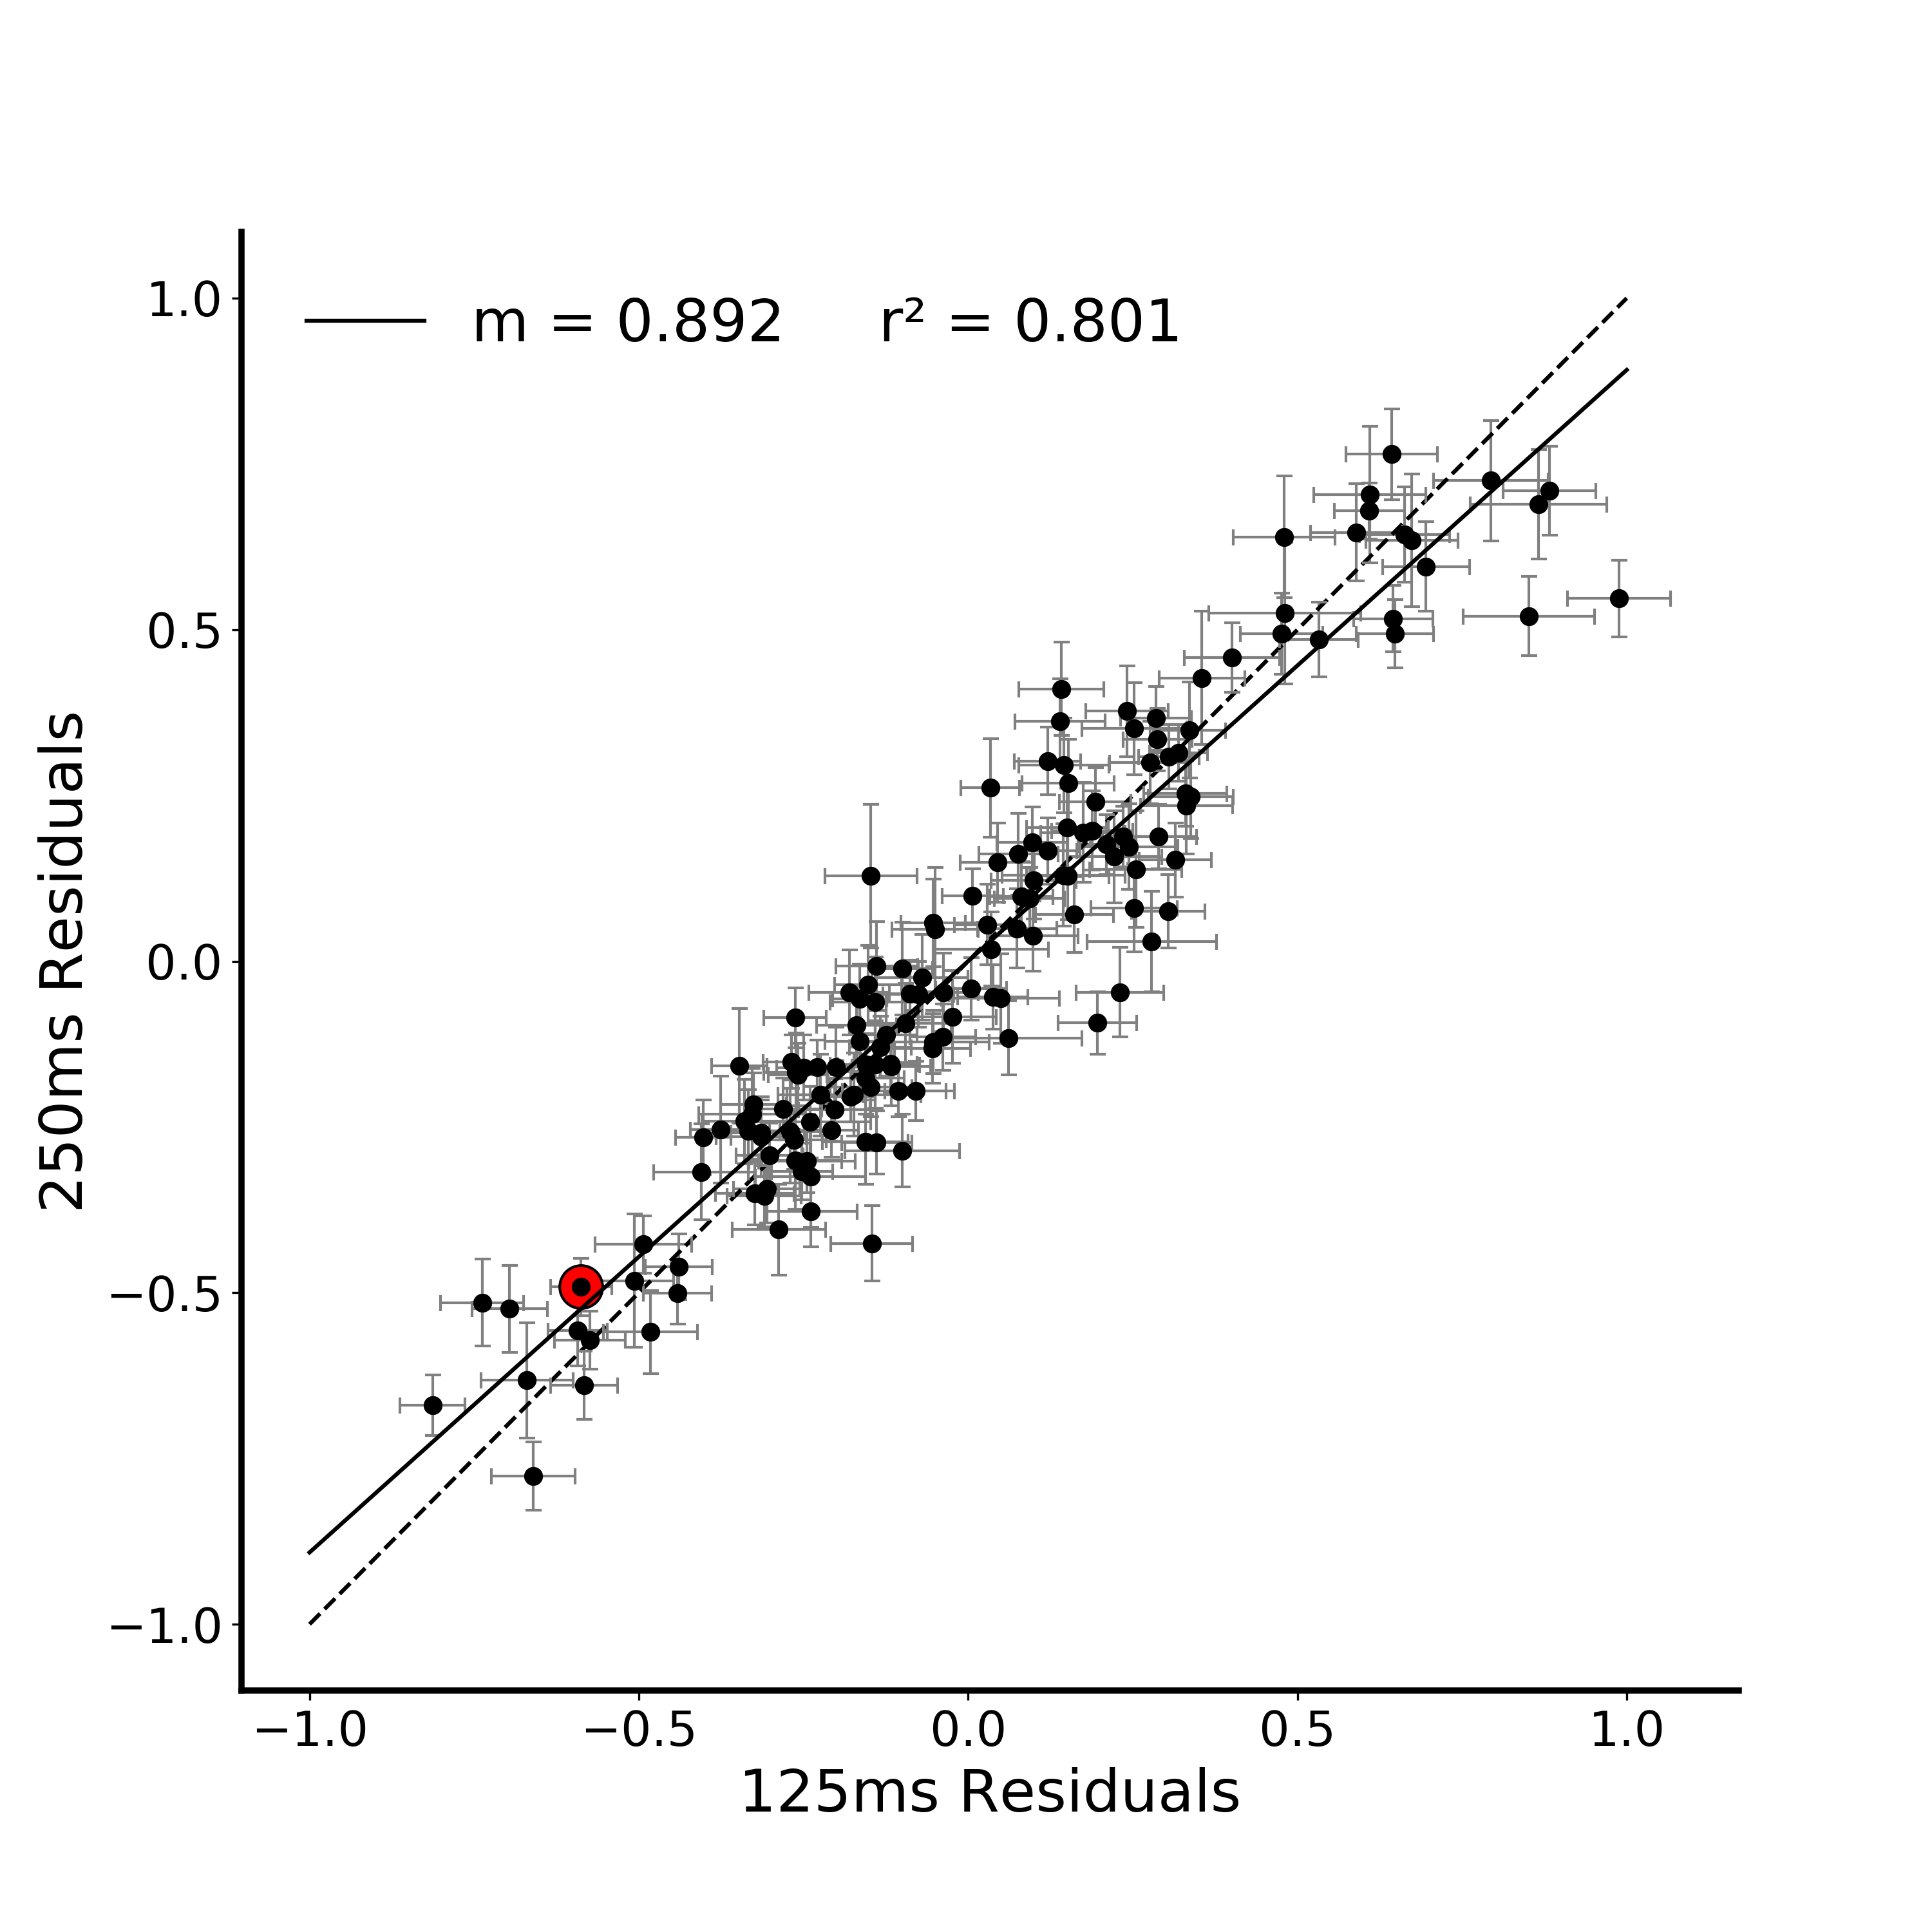


A.
*
B.
**
Figure 3. Correlation between verbal estimate regression residuals in Figure 2. A) Verbal estimate residuals (difference between the model prediction and the average estimate for that stimulus) at each viewing duration plotted against z-scored actual depth. The residual for a particular stimulus at each viewing duration is highlighted in red. B) Correlation between all combination of verbal estimate regression residuals at the three viewing durations (125, 250, 1000ms). The residual correlation for a particular stimulus is highlighted in red on all plots. (* indicates p < 0.05, ** indicates p < 0.01)
Notes:
FIX ALIGNMENT OF LEGEND TEXT
Note temporal evolution here (250 and 1000 are basically identical)
Pairwise compareisons between the plots – Fischers r to z transform (linearlizes the r values)
http://vassarstats.net/rdiff.html

Slide 7
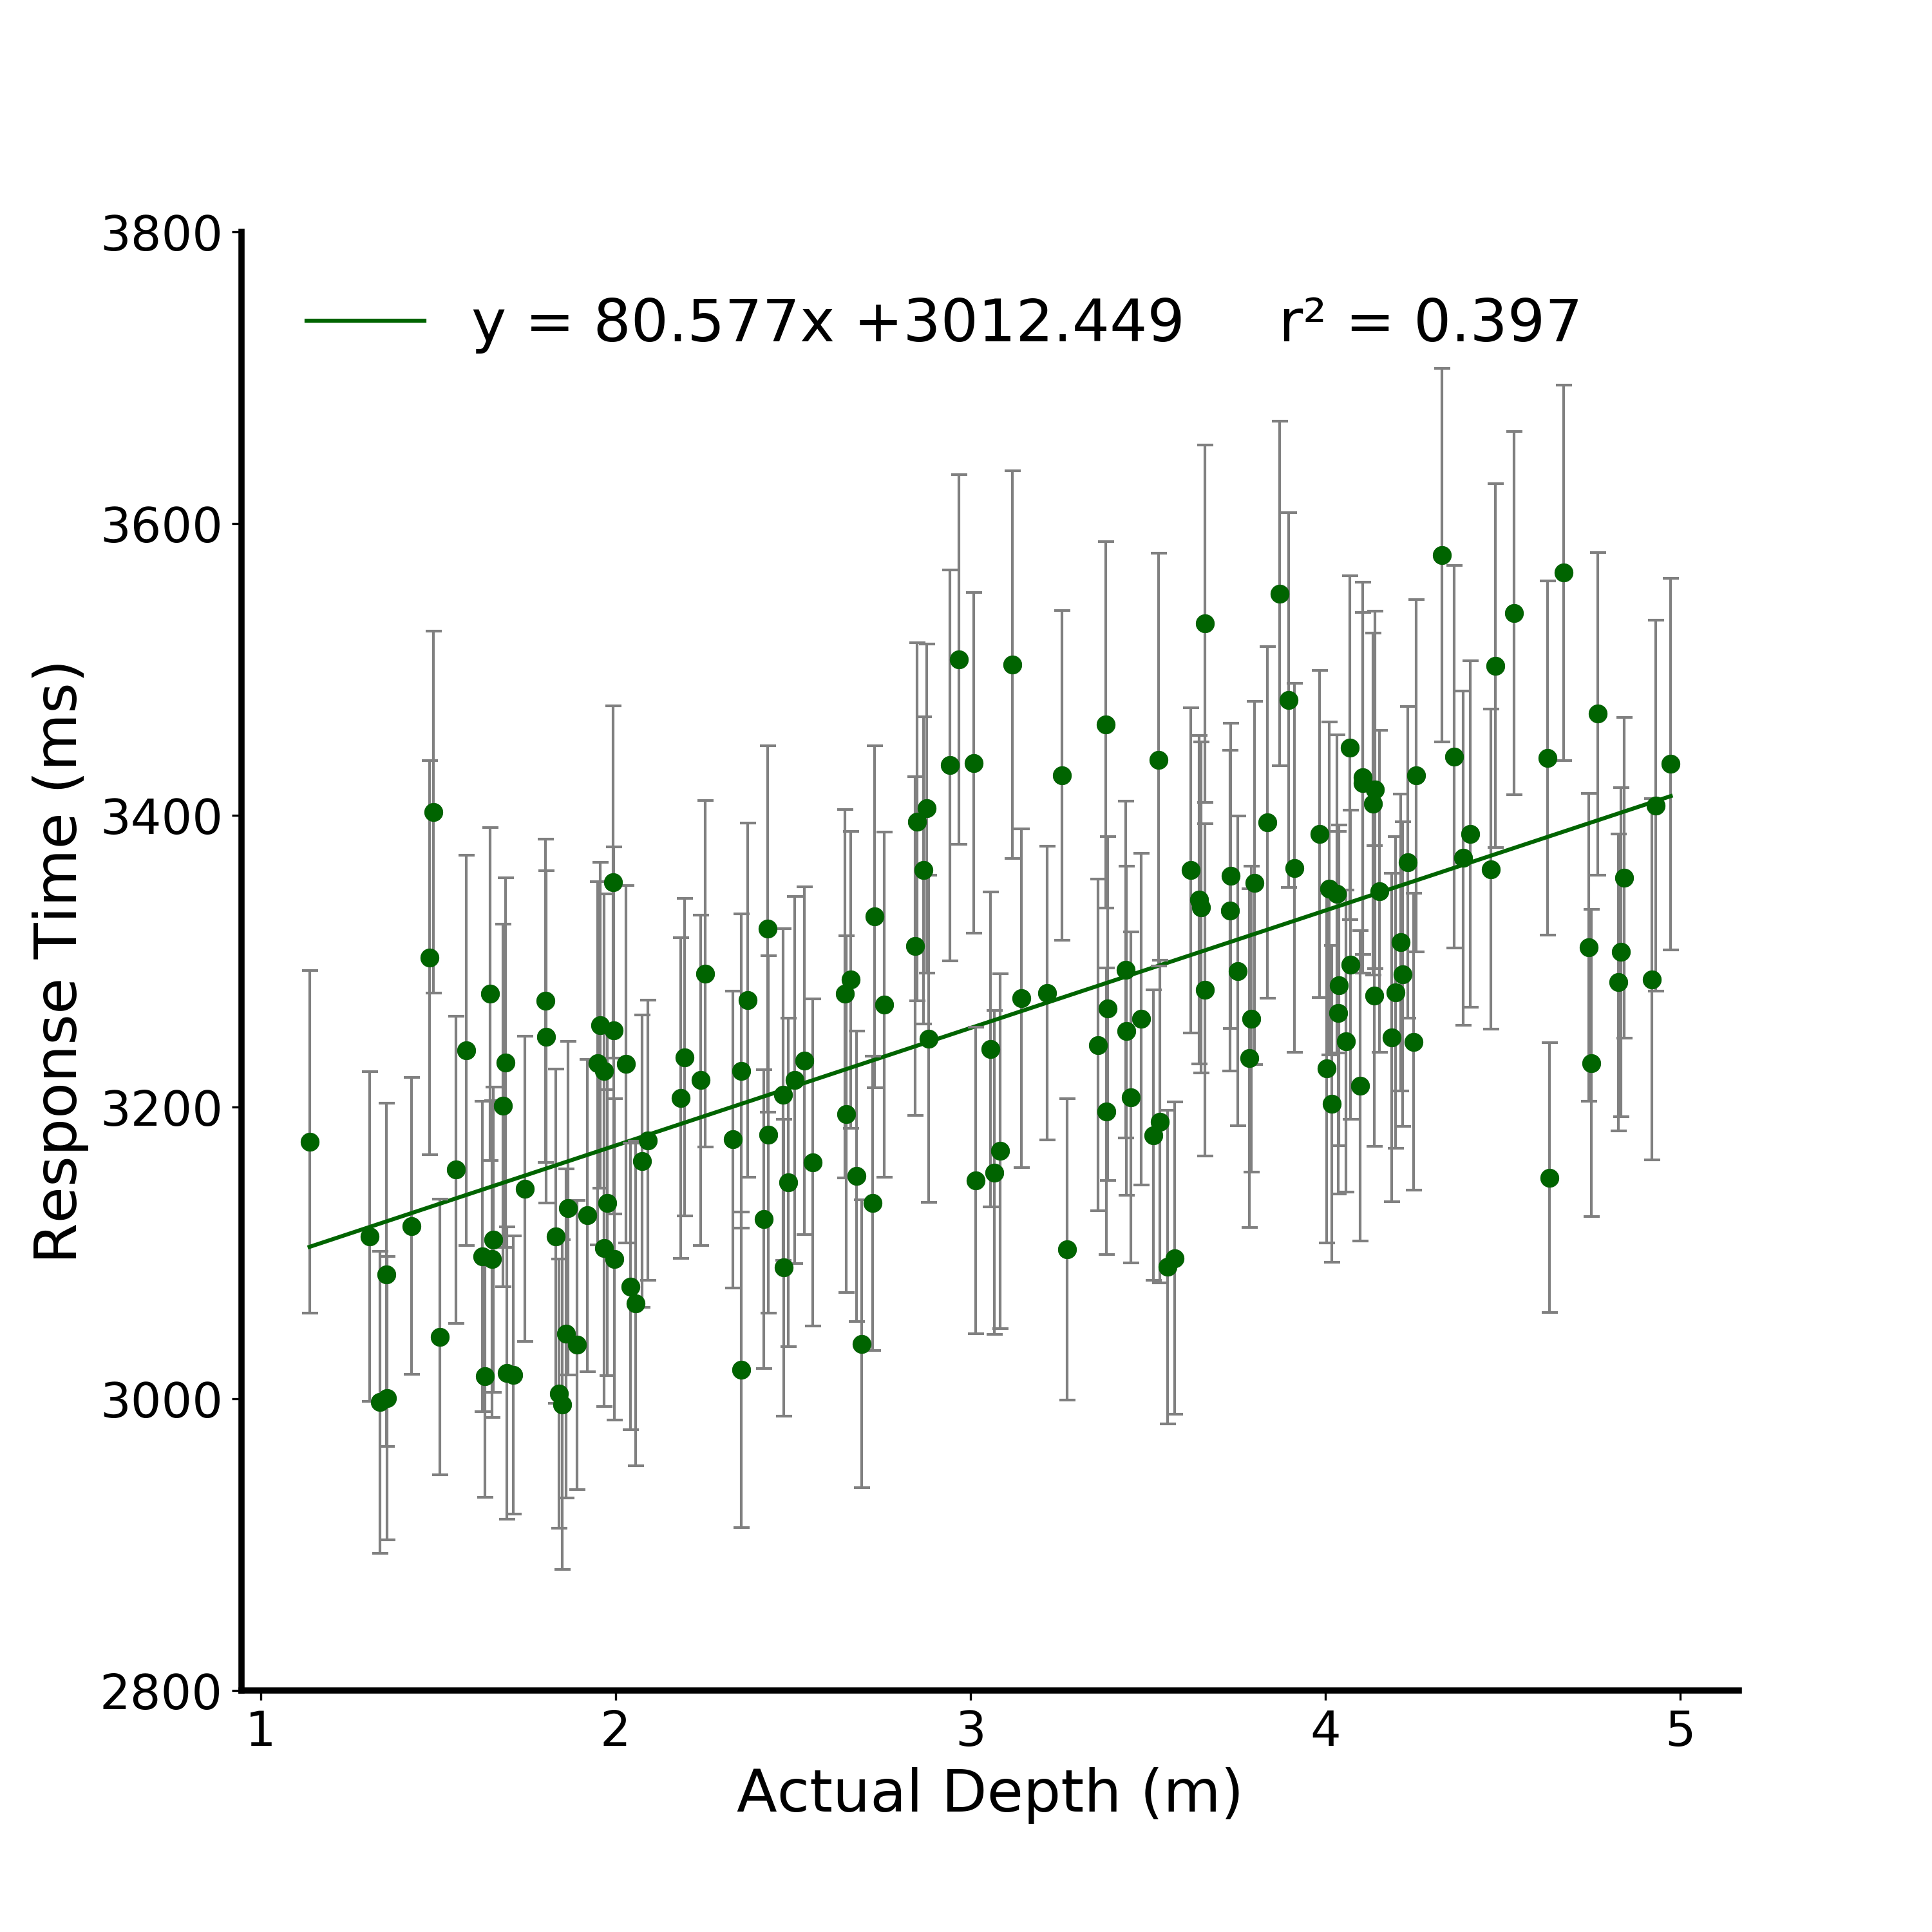
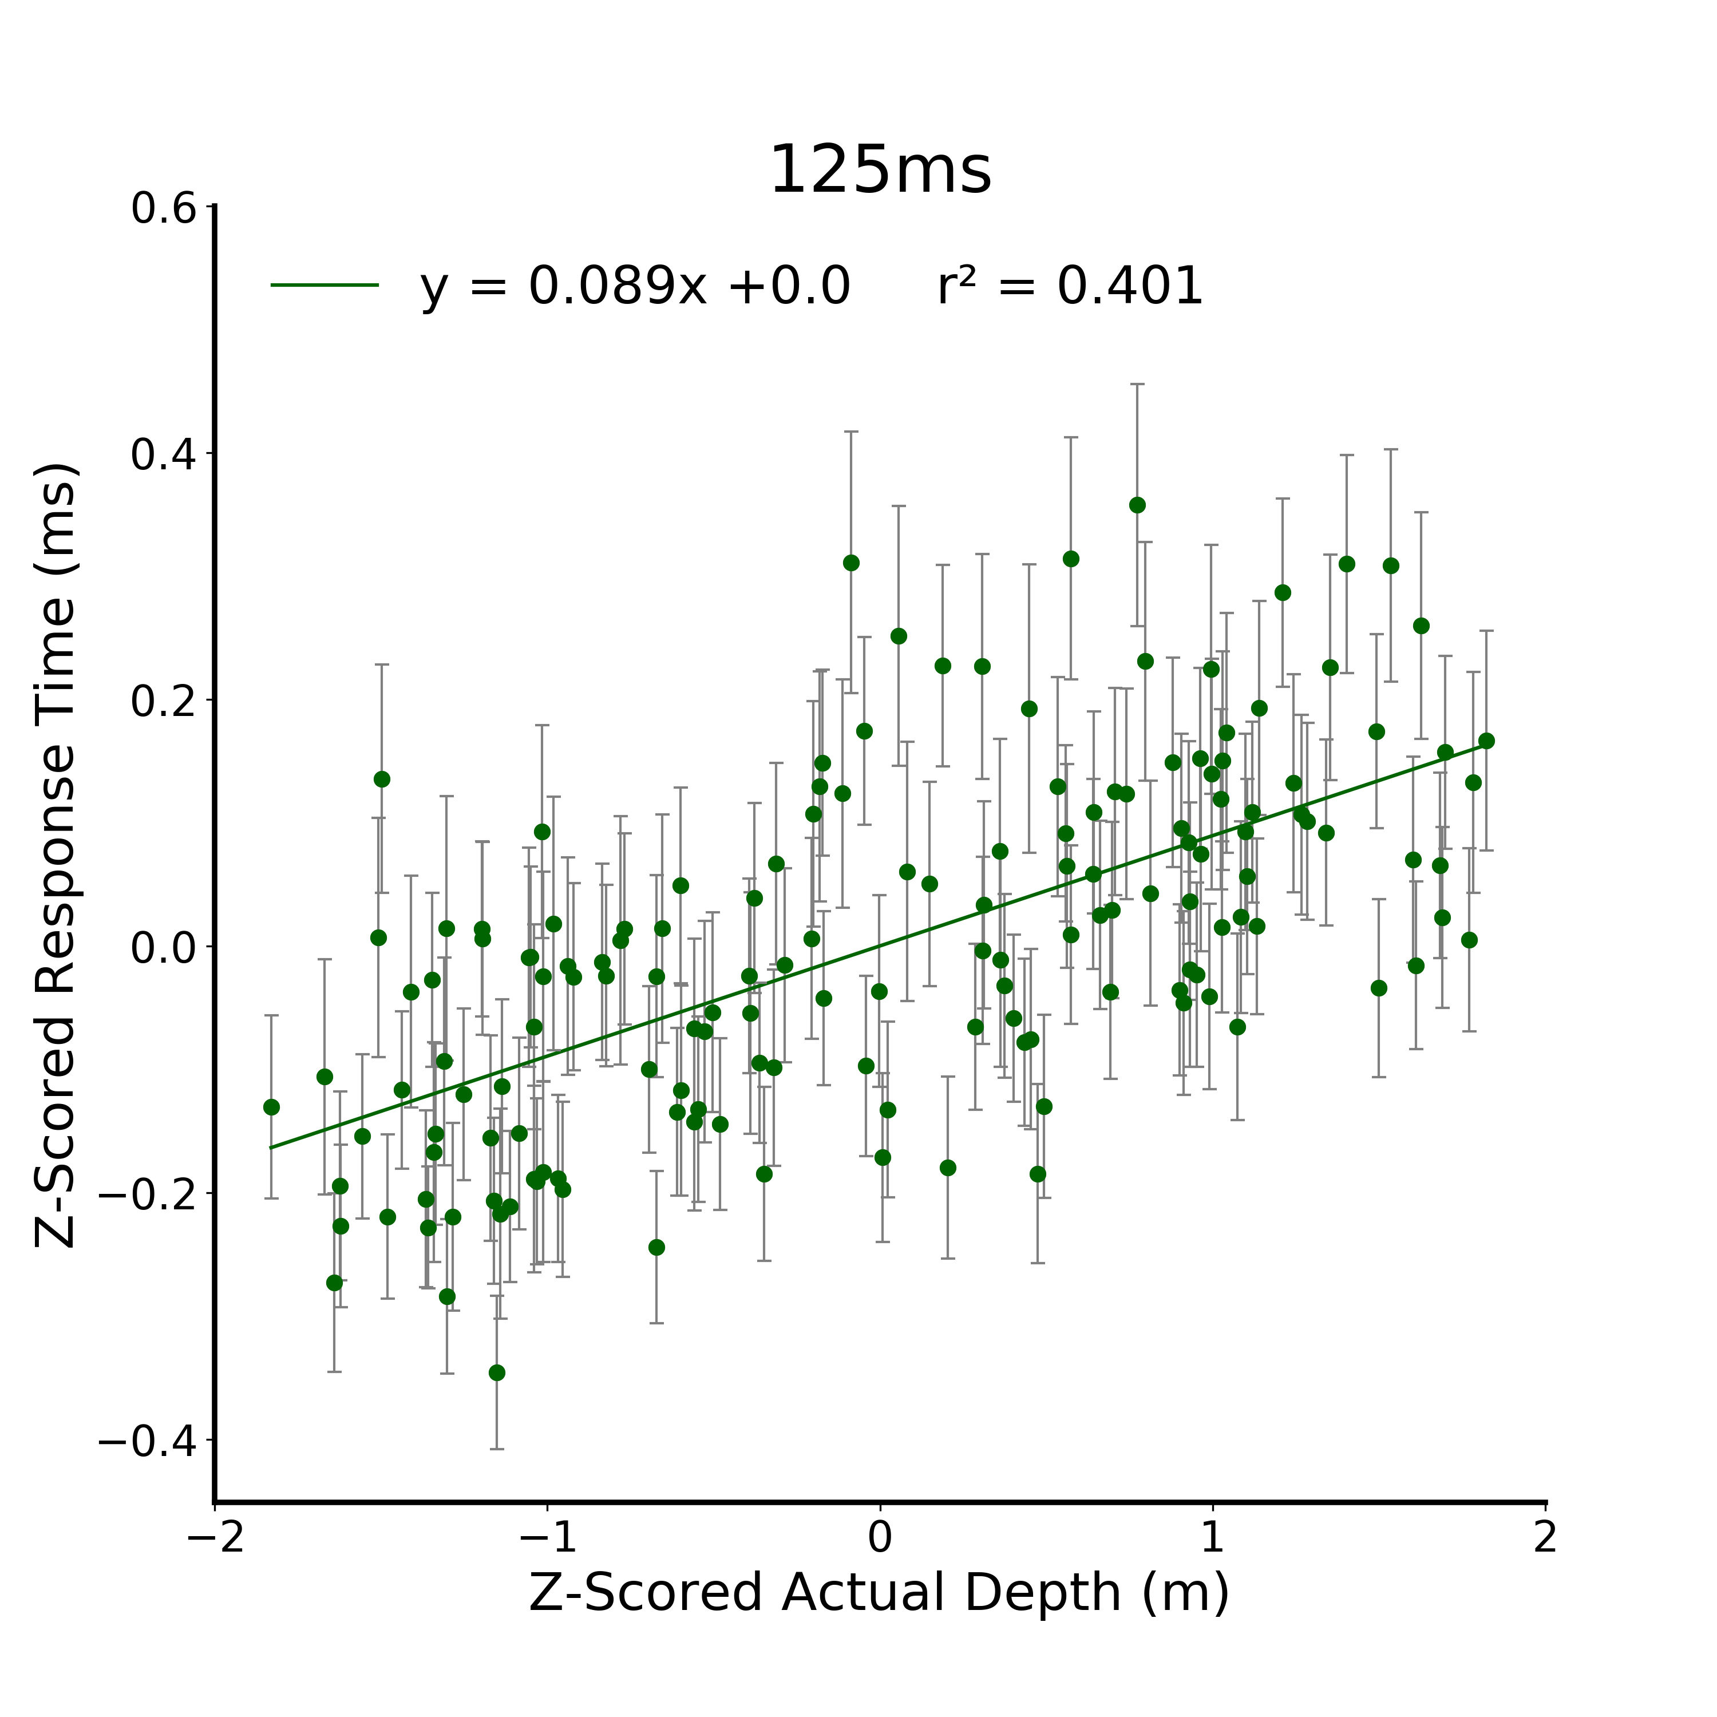
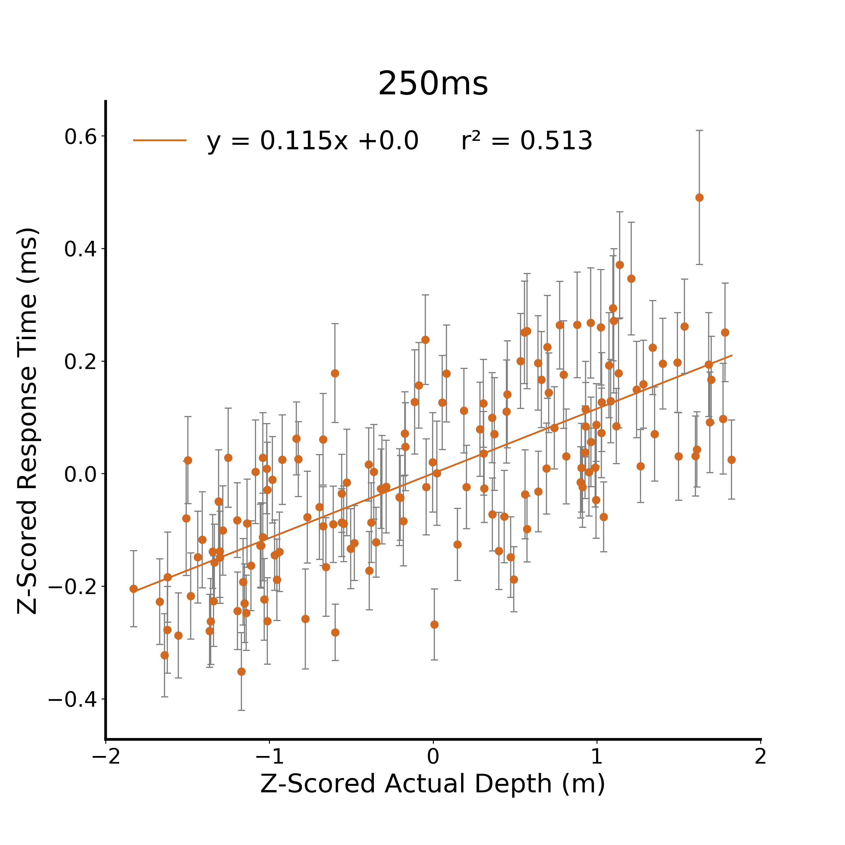
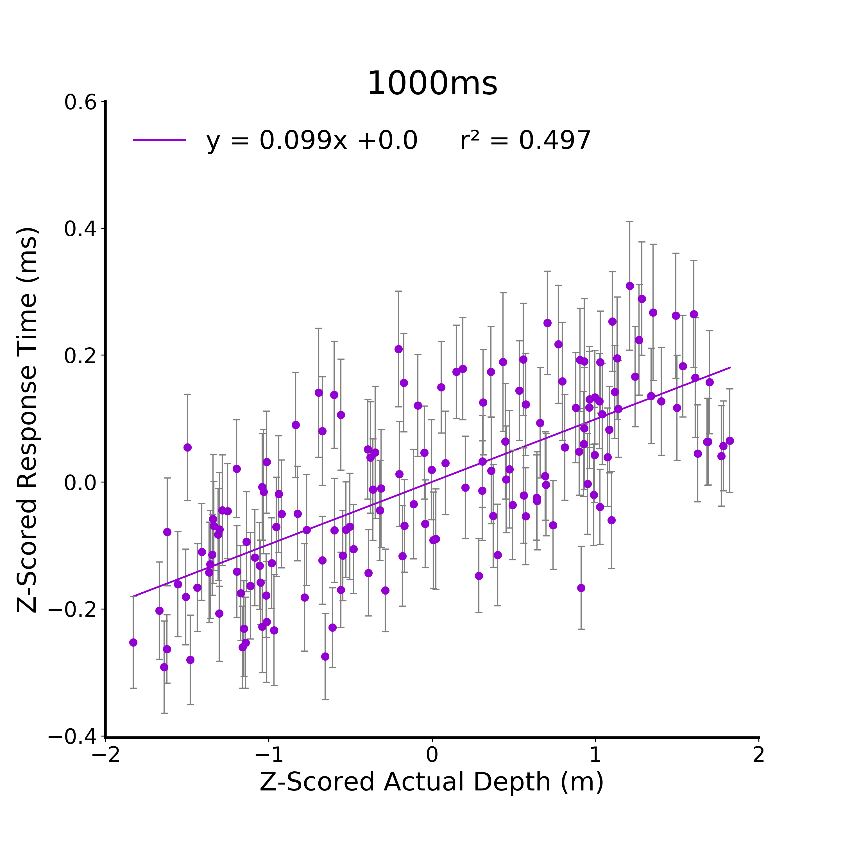
A.
B.
C.
D.
Figure 4. Verbal Estimate Response Time Linear Models. A) Raw response time from the verbal estimate task for the 125 ms viewing duration condition. Participants are independent between viewing duration conditions and all error bars in plots are between subjects standard error. C) Z-scored response time at 125ms. B) Z-scored response time at 250ms. D) Z-scored response time at 1000ms.

Slide 8


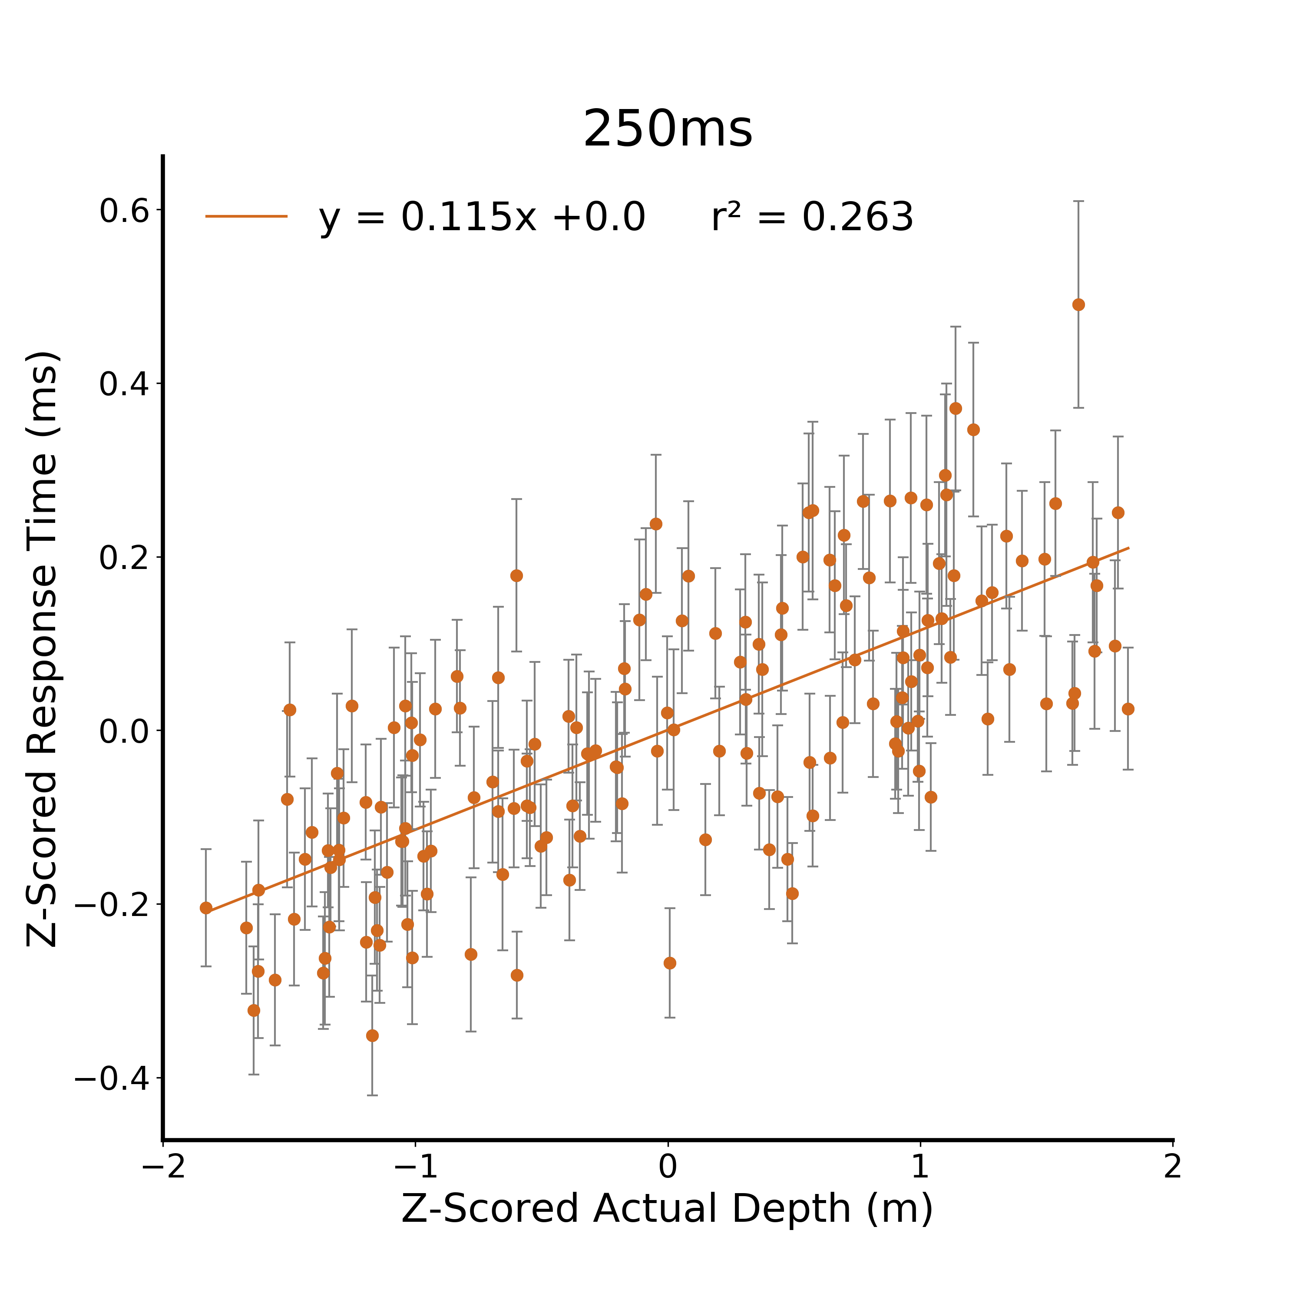

A..
B.
C.
D.
Figure 4. Verbal Estimate Response Time Linear Models. A) Raw response time from the verbal estimate task for the 125 ms viewing duration condition. Participants are independent between viewing duration conditions and all error bars in plots are between subjects standard error. C) Z-scored response time at 125ms. B) Z-scored response time at 250ms. D) Z-scored response time at 1000ms.
Notes:
Add to figure text: intercepts are not reported since they are all 0

Slide 9
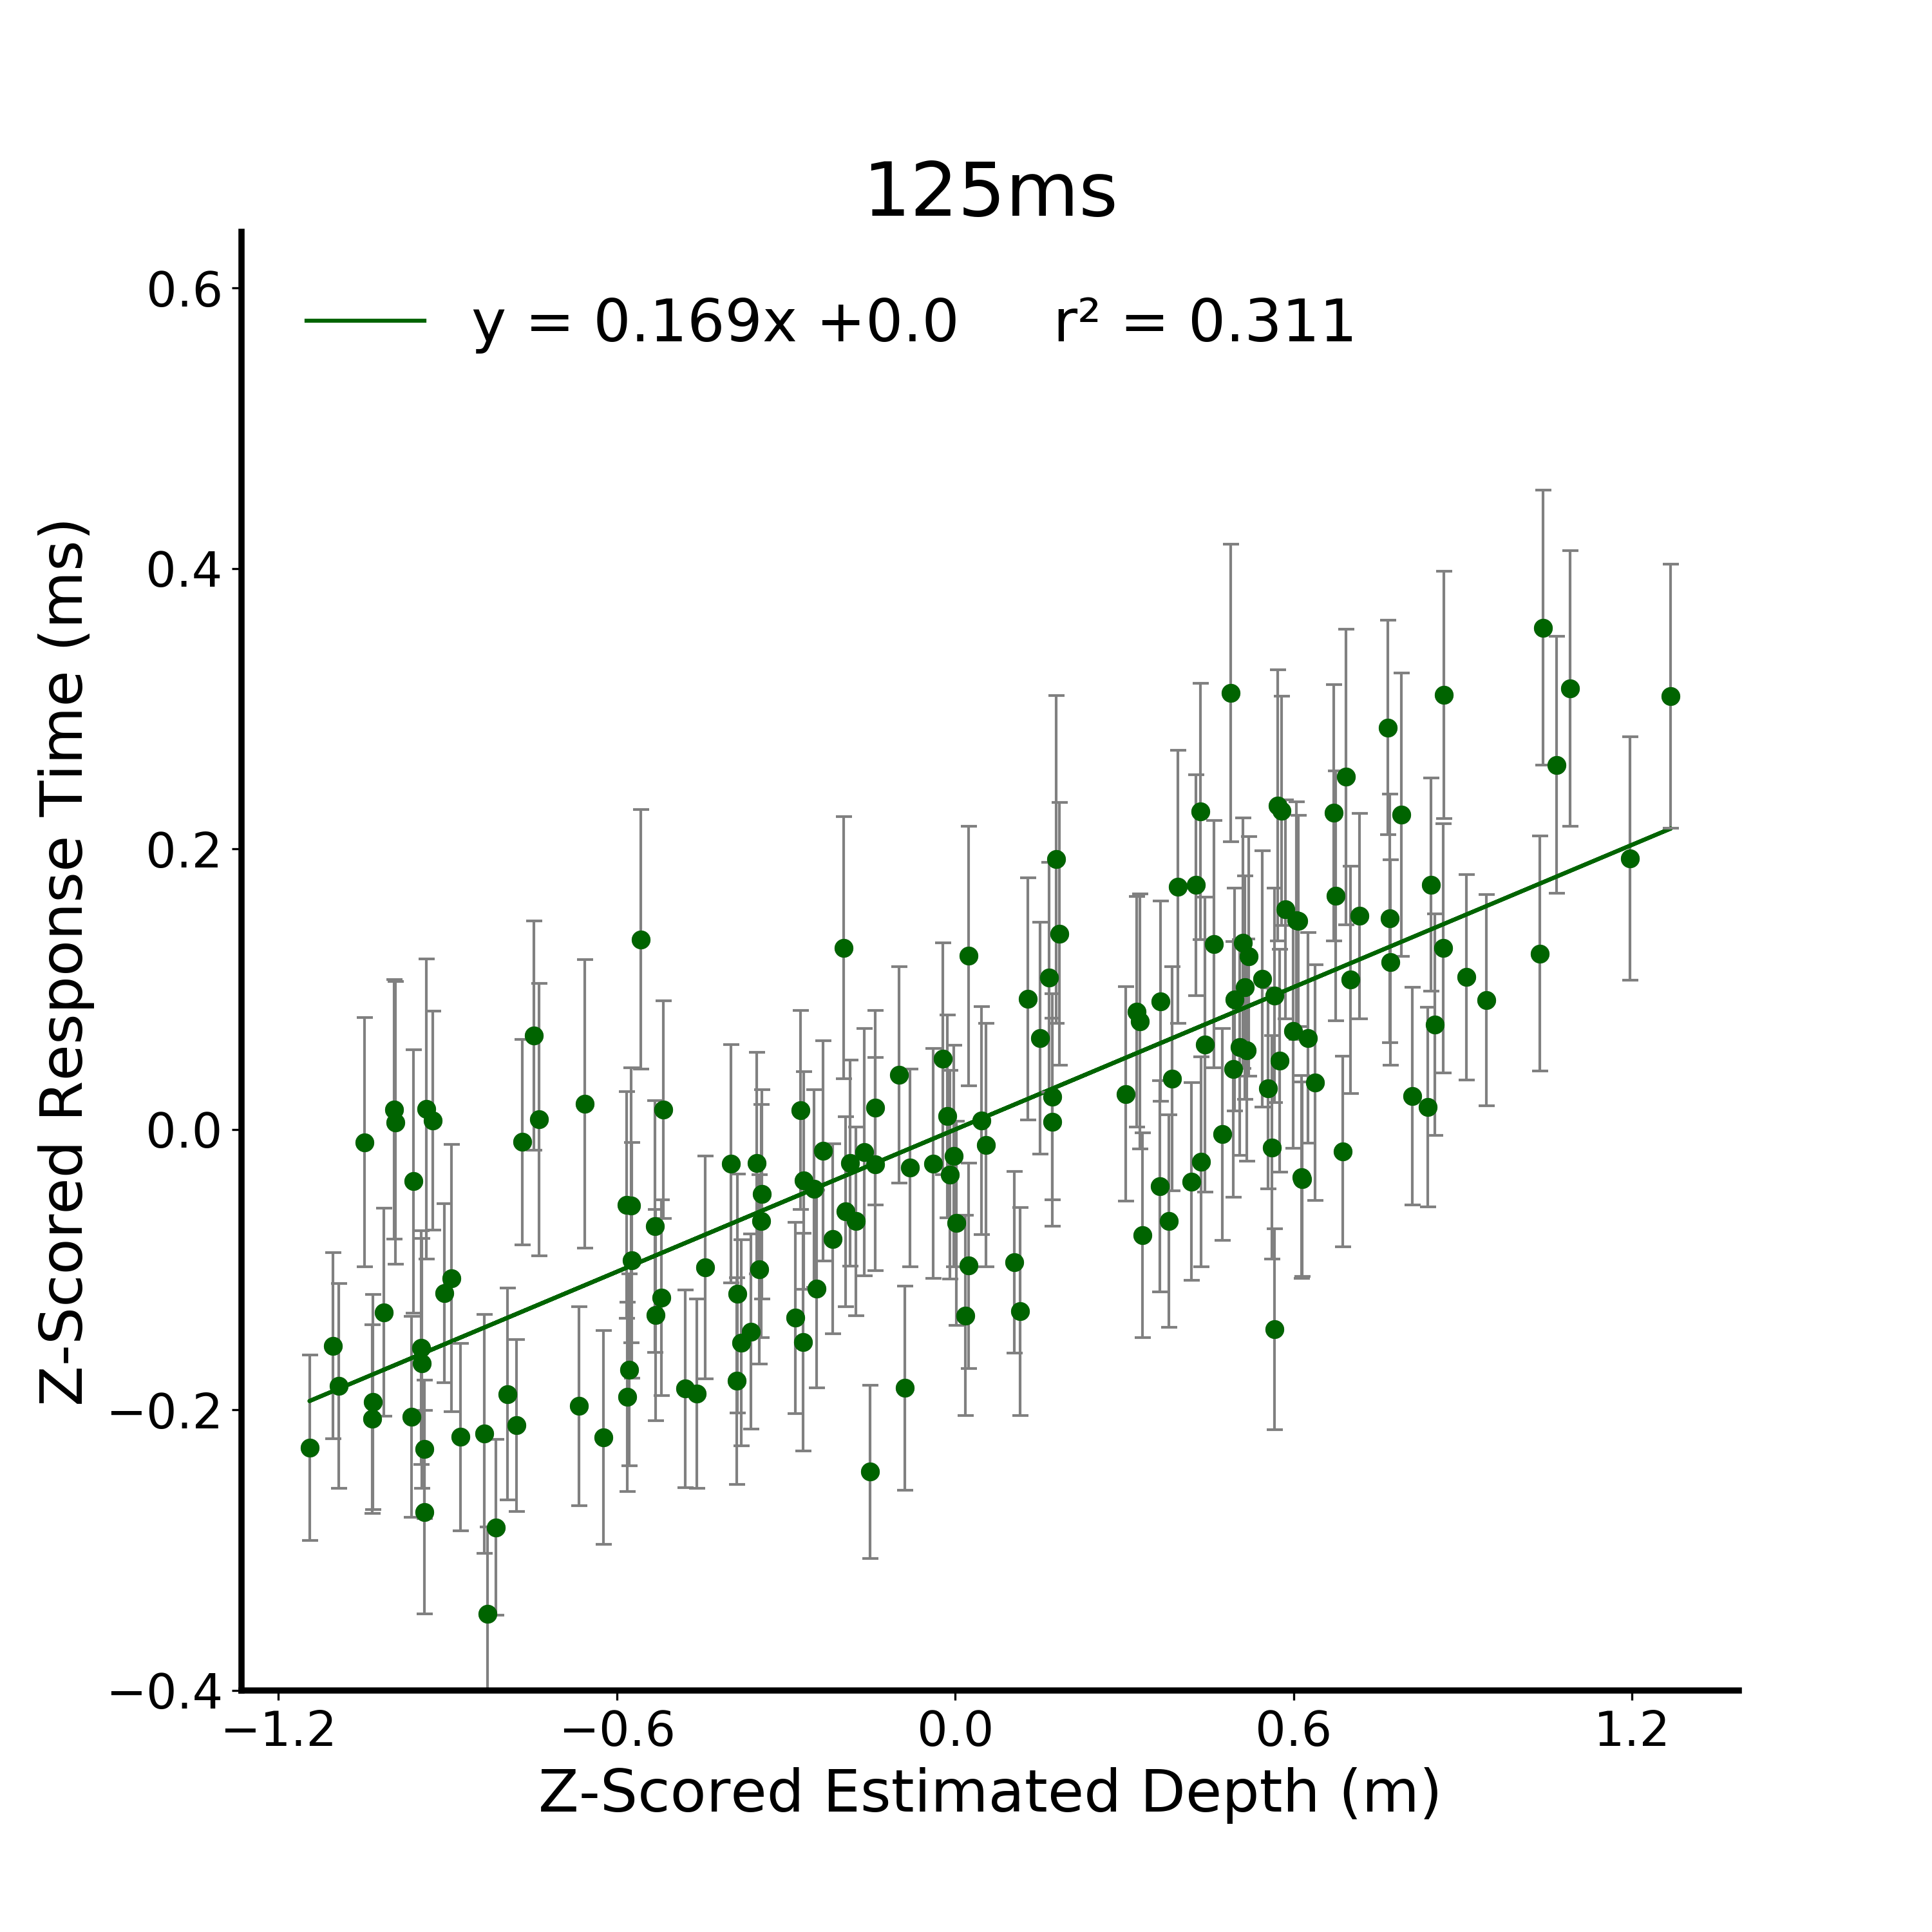
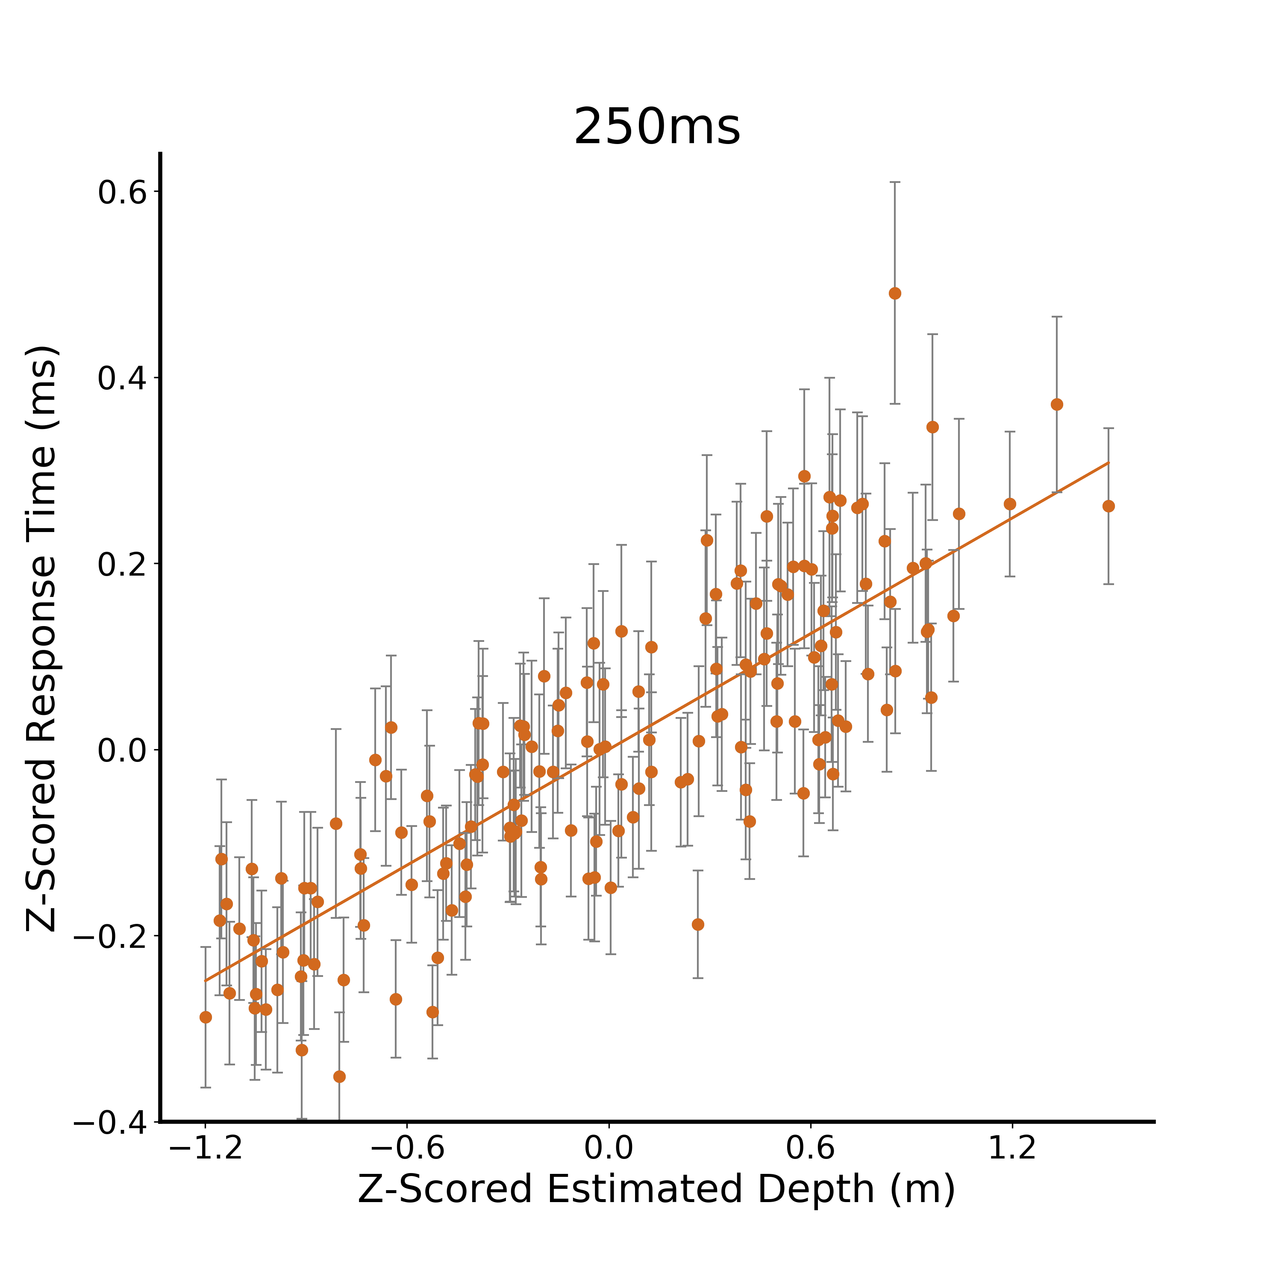
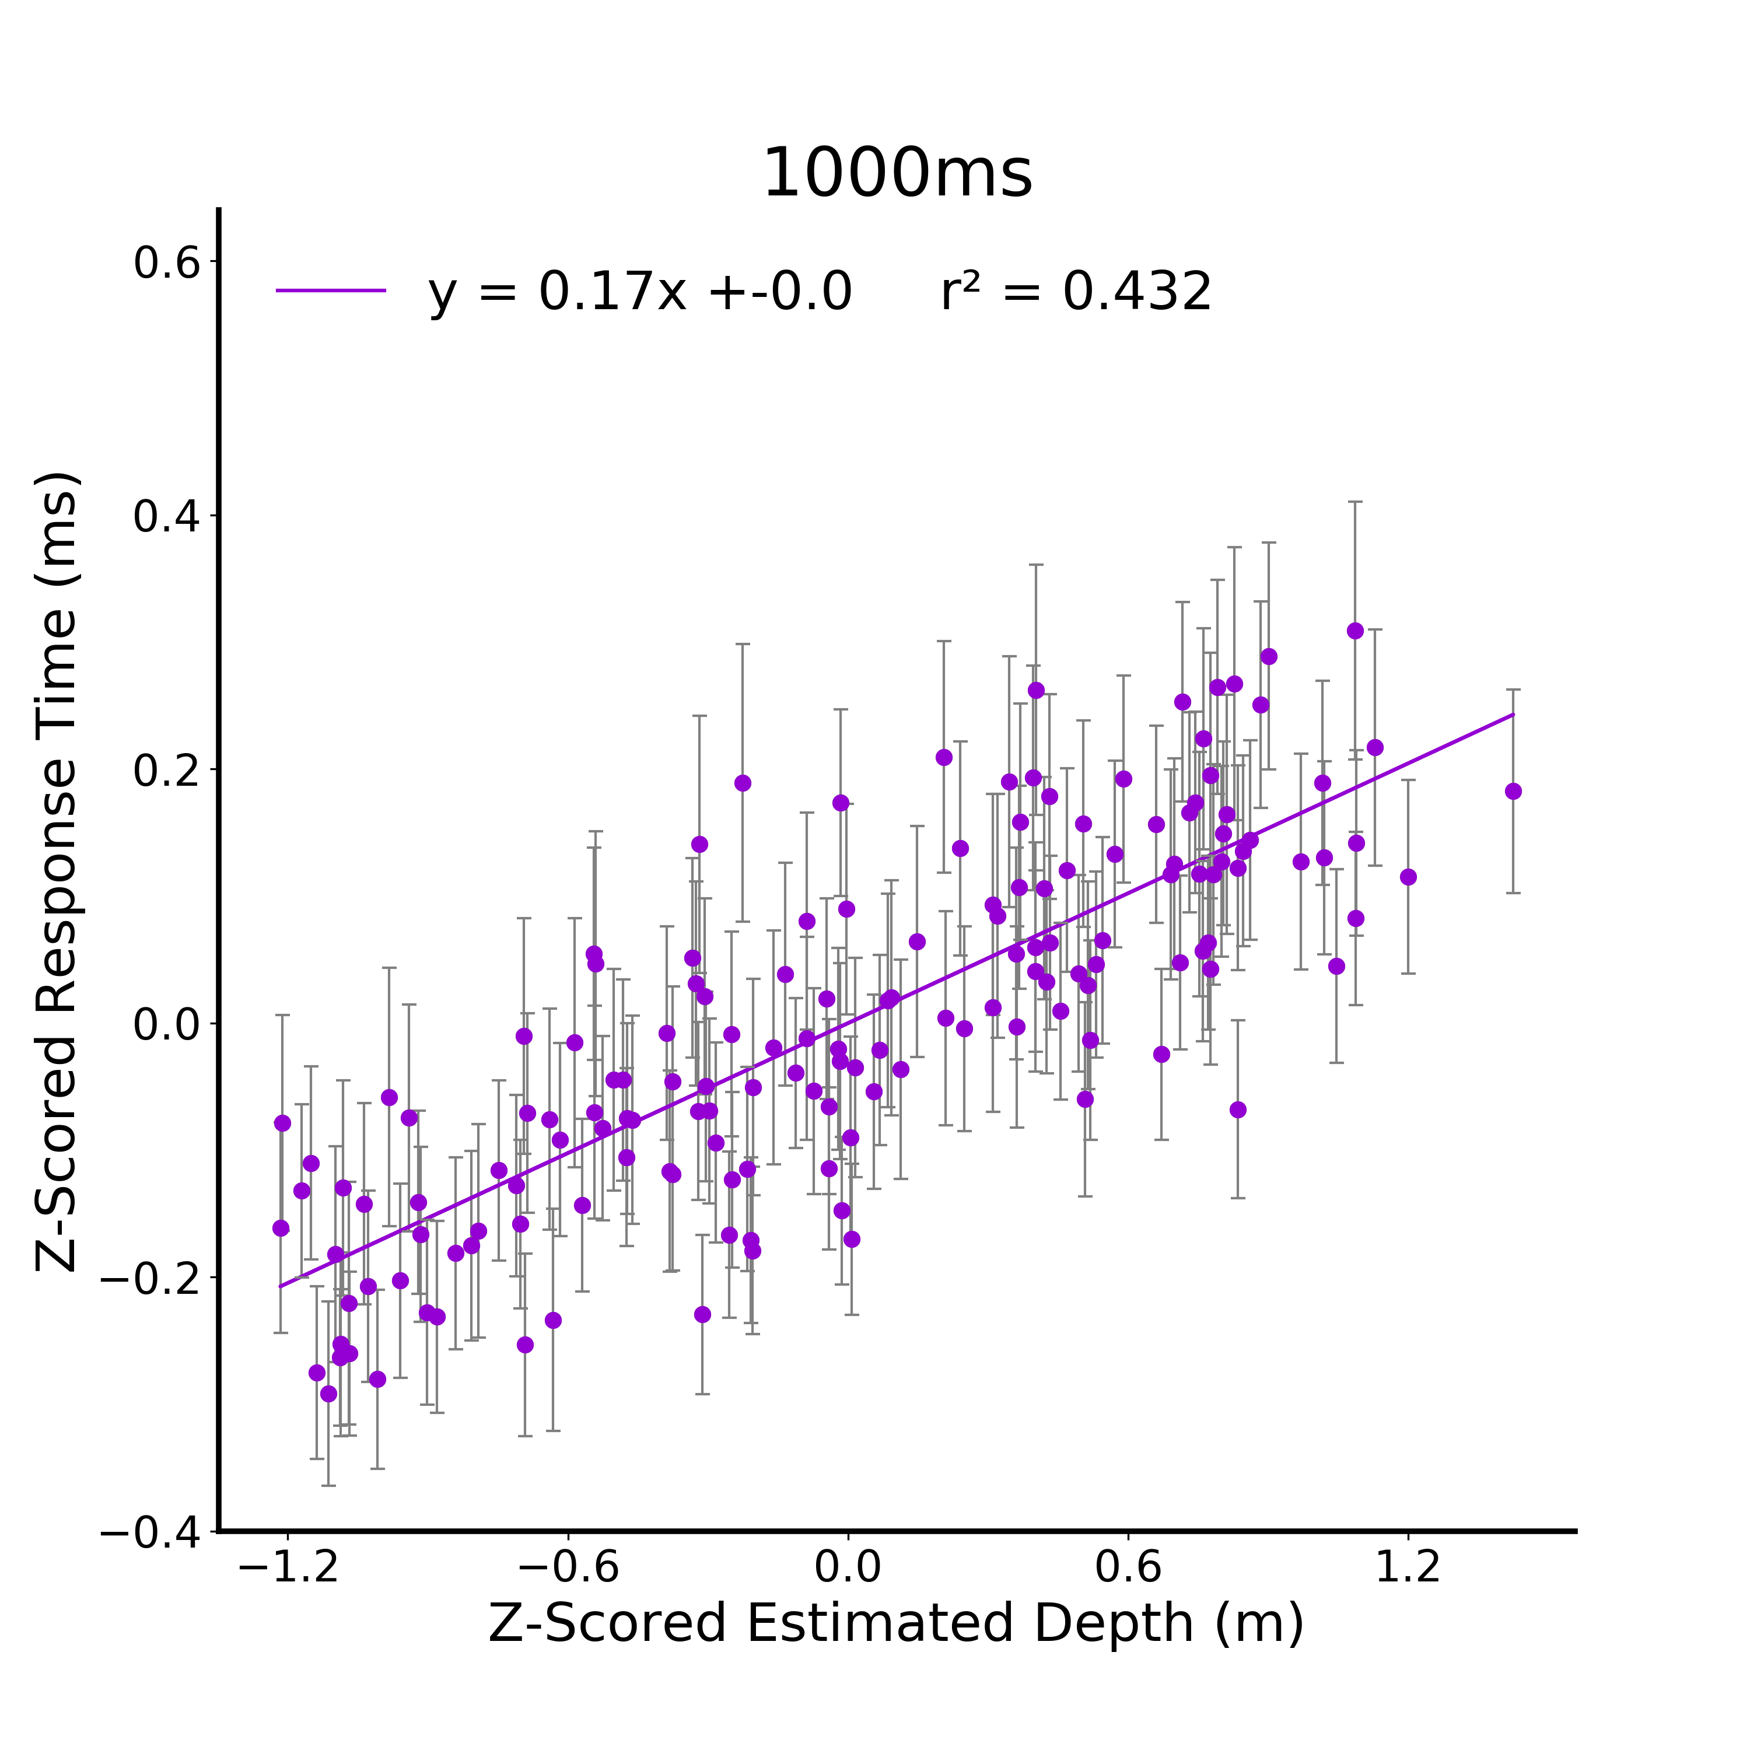
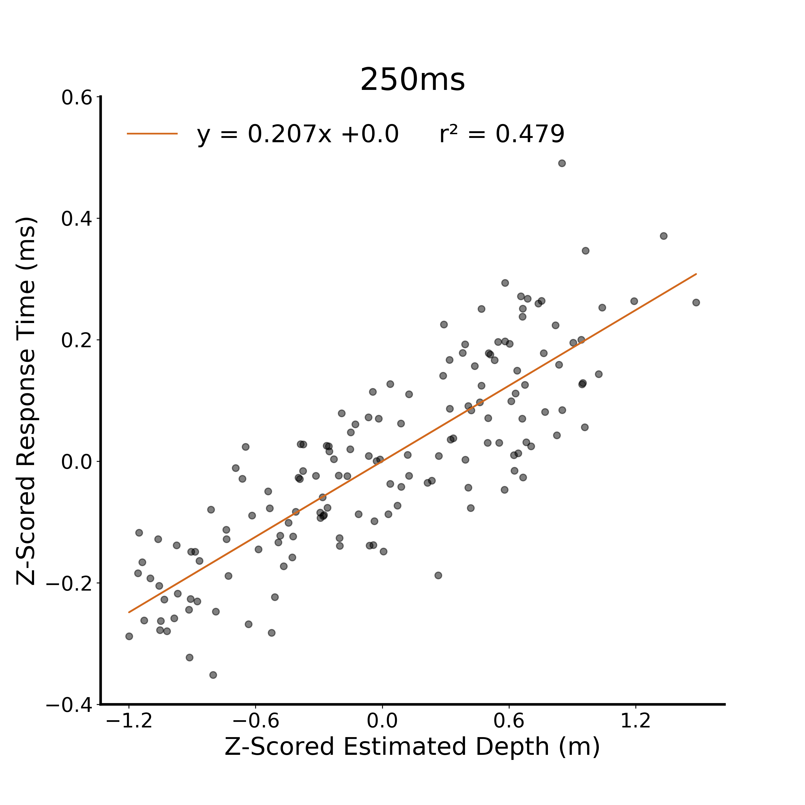
A.
B.
C.
D.
E.
E.
Figure 4. Verbal Estimate Response Time Linear Models. A) Raw response time from the verbal estimate task for the 125 ms viewing duration condition. Participants are independent between viewing duration conditions and all error bars in plots are between subjects standard error. B) Z-scored response time at 125ms. C) XX D) XX E) XX
Notes:
Add to figure text: intercepts are not reported since they are all 0

Slide 10
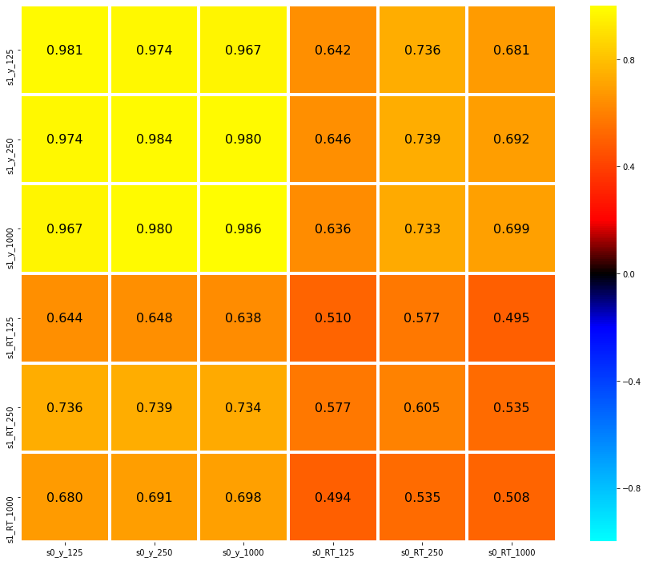

Slide 11
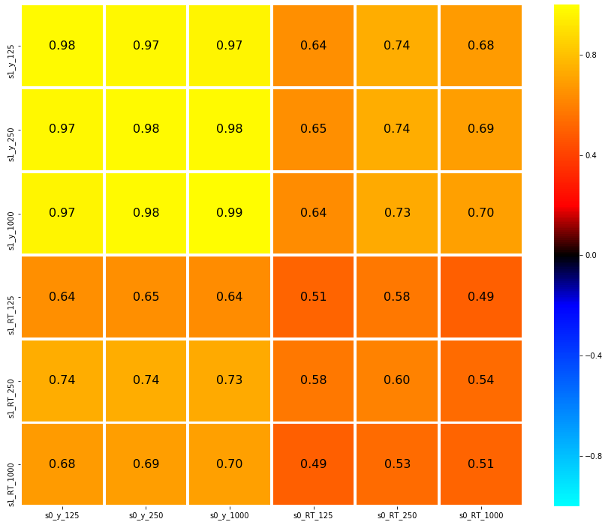
125
0.8
Depth Estimate
250
0.4
1000
*
0.16
0
Correlation
*
125
- 0.16
- 0.4
Response Time
250
1000
- 0.8
125
250
1000
125
250
1000
Depth Estimate
Response Time
Figure 5. Verbal Estimate Average Correlation Matrix. Data were randomly split in half and correlated against itself. This was repeated 10,000 times resulting in this average correlation matrix. Given a sample size of 156 images and a significance level of 0.05, r >= 0.16 are significant. Within task outcome correlations are significant within and between viewing durations, demonstrating strong reliability between independent groups of participants. Significant correlations between task outcome (response time, depth estimate) and viewing durations were also observed, indicating stimulus-level generalization.

Slide 12
125
0.8
Depth Estimate
250
0.4
1000
0.16
*
Correlation
0
125
- 0.16
*
Response Time
- 0.4
250
1000
- 0.8
125
250
1000
125
250
1000
Depth Estimate
Response Time
Figure 5. Verbal Estimate Average Correlation Matrix. Data were randomly split in half and correlated against itself. This was repeated 10,000 times resulting in this average correlation matrix. Given a sample size of 156 images and a significance level of 0.05, r >= 0.16 are significant. Within task outcome correlations are significant within and between viewing durations, demonstrating strong reliability between independent groups of participants. Significant correlations between task outcome (response time, depth estimate) and viewing durations were also observed, indicating stimulus-level generalization.
Notes:
DONE

Slide 13
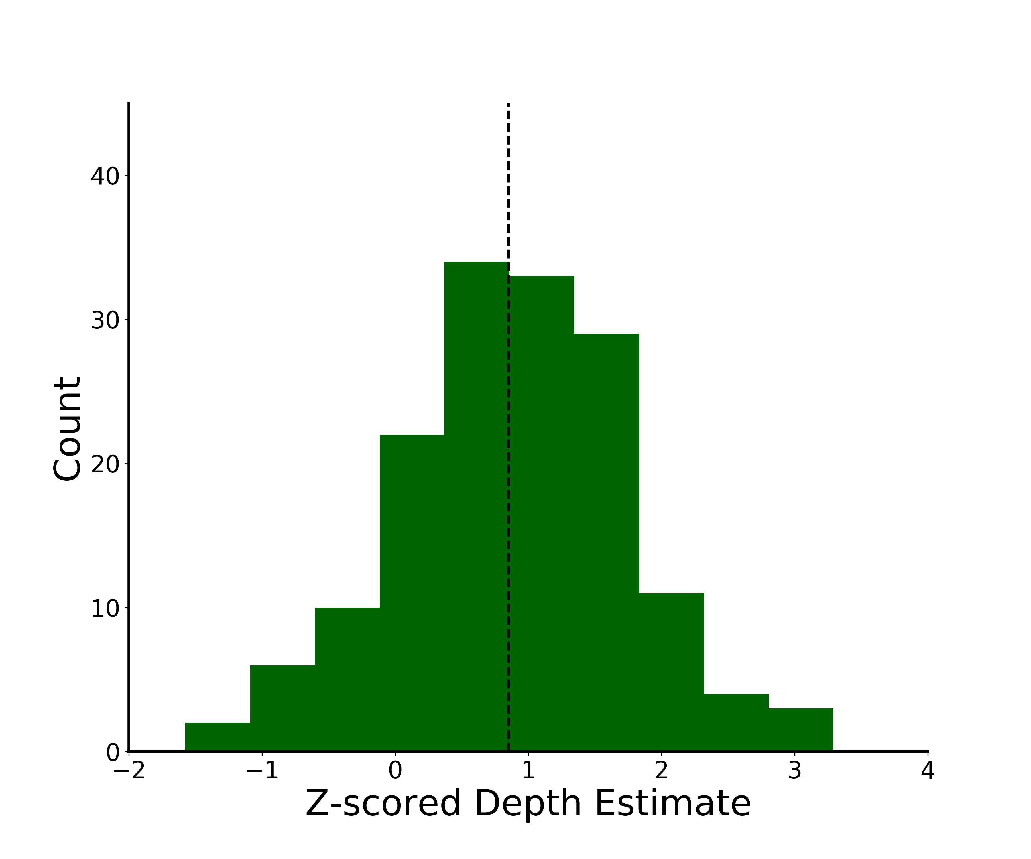
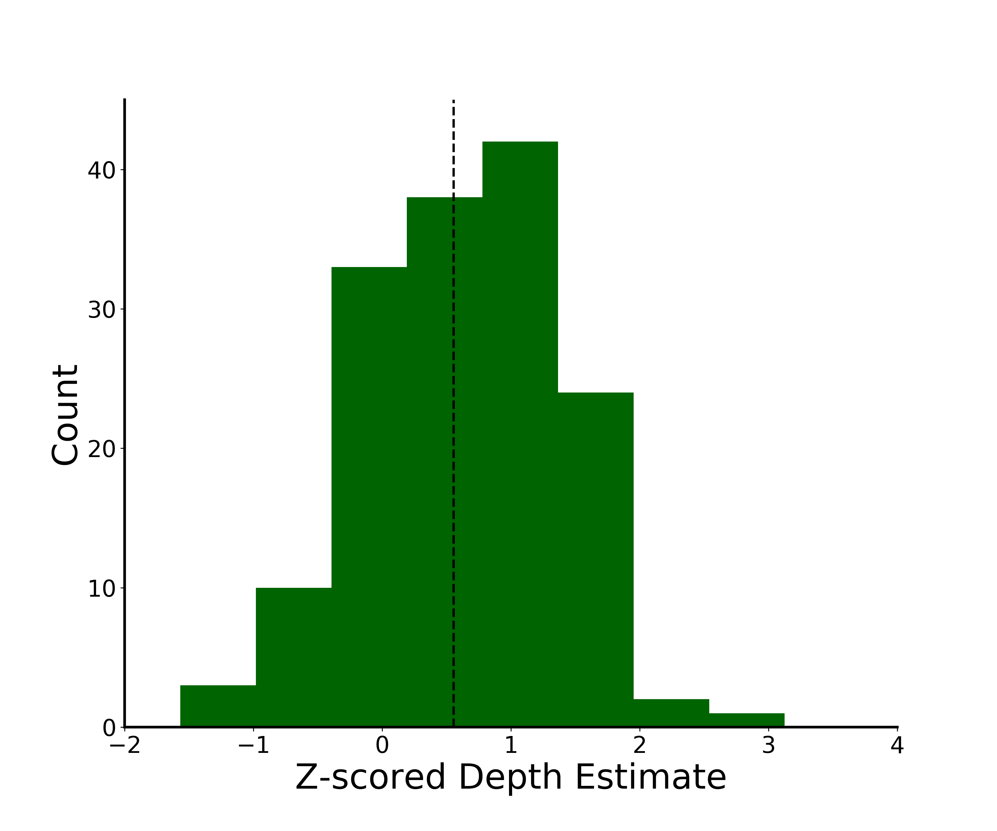
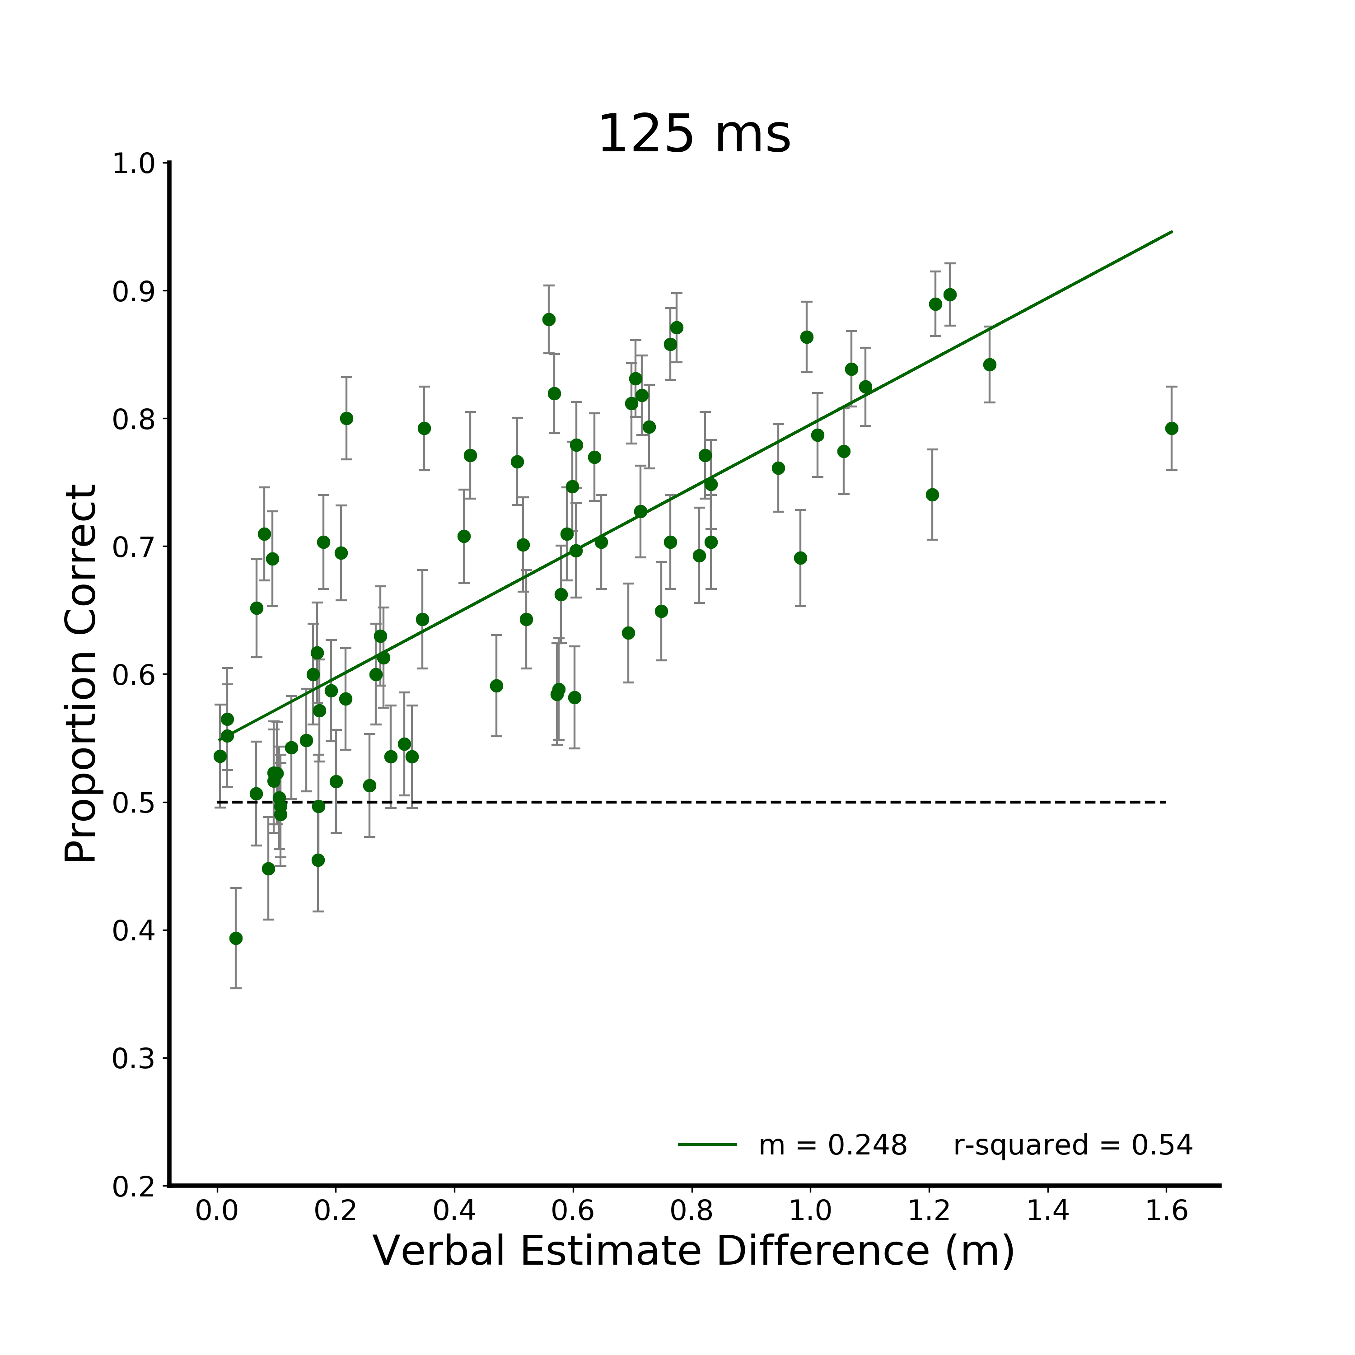
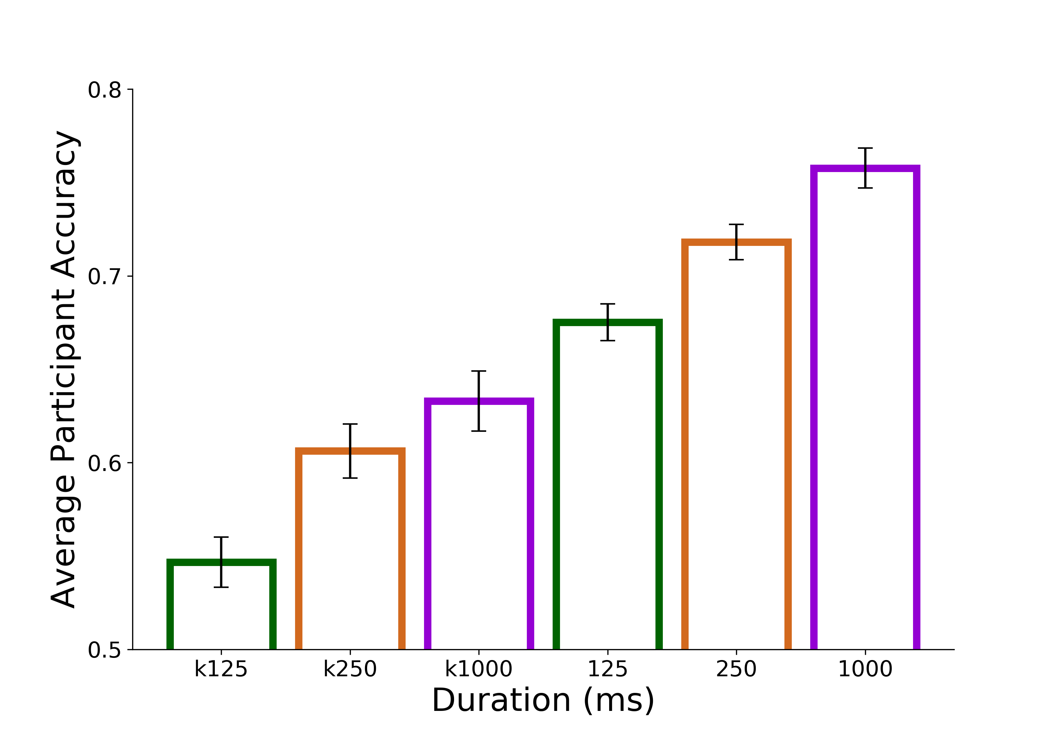
A.
B.
- - - Average Verbal
Estimate
Kinect Depth = 4.6 m
- - - Average Verbal
Estimate
Kinect Depth = 4.2 m
Which target was closer to you?
C.
F.
Verbal Estimate
*
***
***
Figure 4. Discrimination Accuracy Results. A) Linear model of discrimination accuracy as a function of the Kinect depth difference between targets for the 125 ms viewing duration condition. B) Sample transformation to derive discrimination accuracy as a function of verbal estimates. The distribution of z-scored verbal estimates is plotted for the two stimuli of a sample discrimination trial. Based off the Kinect the correct discrimination response would be stimulus 1, however as a function of verbal estimates the correct response is stimulus 0 (circled in red). C) Linear models of discrimination accuracy as a function of verbal estimates from independent participants at each viewing duration (125, 250, 1000 ms) D)Discrimination accuracy as a function of the Kinect (bars with colored outline) and as a function of differences in verbal estimates from independent participants (* indicates p<0.05; ** p<0.005; *** p<0.0005)
Kinect
**
Notes:
Highlight the trial in A that is shown in B – have color of point match color of distribution; remove Kinect depth labeling and just put in figure text
Put the histograms on the same axis
Formula (d prime) – diff between z scored estimates/std * see what we did and add that in → if its just diff between verbal estimate formula is not needed; panel b is only useful if we are dividing by std dev
F. Bigger separation between Kinect and VE; add legend for open and filled in

Slide 14
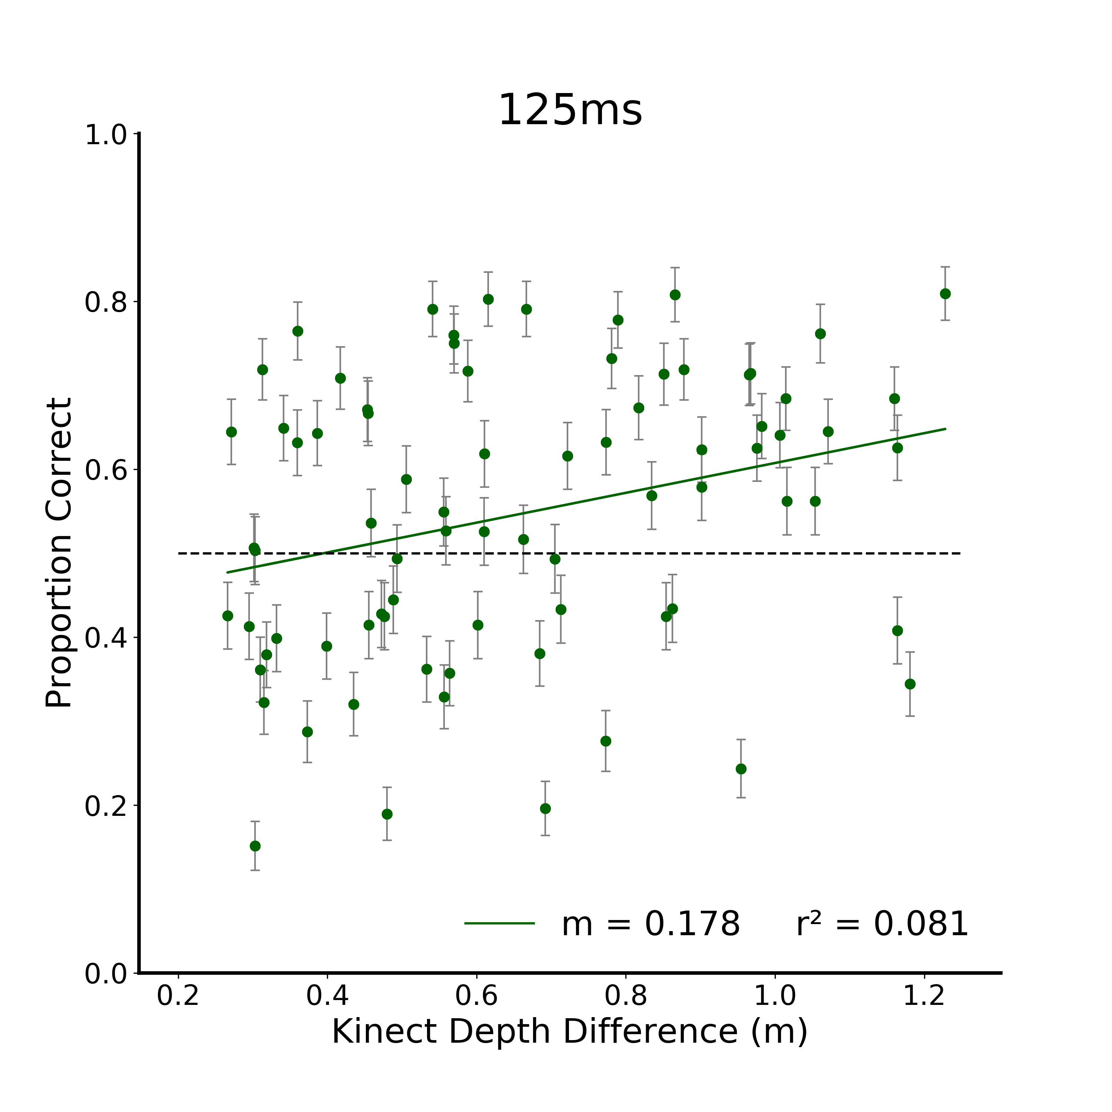
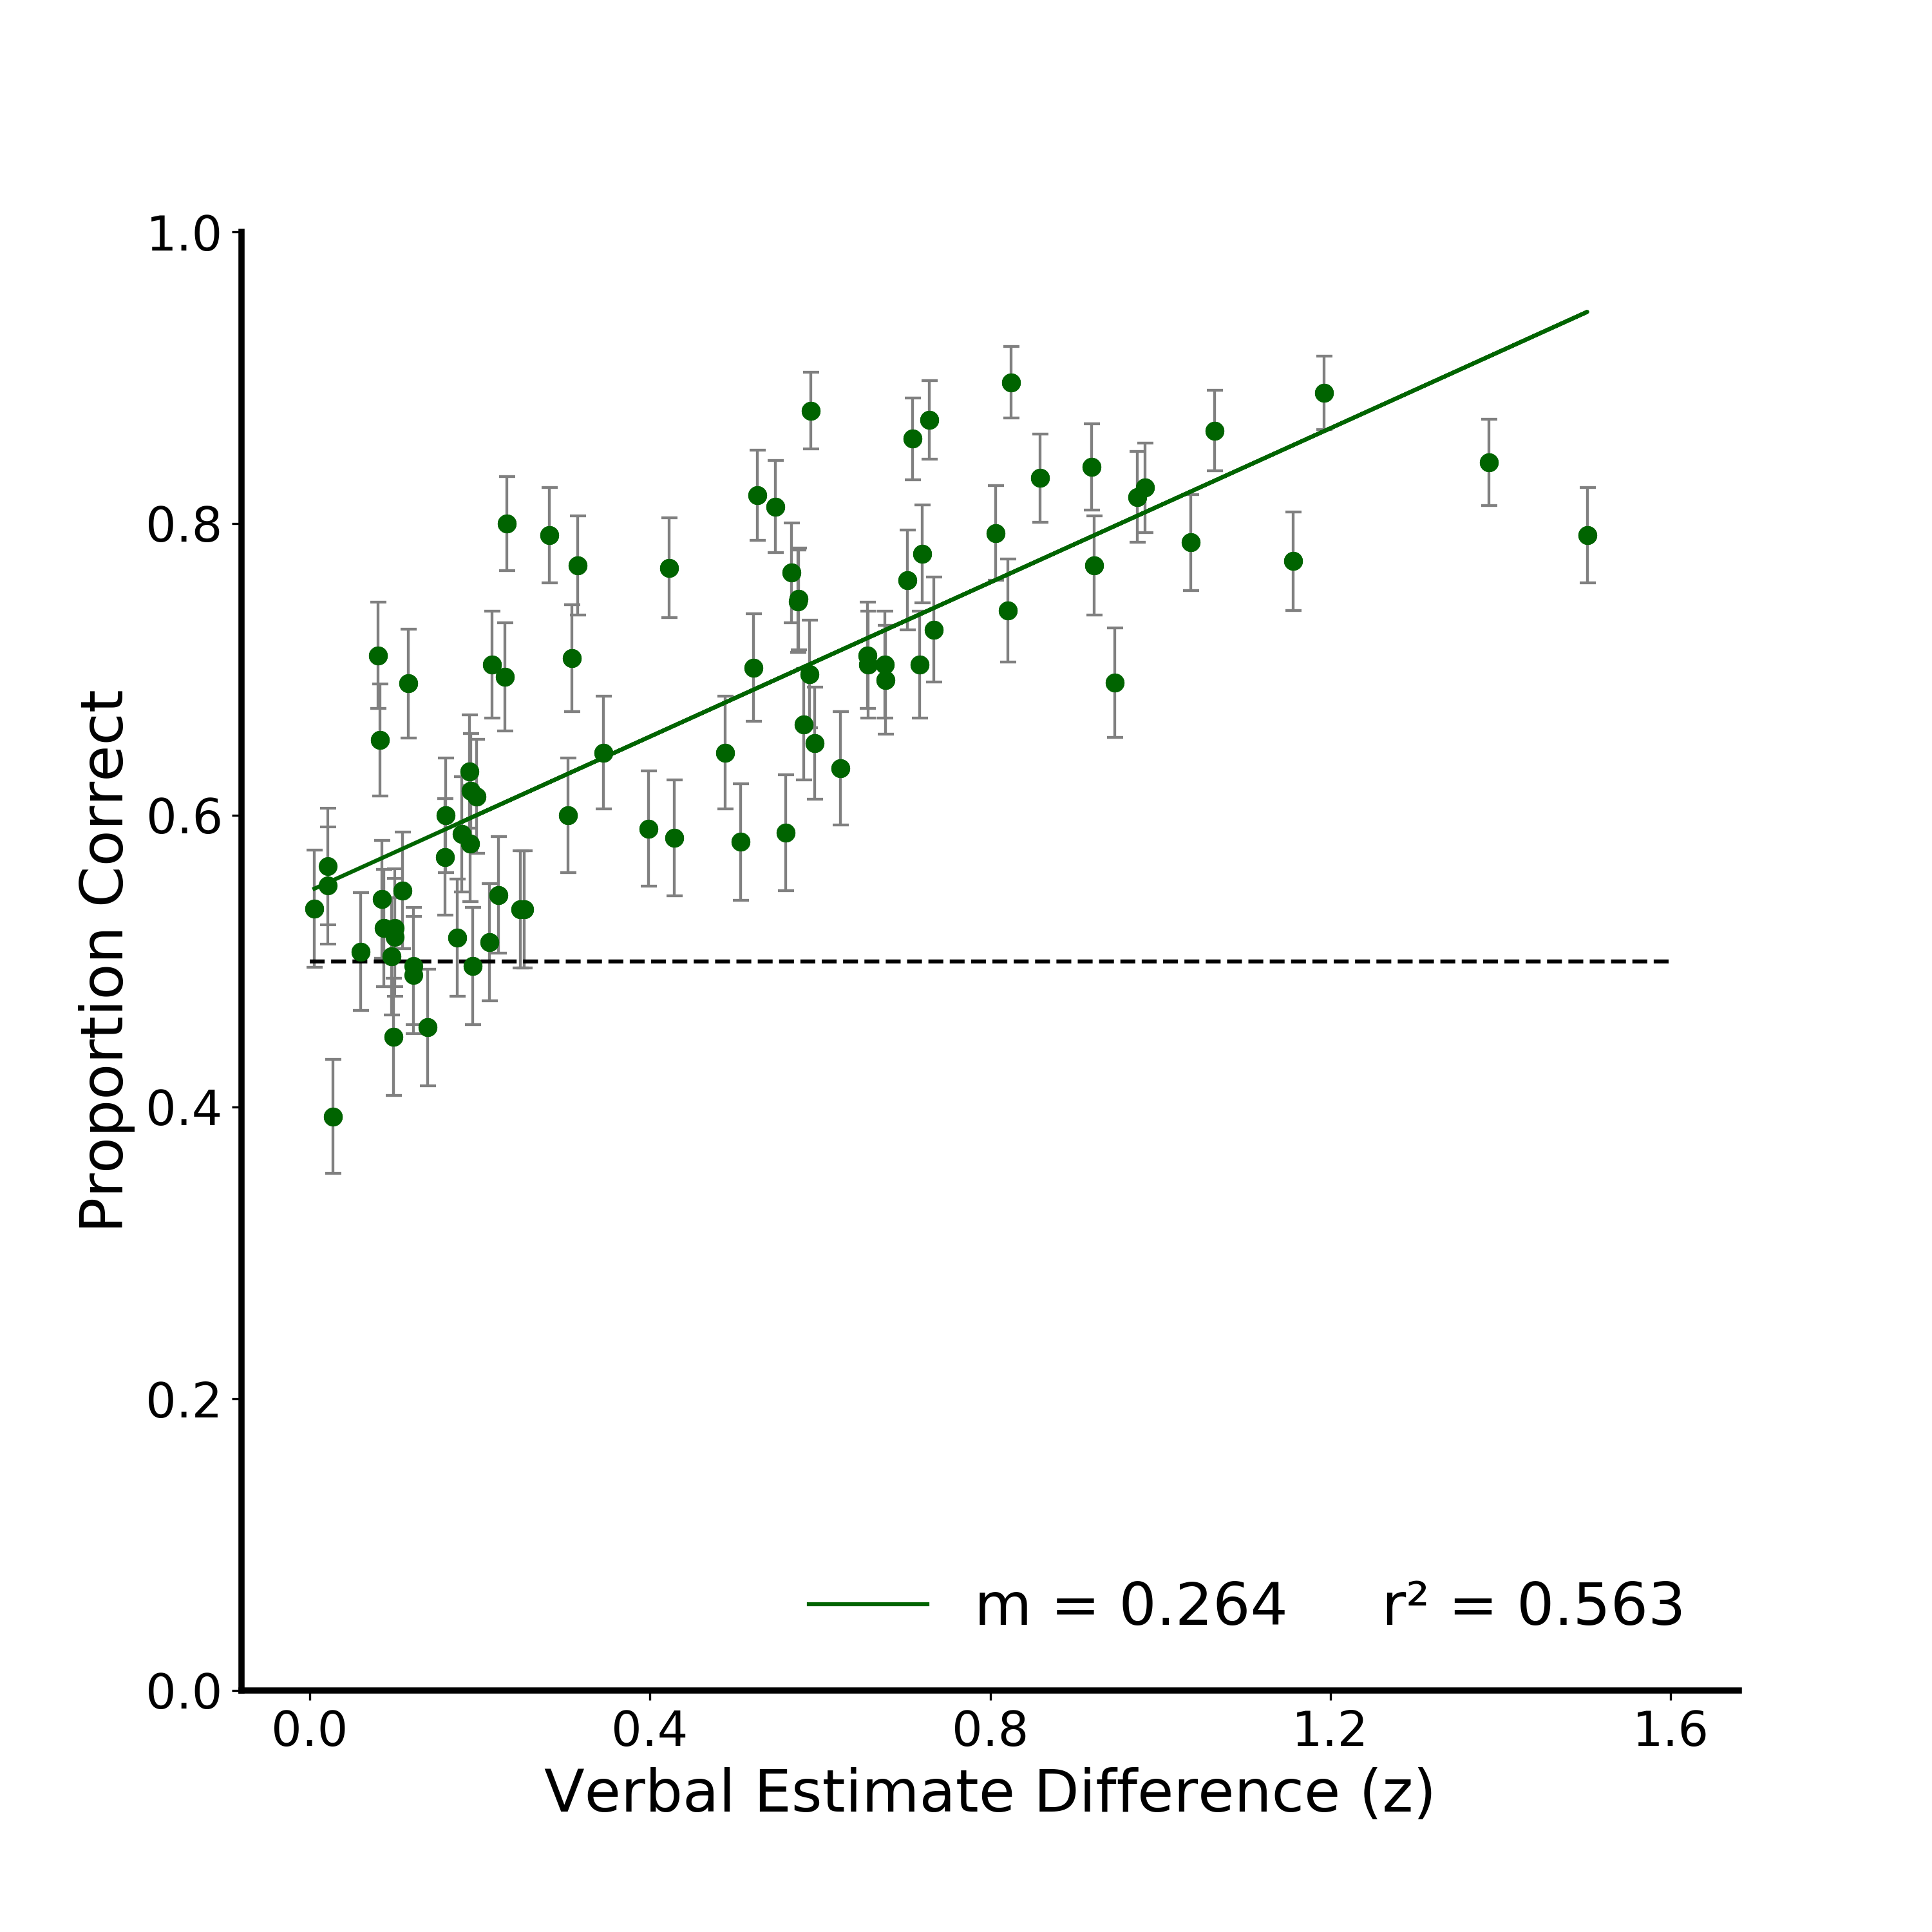
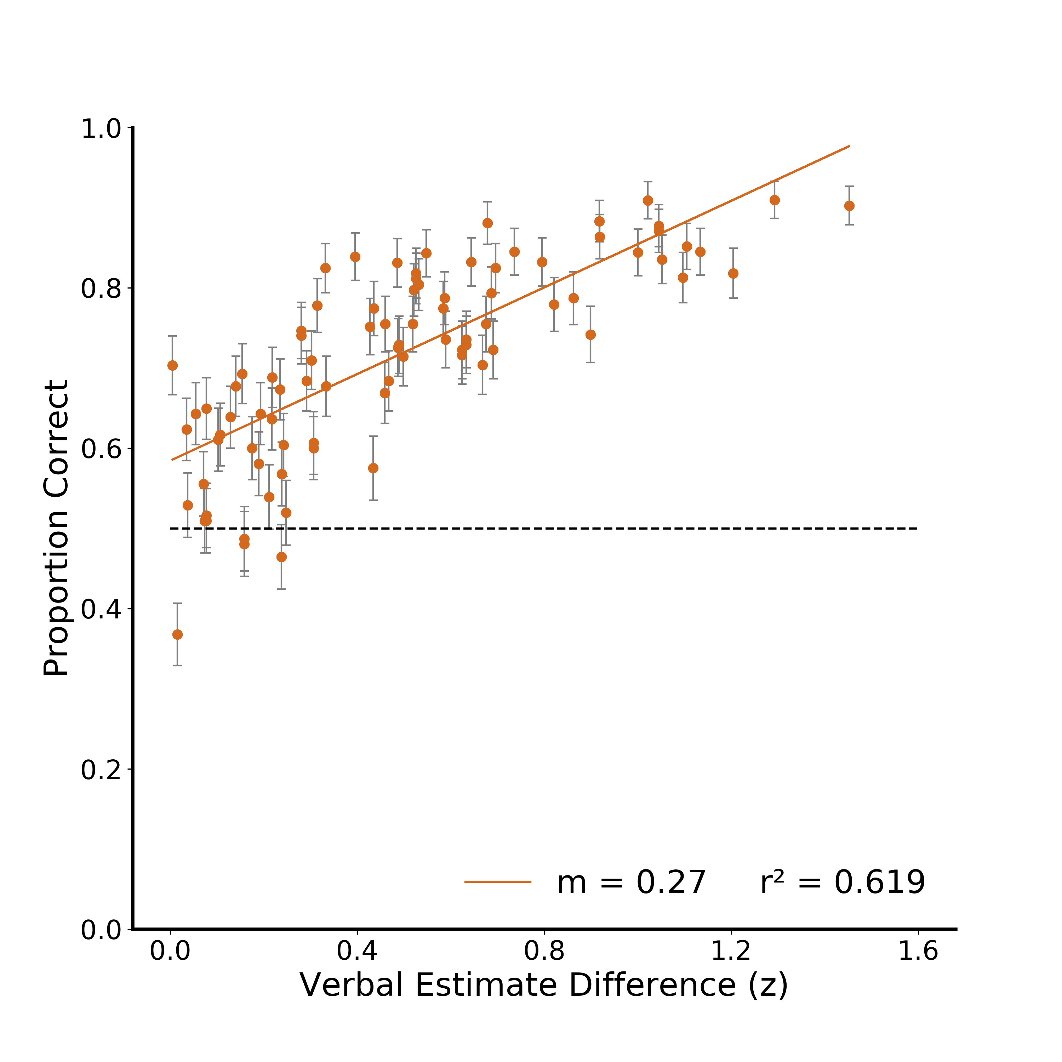
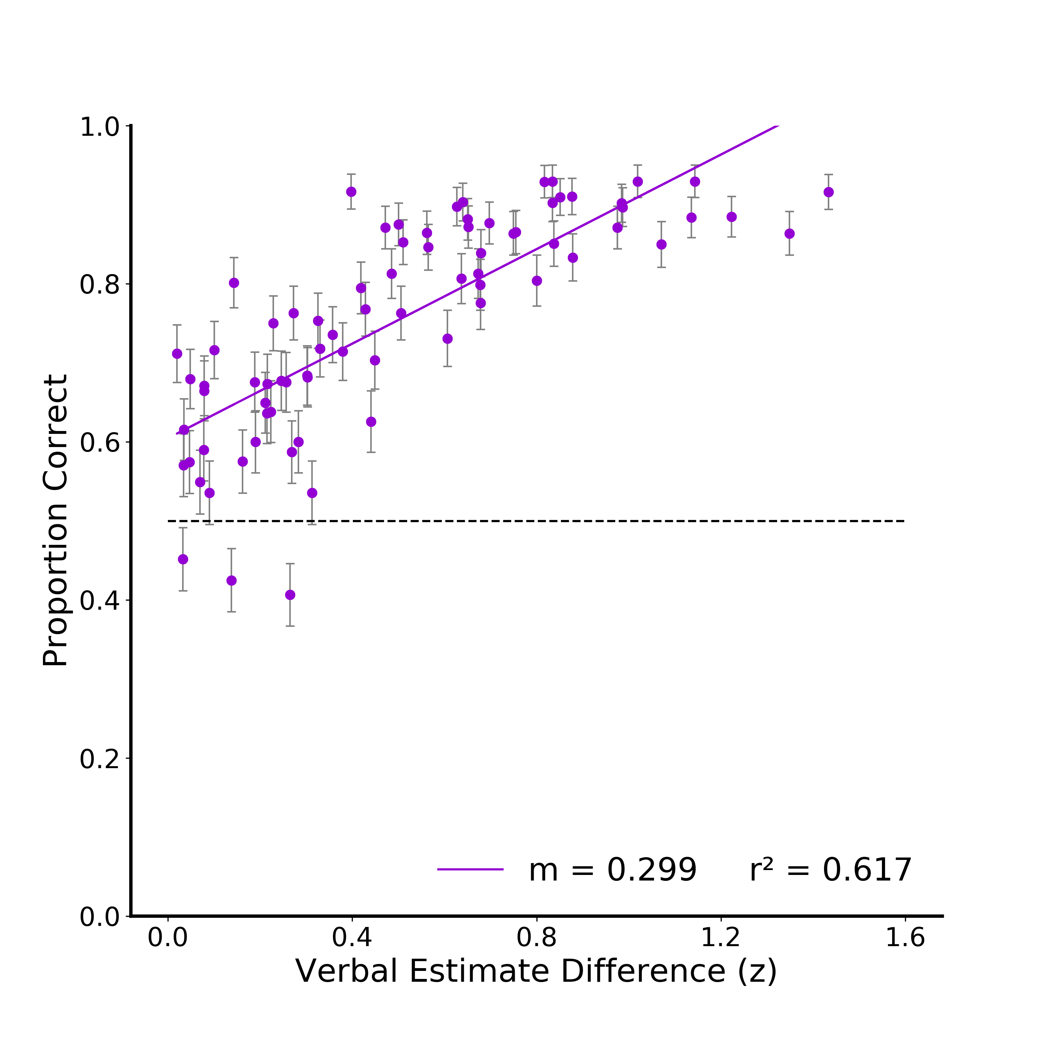
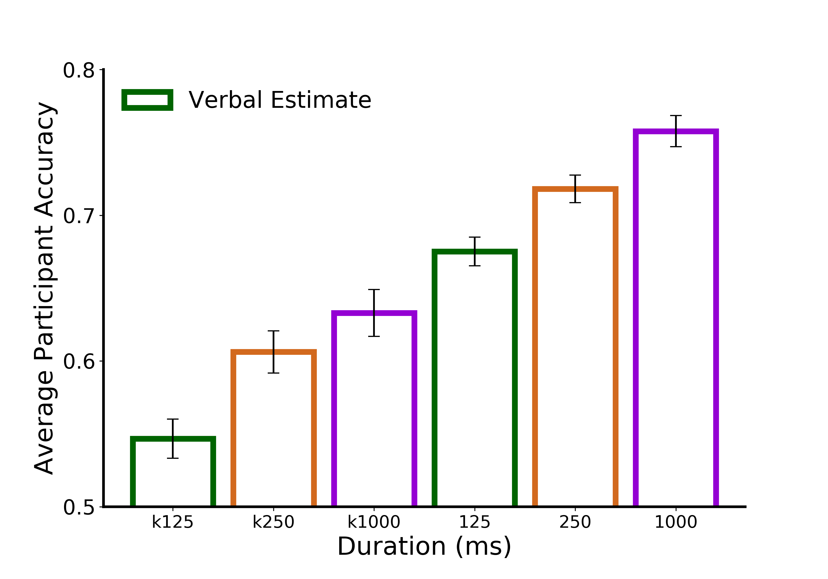
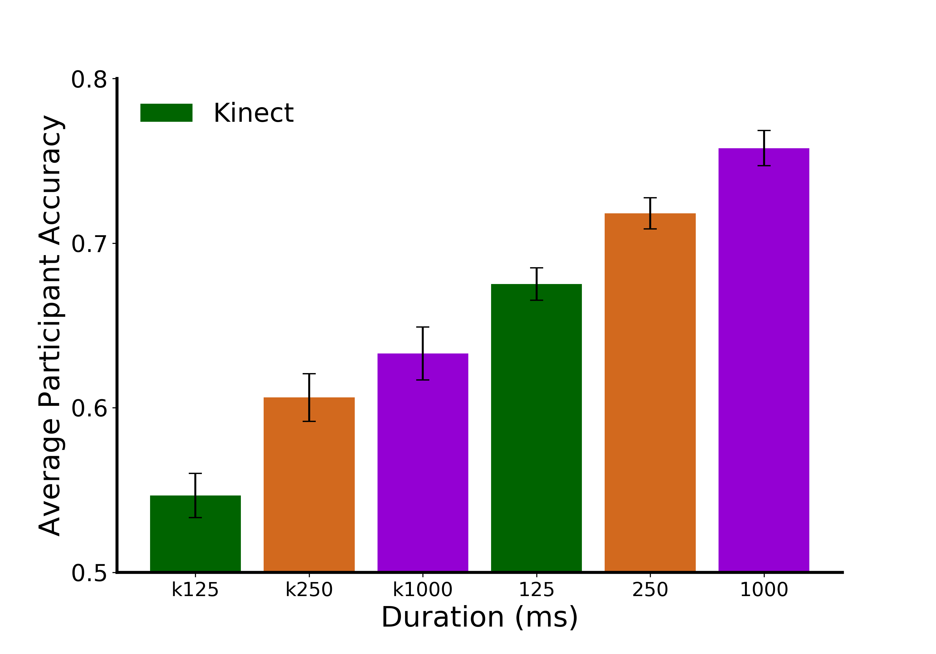
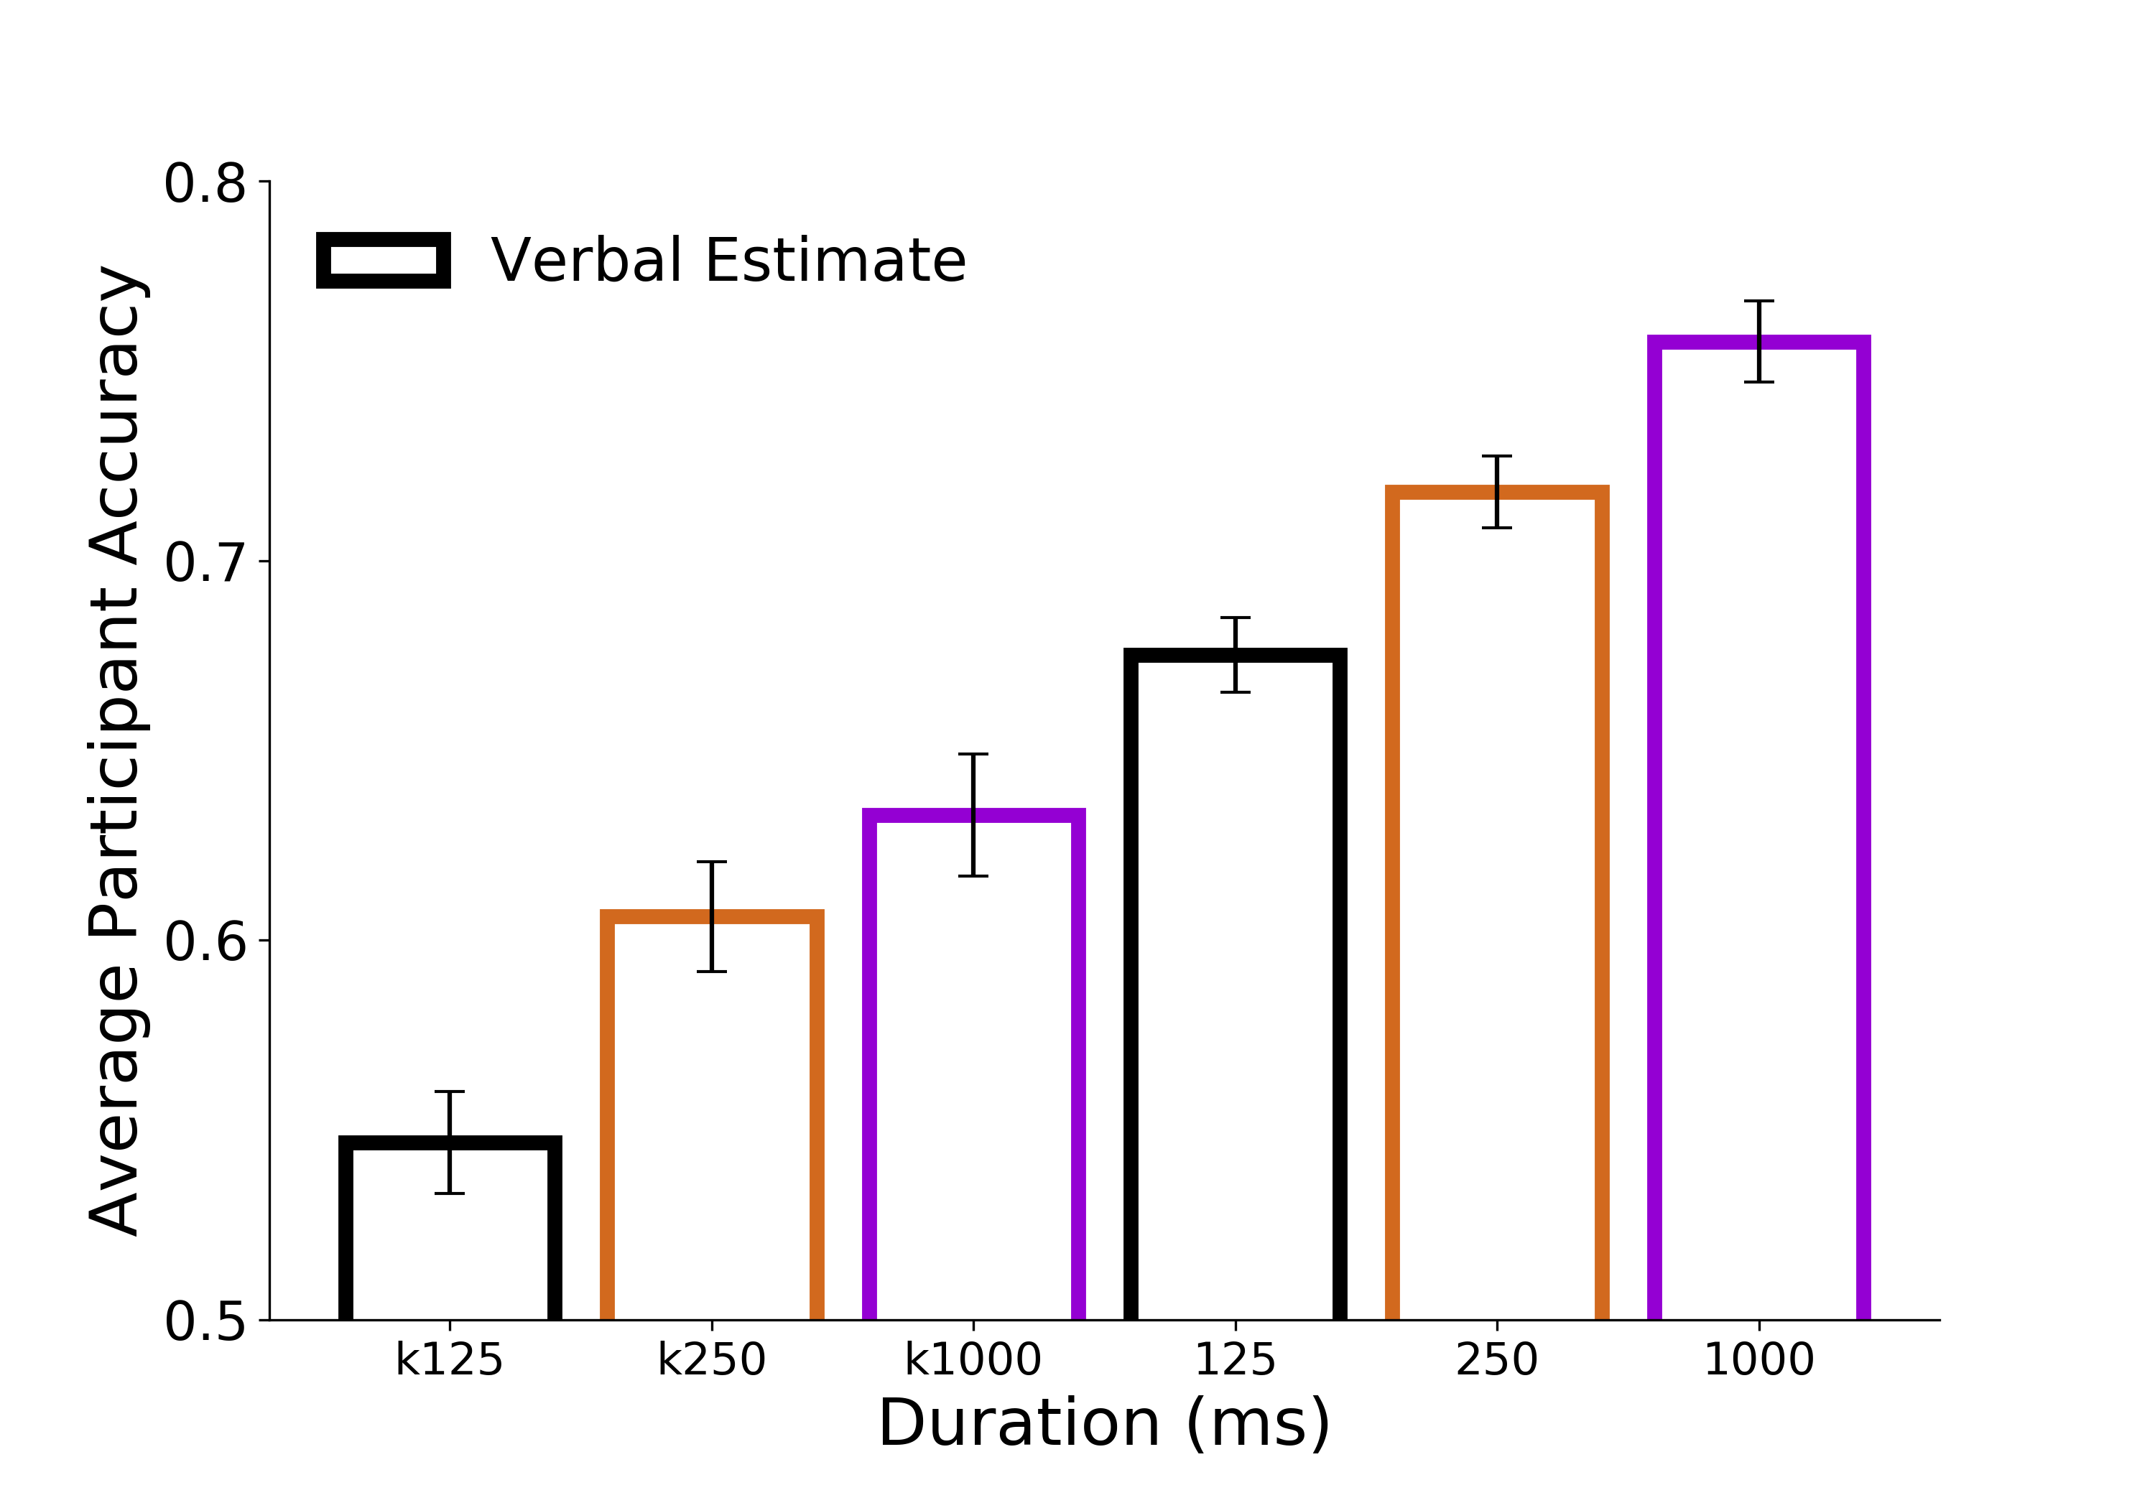
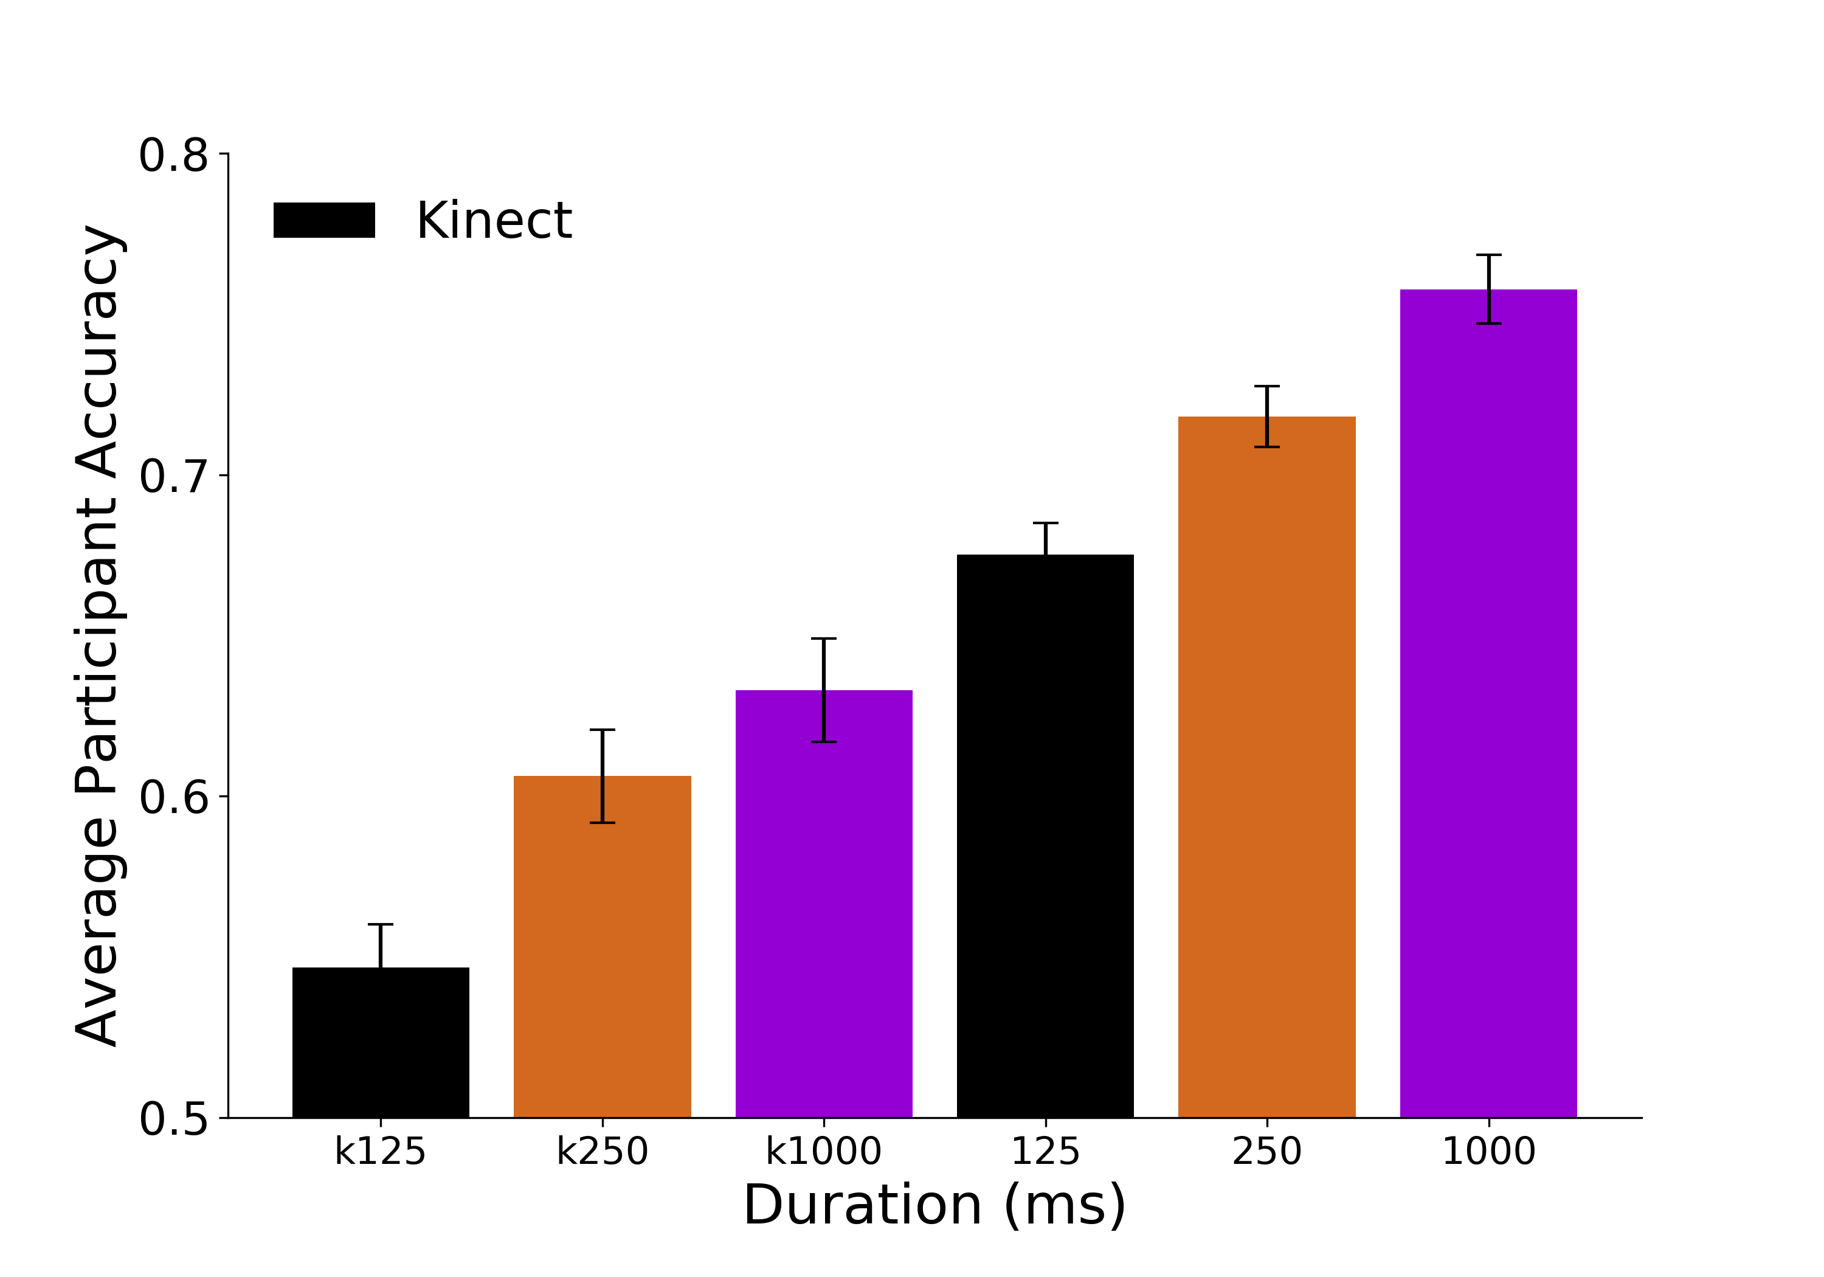

A.
B.
C.
D.
E.
Figure 6. Discrimination Accuracy Results. A) Linear model of discrimination accuracy as a function of the Kinect depth difference between targets for the 125ms viewing duration condition. B) Linear models of discrimination accuracy as a function of verbal estimates from independent participants at 125ms. The verbal estimate difference is calculated as the absolute difference between verbal estimates for images within a discrimination trial divided by their joint variance, effectively resulting in a z-score of the verbal estimate difference. The verbal estimate and discrimination task were comprised of independent groups of participants. C) Accuracy as a function of verbal estimates at 250ms D) Accuracy as a function of verbal estimates at 1000ms D) Discrimination accuracy as a function of the Kinect (bars with colored outline) and as a function of differences in verbal estimates from independent participants (* indicates p<0.05; ** p<0.005; *** p<0.0005)
***
*
**
***

Slide 15




A.
B.
C.
D.
E.
Figure 6. Discrimination Accuracy Results. A) Linear model of discrimination accuracy as a function of the Kinect depth difference between targets for the 125ms viewing duration condition. B) Linear models of discrimination accuracy as a function of verbal estimates from independent participants at 125ms. The verbal estimate difference is calculated as the absolute difference between verbal estimates for images within a discrimination trial divided by their joint variance, effectively resulting in a z-score of the verbal estimate difference. The verbal estimate and discrimination task were comprised of independent groups of participants. C) Accuracy as a function of verbal estimates at 250ms D) Accuracy as a function of verbal estimates at 1000ms D) Discrimination accuracy as a function of the Kinect (bars with colored outline) and as a function of differences in verbal estimates from independent participants (* indicates p<0.05; ** p<0.005; *** p<0.0005)
***
*
**
***
Notes:
Alignment of figure legend text

Slide 16




A.
B.
C.
D.
Figure 7. Discrimination Response Time Results. A) Linear model of discrimination response time as a function of the Kinect depth difference between targets for the 125ms viewing duration condition. B) Linear model of discrimination response time as a function of verbal estimates from independent participants at 125ms. The verbal estimate difference is calculated as the absolute difference between verbal estimates for images within a discrimination trial divided by their joint variance, effectively resulting in a z-score of the verbal estimate difference. The verbal estimate and discrimination task were comprised of independent groups of participants. C) 250ms and D) 1000ms

Slide 17




A.
B.
C.
D.
Figure 7. Discrimination Response Time Results. A) Linear model of discrimination response time as a function of the Kinect depth difference between targets for the 125ms viewing duration condition. B) Linear model of discrimination response time as a function of verbal estimates from independent participants at 125ms. The verbal estimate difference is calculated as the absolute difference between verbal estimates for images within a discrimination trial divided by their joint variance, effectively resulting in a z-score of the verbal estimate difference. The verbal estimate and discrimination task were comprised of independent groups of participants. C) 250ms and D) 1000ms
Notes:
DONE

Slide 18

Discrimination split matrix
125
0.8
Percent Correct
250
0.4
1000
*
0.16
Correlation
0
*
125
- 0.16
- 0.4
Response Time
250
1000
- 0.8
125
250
1000
125
250
1000
Percent Correct
Response Time
Figure 8. Discrimination Average Correlation Matrix. Data were randomly split in half and correlated against itself. This was repeated 10,000 times resulting in this average correlation matrix. Given a sample size of 156 images and a significance level of 0.05, r >= 0.16 are significant. Within task outcome correlations are significant within and between viewing durations, demonstrating strong reliability between independent groups of participants. Significant correlations between task outcome (response time, percent correct) and viewing durations were also observed, indicating stimulus-level generalization.
Notes:
DONE

Slide 19
125
0.8
Percent Correct
250
0.4
1000
*
0.16
Correlation
0
125
- 0.16
*
Response Time
- 0.4
250
1000
- 0.8
125
250
1000
125
250
1000
Percent Correct
Response Time
Figure 8. Discrimination Average Correlation Matrix. Data were randomly split in half and correlated against itself. This was repeated 10,000 times resulting in this average correlation matrix. Given a sample size of 156 images and a significance level of 0.05, r >= 0.16 are significant. Within task outcome correlations are significant within and between viewing durations, demonstrating strong reliability between independent groups of participants. Significant correlations between task outcome (response time, percent correct) and viewing durations were also observed, indicating stimulus-level generalization.
Notes:
DONE

Slide 20


125
Discrimination
0.8
0.8
250
1000
Percent Correct
125
0.4
0.4
250
Verbal Estimate
*
0.16
0.16
1000
Correlation
0.0
0
125
*
- 0.16
- 0.16
250
Discrimination
1000
- 0.4
- 0.4
Response Time
125
250
Verbal Estimate
- 0.8
- 0.8
1000
125
250
1000
125
250
1000
125
250
1000
125
250
1000
Discrimination
Verbal Estimate
Discrimination
Verbal Estimate
Percent Correct
Response Time
Figure 6. Average Correlation Matrix (Task x Outcome Measure x Viewing Duration). XX 5,000 on each side
Explain significance tests…
Notes:
Discrimination decoding analysis
-RT
VE is diff from discrim
Is the interreliabilty between discrim PC 125 x Discrim PC 125
Fix the order of the conditions so that across the diagonals it’s the same comparisons and average matrix across the diagonal
Within duration across task comparison

Slide 21

125
0.8
250
Percent Correct
0.4
1000
*
0.16
Verbal Estimate
Correlation
0
125
*
- 0.16
250
- 0.4
Response Time
1000
- 0.8
125
250
1000
125
250
1000
Percent Correct
Response Time
Discrimination
Figure 9. Average Correlation Matrix (Task x Outcome Measure x Viewing Duration). Data were randomly split in half and correlated against itself. This was repeated 10,000 times resulting in this average correlation matrix. Given a sample size of 156 images and a significance level of 0.05, r >= 0.16 are significant. This analysis was conducted in the ‘discrimination space’, meaning that comparisons between tasks were made in the context of a discrimination trial. Between task correlations are presented here. Significant correlations were observed in accuracy and response time between tasks (discrimination, verbal estimate) within and between viewing durations. Impressively, significant correlations were also found between tasks, outcome measure, and viewing duration (top right 3x3 matrix). These results indicate systematic errors and biases for individual stimuli between independent groups of participants.

Slide 22
125
0.8
250
Percent Correct
0.4
1000
0.16
Verbal Estimate
0
*
125
Correlation
- 0.16
*
250
- 0.4
Response Time
1000
- 0.8
125
250
1000
125
250
1000
Percent Correct
Response Time
Discrimination
Figure 9. Average Correlation Matrix (Task x Outcome Measure x Viewing Duration). Data were randomly split in half and correlated against itself. This was repeated 10,000 times resulting in this average correlation matrix. Given a sample size of 156 images and a significance level of 0.05, r >= 0.16 are significant. This analysis was conducted in the ‘discrimination space’, meaning that comparisons between tasks were made in the context of a discrimination trial. Between task correlations are presented here. Significant correlations were observed in accuracy and response time between tasks (discrimination, verbal estimate) within and between viewing durations. Impressively, significant correlations were also found between tasks, outcome measure, and viewing duration (top right 3x3 matrix). These results indicate systematic errors and biases for individual stimuli between independent groups of participants.
Notes:
DONE

Slide 23



N1
N2
POI
(x_{res}, y_{res}, depth)

Slide 24

2.64 m²
4.41 m²
9.82 m²
1.76 m²
4.58 m²
Visible ground plane: 7.95 m²
Complete ground plane: 13.247 m²
Notes:
Faux magnifying glass
Make bed the og color
Put dotted line where presume edge of complete ground plane is, and then report that number

Slide 25
N1
N2
POI
(x_{res}, y_{res}, depth)
2.64 m²
4.41 m²
9.82 m²
1.76 m²
4.58 m²
Visible ground plane: 7.95 m²
Complete ground plane: 13.247 m²
Notes:
Faux magnifying glass
Make bed the og color
Put dotted line where presume edge of complete ground plane is, and then report that number

Slide 26
A.
(x_{res}, y_{res}, depth)
N1
N2
POI
B.
2.64 m²
4.41 m²
9.82 m²
1.76 m²
4.58 m²
Visible ground plane: 7.95 m²
Complete ground plane: 13.247 m²
Figure 10. Pixelwise derivation of real-world object surface area. A) Surface area for each pixel with the image (730x530 pixels) is calculated by first deriving its coordinates in 3D space as (x_{res}, y_{res}, depth) where x_{res} is the real-world width of the pixel and y_{res} is the real-world height of the pixel. Euclidean distance between the pixel of interest (POI) and its neighbors is calculated. The area of the triangles defined by the POI and its neighbors is subsequently calculated and summated across all pixels within an object. B) Sample output of the surface area algorithm. The polygon that subtends the complete ground plane (GP) is estimated using scene boundaries. The surface area of the visible ground plane (VGP) is calculated using the method described in A). Accordingly, the surface area of GP is equal to the proportion of pixels belonging to the visible vs. complete ground plane multiplied by the surface area of the VGP.
Notes:
Put A next to B and put the ground plane data on the bottom
Shrink the box and put it on the ground plane

Slide 27


A.
B.
2.64 m²
4.41 m²
9.82 m²
1.76 m²
(x_{res}, y_{res}, depth)
4.58 m²
N1
N2
POI
Visible ground plane: 7.95 m²
Complete ground plane: 13.247 m²
C.
D.
E.
Figure 10. XX. A) Surface area for each pixel with the image (730x530 pixels) is calculated by first deriving its coordinates in 3D space as (x_{res}, y_{res}, depth) where x_{res} is the real-world width of the pixel and y_{res} is the real-world height of the pixel. Euclidean distance between the pixel of interest (POI) and its neighbors is calculated. The area of the triangles defined by the POI and its neighbors is subsequently calculated and summated across all pixels within an object. B) Sample output of the surface area algorithm. The polygon that subtends the complete ground plane (GP) is estimated using scene boundaries. The surface area of the visible ground plane (VGP) is calculated using the method described in A). Accordingly, the surface area of GP is equal to the proportion of pixels belonging to the visible vs. complete ground plane multiplied by the surface area of the VGP. C) XX D) XX E) XX
Notes:
Put A next to B and put the ground plane data on the bottom
Shrink the box and put it on the ground plane

Slide 28



A.
B.
2.64 m²
4.41 m²
9.82 m²
1.76 m²
(x_{res}, y_{res}, depth)
4.58 m²
$$s= \frac{a+b+c}{2}$$
N1
N2
a
T
b
$$A_{T}= \sqrt{s(s−a)(s−b)(s−c)}$$
c
$${SA}_{POI}= \sum_{i=0}^{k=8}{\frac{A_{T_{i}}}{4}}$$
POI
Visible ground plane: 7.95 m²
Complete ground plane: 13.247 m²
C.
D.
E.
Abs(Residuals) (z-scored)
Residuals (z-scored)
Residuals (z-scored)
Complete Ground Plane (m²)
Complete Ground Plane (m²)
Complete Ground Plane (m²)
Figure 10. XX. A) Surface area for each pixel with the image (730x530 pixels) is calculated by first deriving its coordinates in 3D space as (x_{res}, y_{res}, depth) where x_{res} is the real-world width of the pixel and y_{res} is the real-world height of the pixel. Euclidean distance between the pixel of interest (POI) and its neighbors is calculated. The area of the triangles defined by the POI and its neighbors is subsequently calculated and summated across all pixels within an object. B) Sample output of the surface area algorithm. The polygon that subtends the complete ground plane (GP) is estimated using scene boundaries. The surface area of the visible ground plane (VGP) is calculated using the method described in A). Accordingly, the surface area of GP is equal to the proportion of pixels belonging to the visible vs. complete ground plane multiplied by the surface area of the VGP. C) XX D) XX E) XX
Notes:
Put A next to B and put the ground plane data on the bottom
Shrink the box and put it on the ground plane

Slide 29







A.
B.
Figure 11. Complete Ground Plane Linear Models. A) Absolute value of the residuals from the verbal estimate linear models against the complete ground plane surface area for each stimulus (plotted for each viewing duration - 125, 250, and 1000 ms). Residuals that were originally positive are plotted as open circles. Originally negative residuals are plotted as colored in circles. B) Directional residual linear models (i.e., positive and negative residual models) per viewing duration reveal a diverging effect within the residuals wherein the positive residuals increase, and the negative residuals decrease with larger complete ground plane values.
Notes:
DONE

